Slide 1


French deep-sea hinterlands:
Some empirical evidence of the
spatial impact of containerisation
David Guerrero
IAME, Taipei, September 6th, 2012

Slide 2
Aim of the paper
Understand the evolution of hinterlands in France, a middle-sized country located between the two main European port ranges: Northern Range and Mediterranean.
Build a typology of cargo depending on the size and degree of overlapping of hinterlands
Examine the link between hinterland and foreland for French global ports (Le Havre and Marseilles)

Slide 3
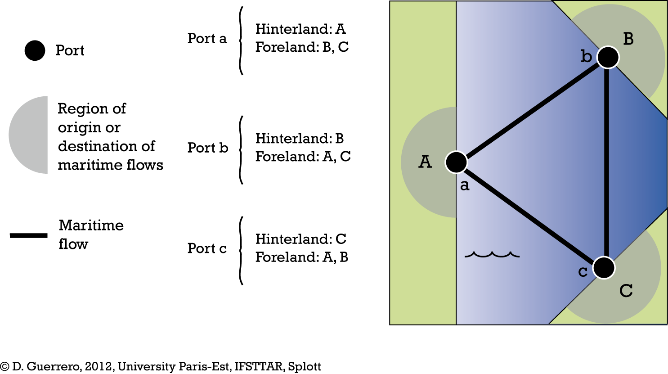
Analysing hinterlands and forelands (Weigend, 1956)

Slide 4
We shouldn’t separate hinterland and foreland …
“The separation of foreland and hinterland relationships of a port into two neatly labeled packages in previous conceptualization represents a false dichotomy. The flow of commodities from foreland to hinterland, albeit across segments of maritime and landward space and through two ports might be better viewed as a continuum”
Ross Robinson, 1970
… but we did

Slide 5
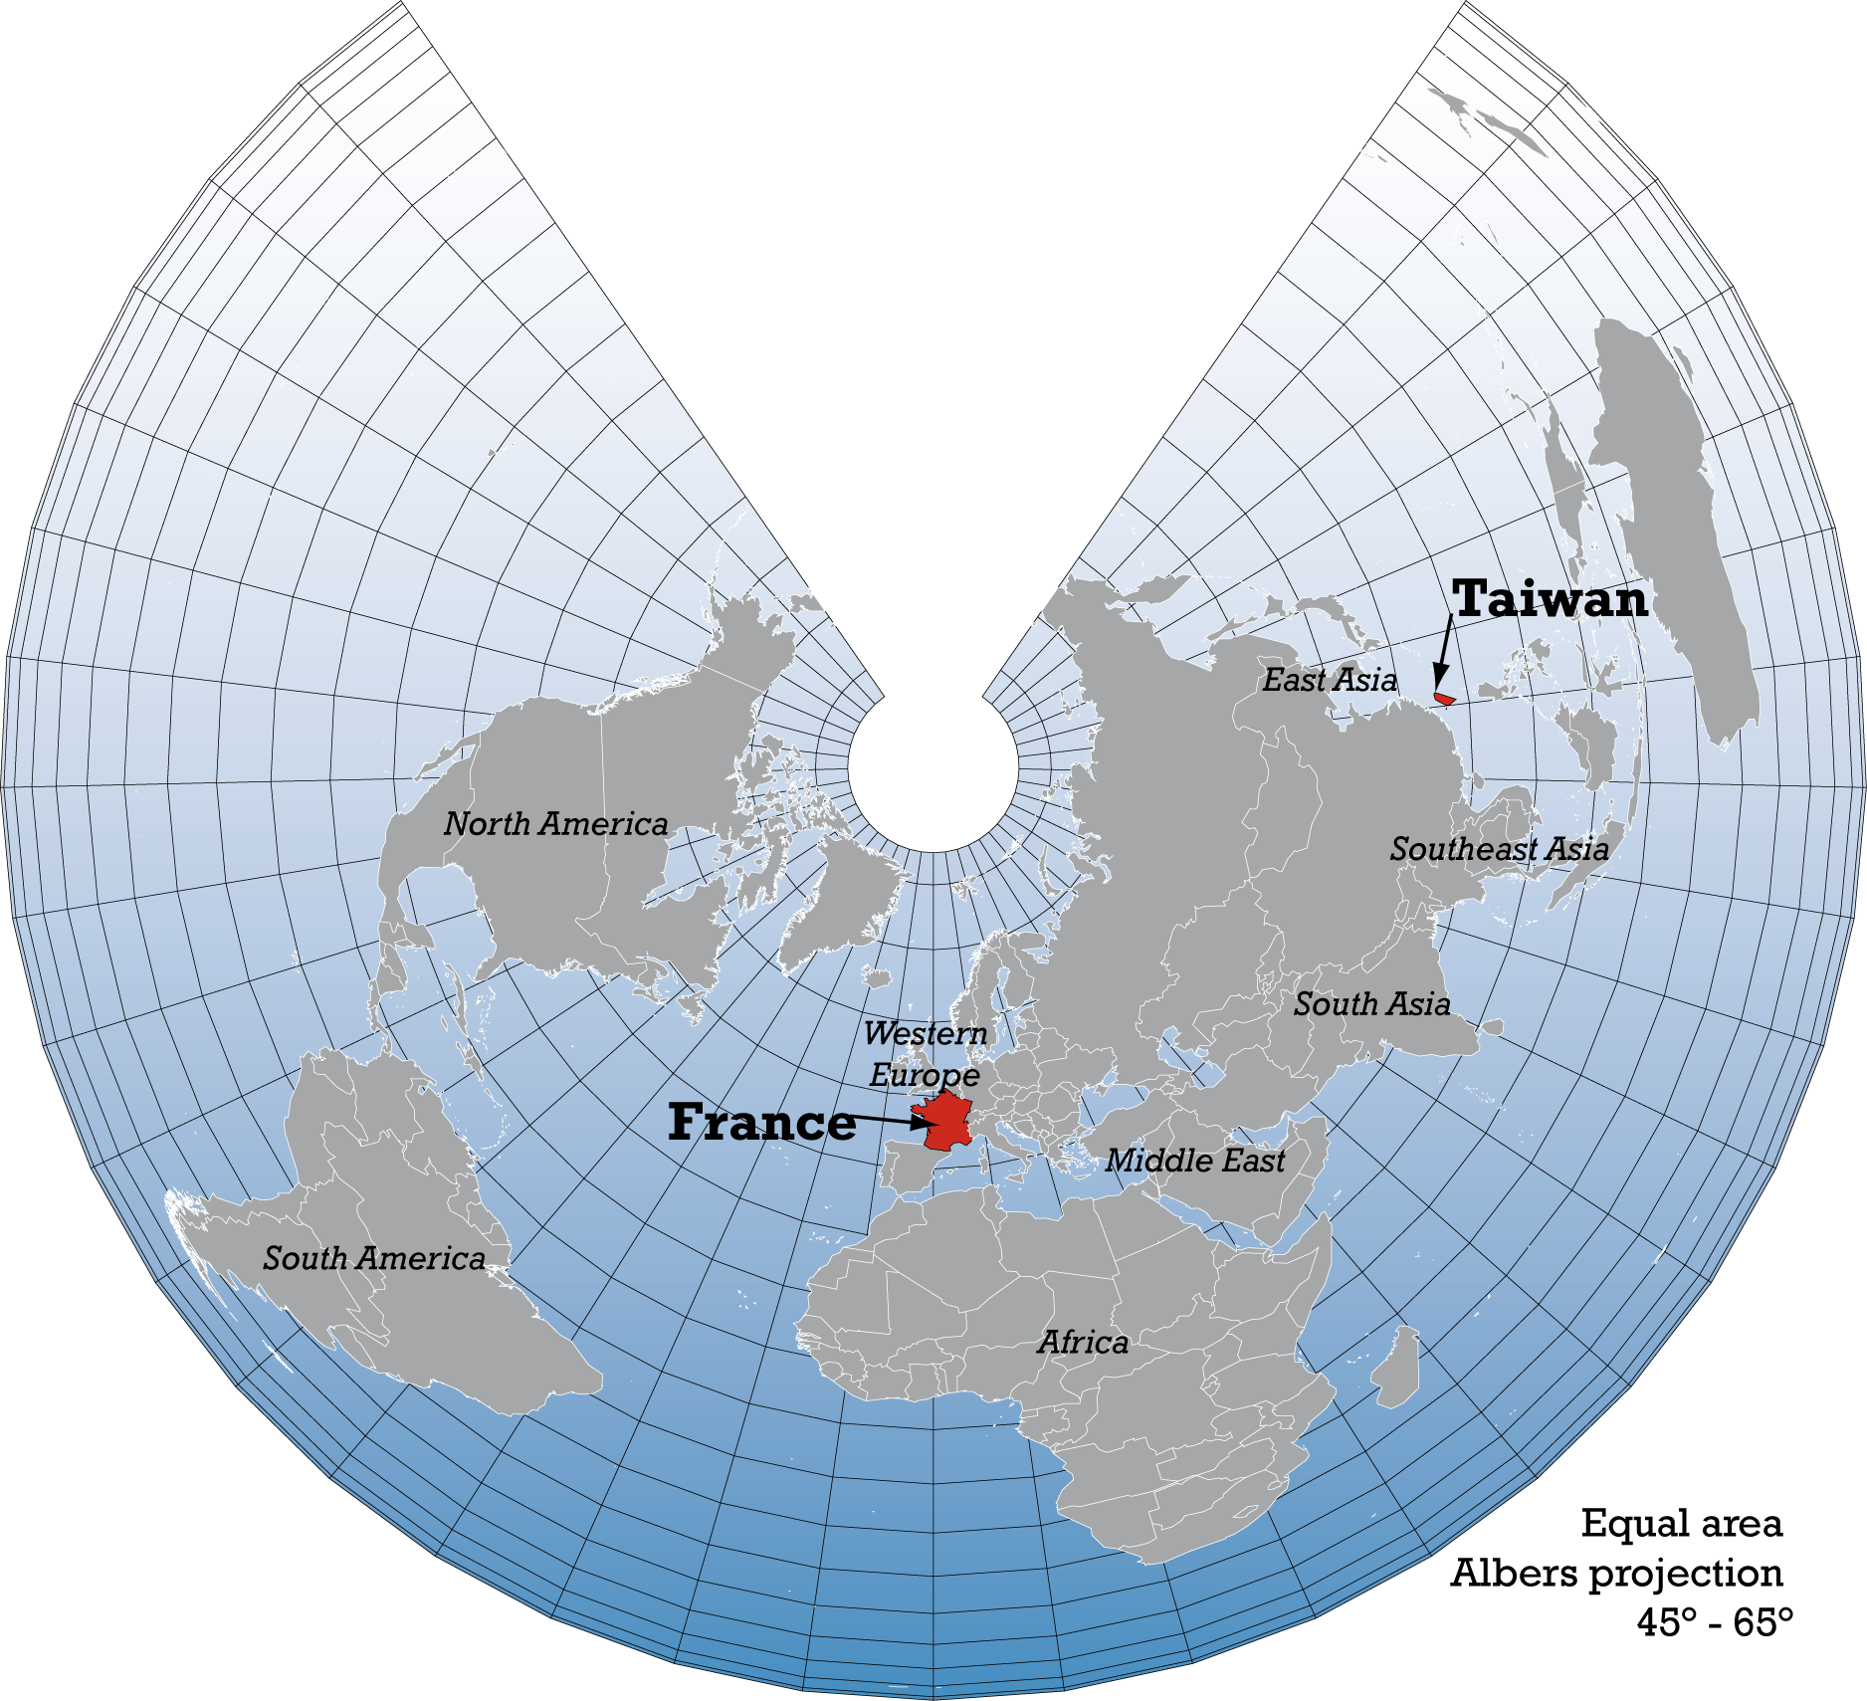
Geographical framework

Slide 6
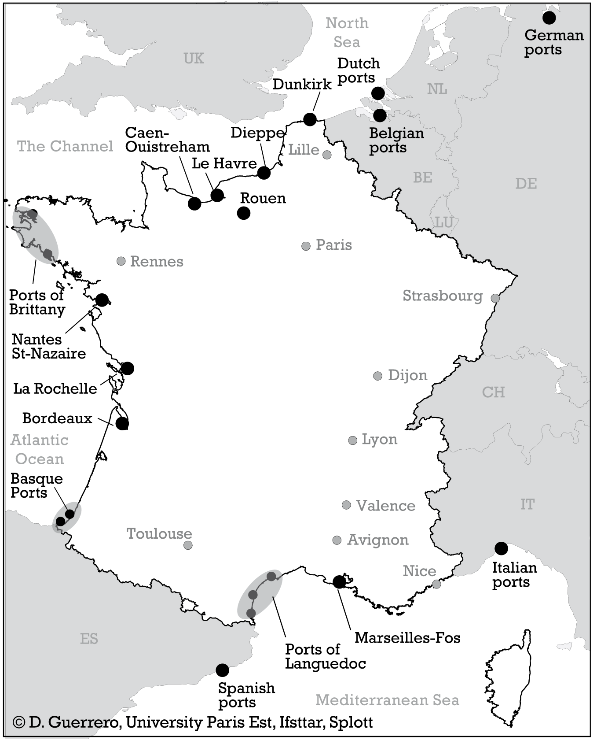
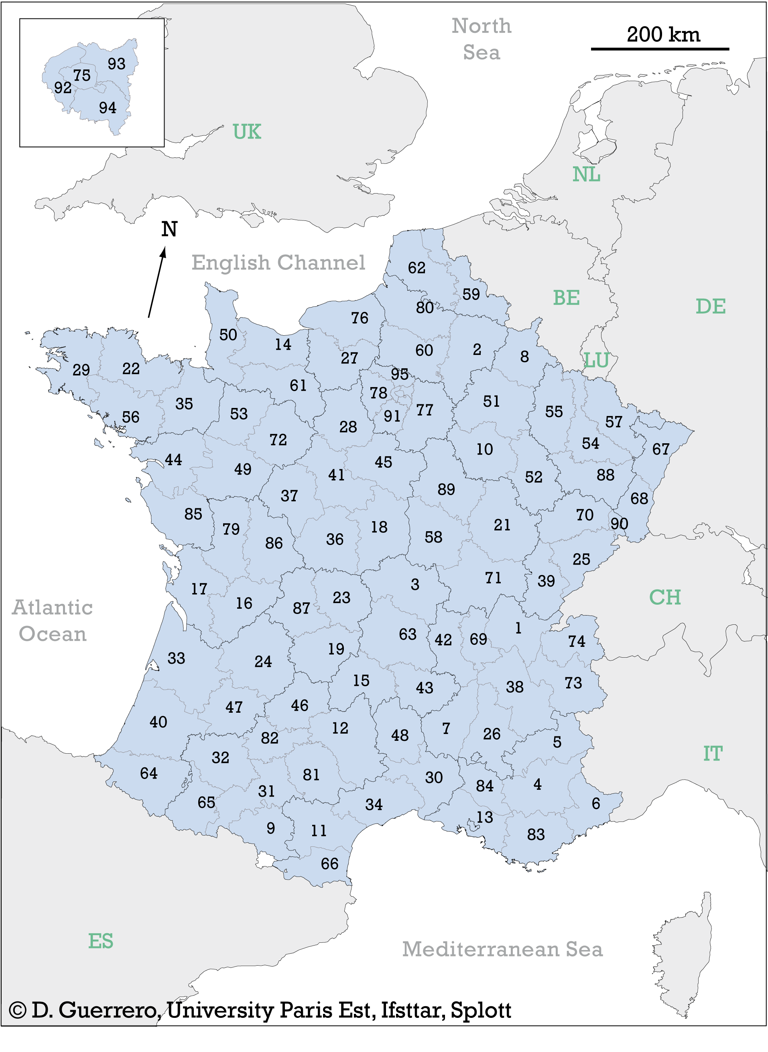
Geographical Framework
Ports handling French Trade
French counties

Slide 7
Operational Framework
Port authorities provide their demand forecasts, mostly based exclusively on port traffic and GDP.
Planners and policy-makers stress on the need of a better understanding of territorial issues:
Which regions generate cargo flows?
Which ports handle the traffic of regions?
Which regions should support port development?
In order to make more accurate forecast…
…justifying investment in port and inland transport infrastructure

Slide 8
Data
French Foreign Trade Data (non-EU countries)
Hinterland
Foreland
94 counties (French inland regions)
165 countries (overseas)
10 cargo types
10 cargo types
20 ports*
20 ports*
€
tons
Imports
Exports

Slide 9
Methods
Cluster analysis techniques, in order to make:
  Typology of ports depending on their hinterlands
  Typology of regions depending on the ports that handle their maritime flows
Spatial interaction modelling of flows between ports and regions, in order to measure:
  The effect of distance and size for different types of cargo
  The degree of overlapping of hinterlands

Slide 10
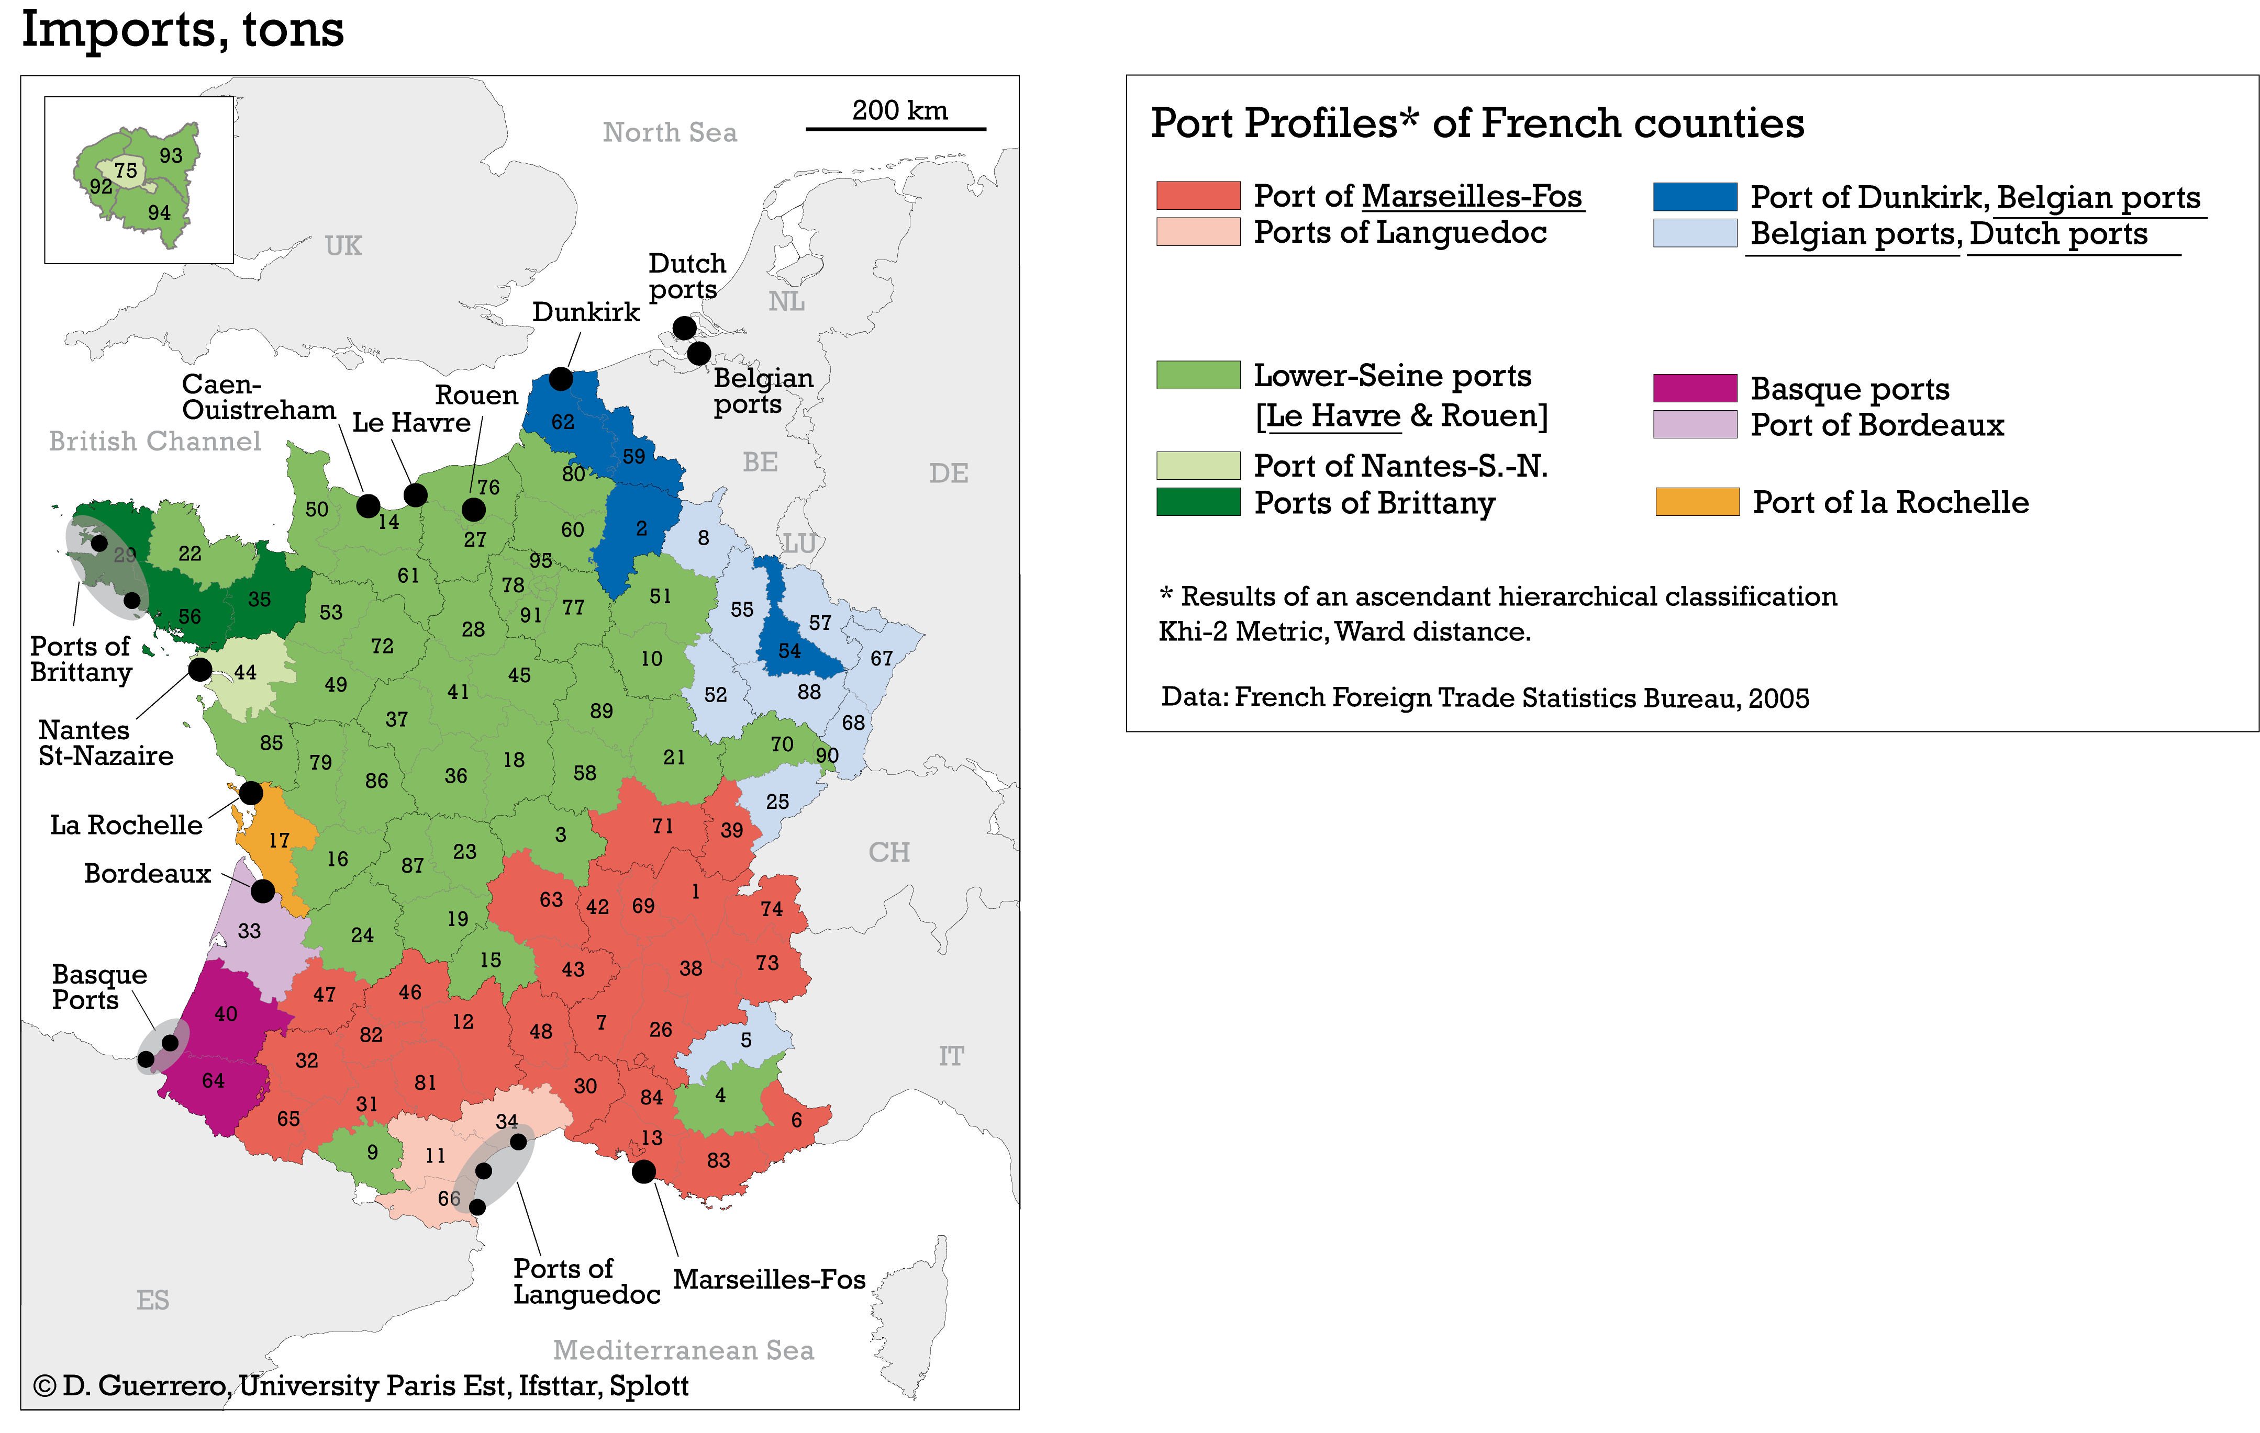
Global ports (National Hinterlands) versus Secondary ports (Local hinterlands)

Slide 11
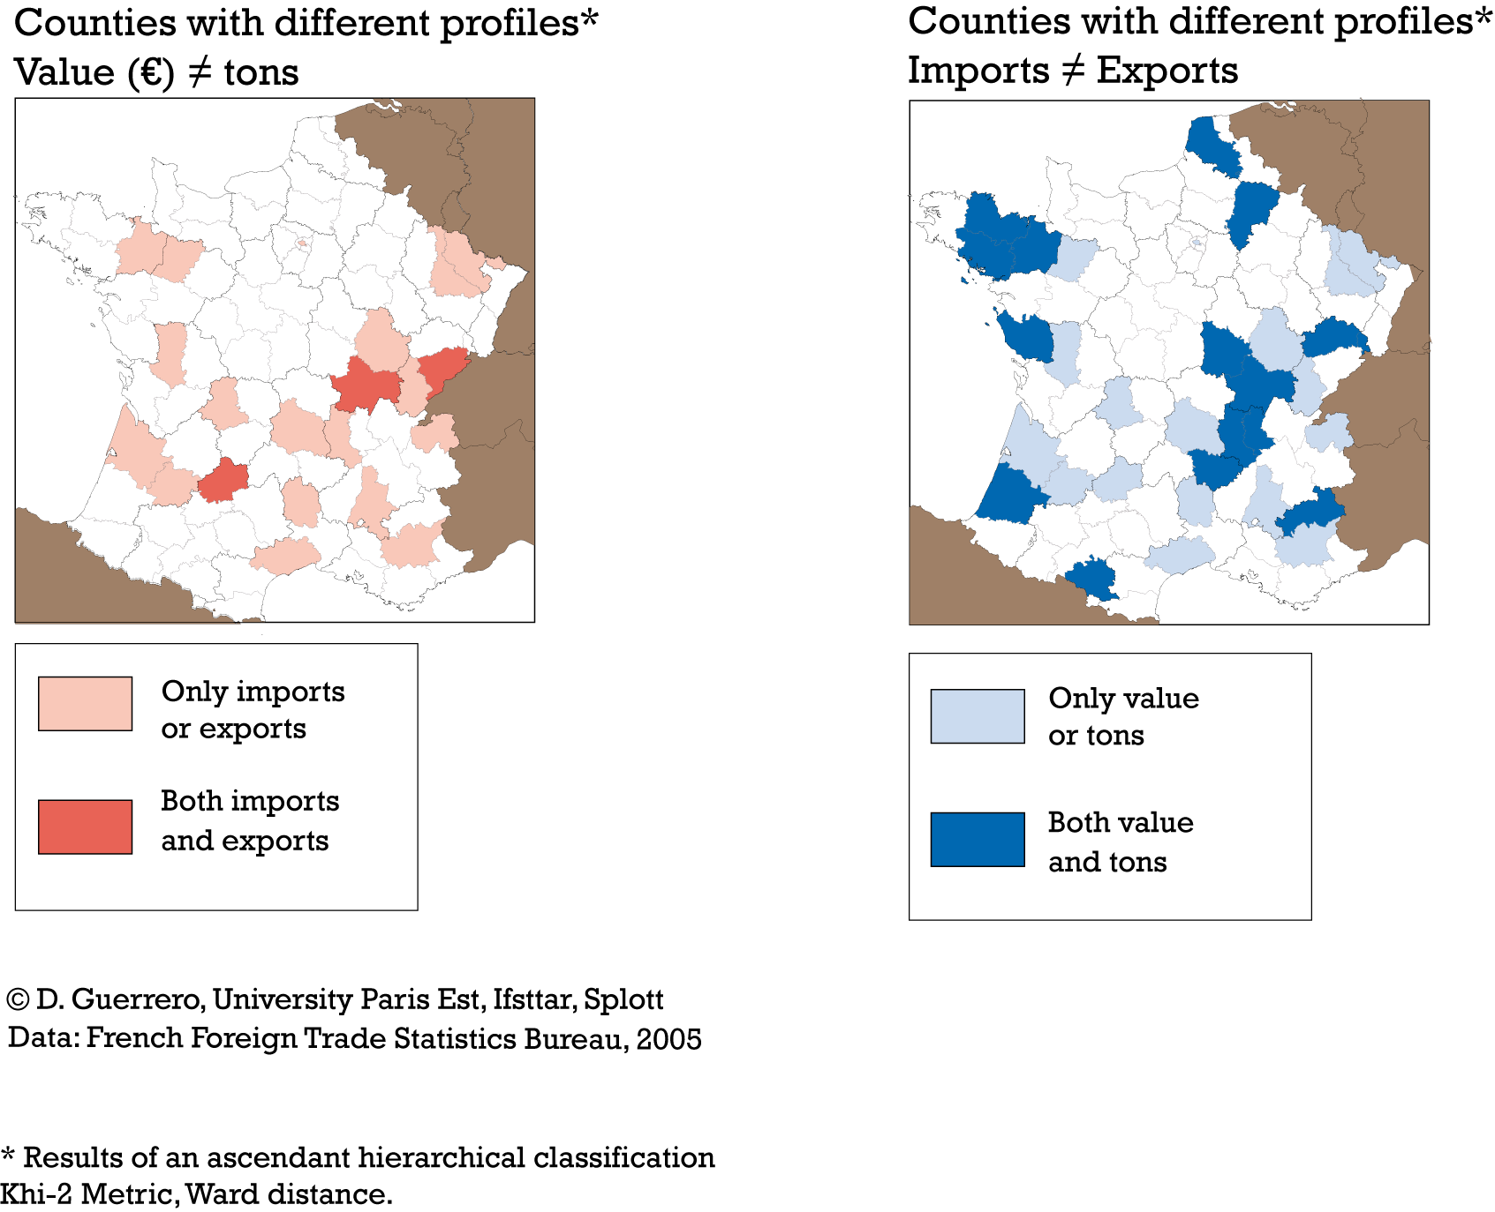
Competition margins of global ports (mainly around Lyon)

Slide 12
Modelling the spatial distribution of flows
A way to analyse the characteristics of hinterlands for different types of cargo, depending on:
Friction (distance decay)
Overlapping
Fij = ai Oi * bj Dj * dij-α
Fij : Estimated flow between the origin i and the destination j
Oi : Total traffic of the origin i
Dj : Total traffic of the destination j
dij : road distance between origin i and destination j
α : Distance decay
ai : Equilibrium factor linked to origins
bj : Equilibrium factor linked to destination

Slide 13
Results

Slide 14
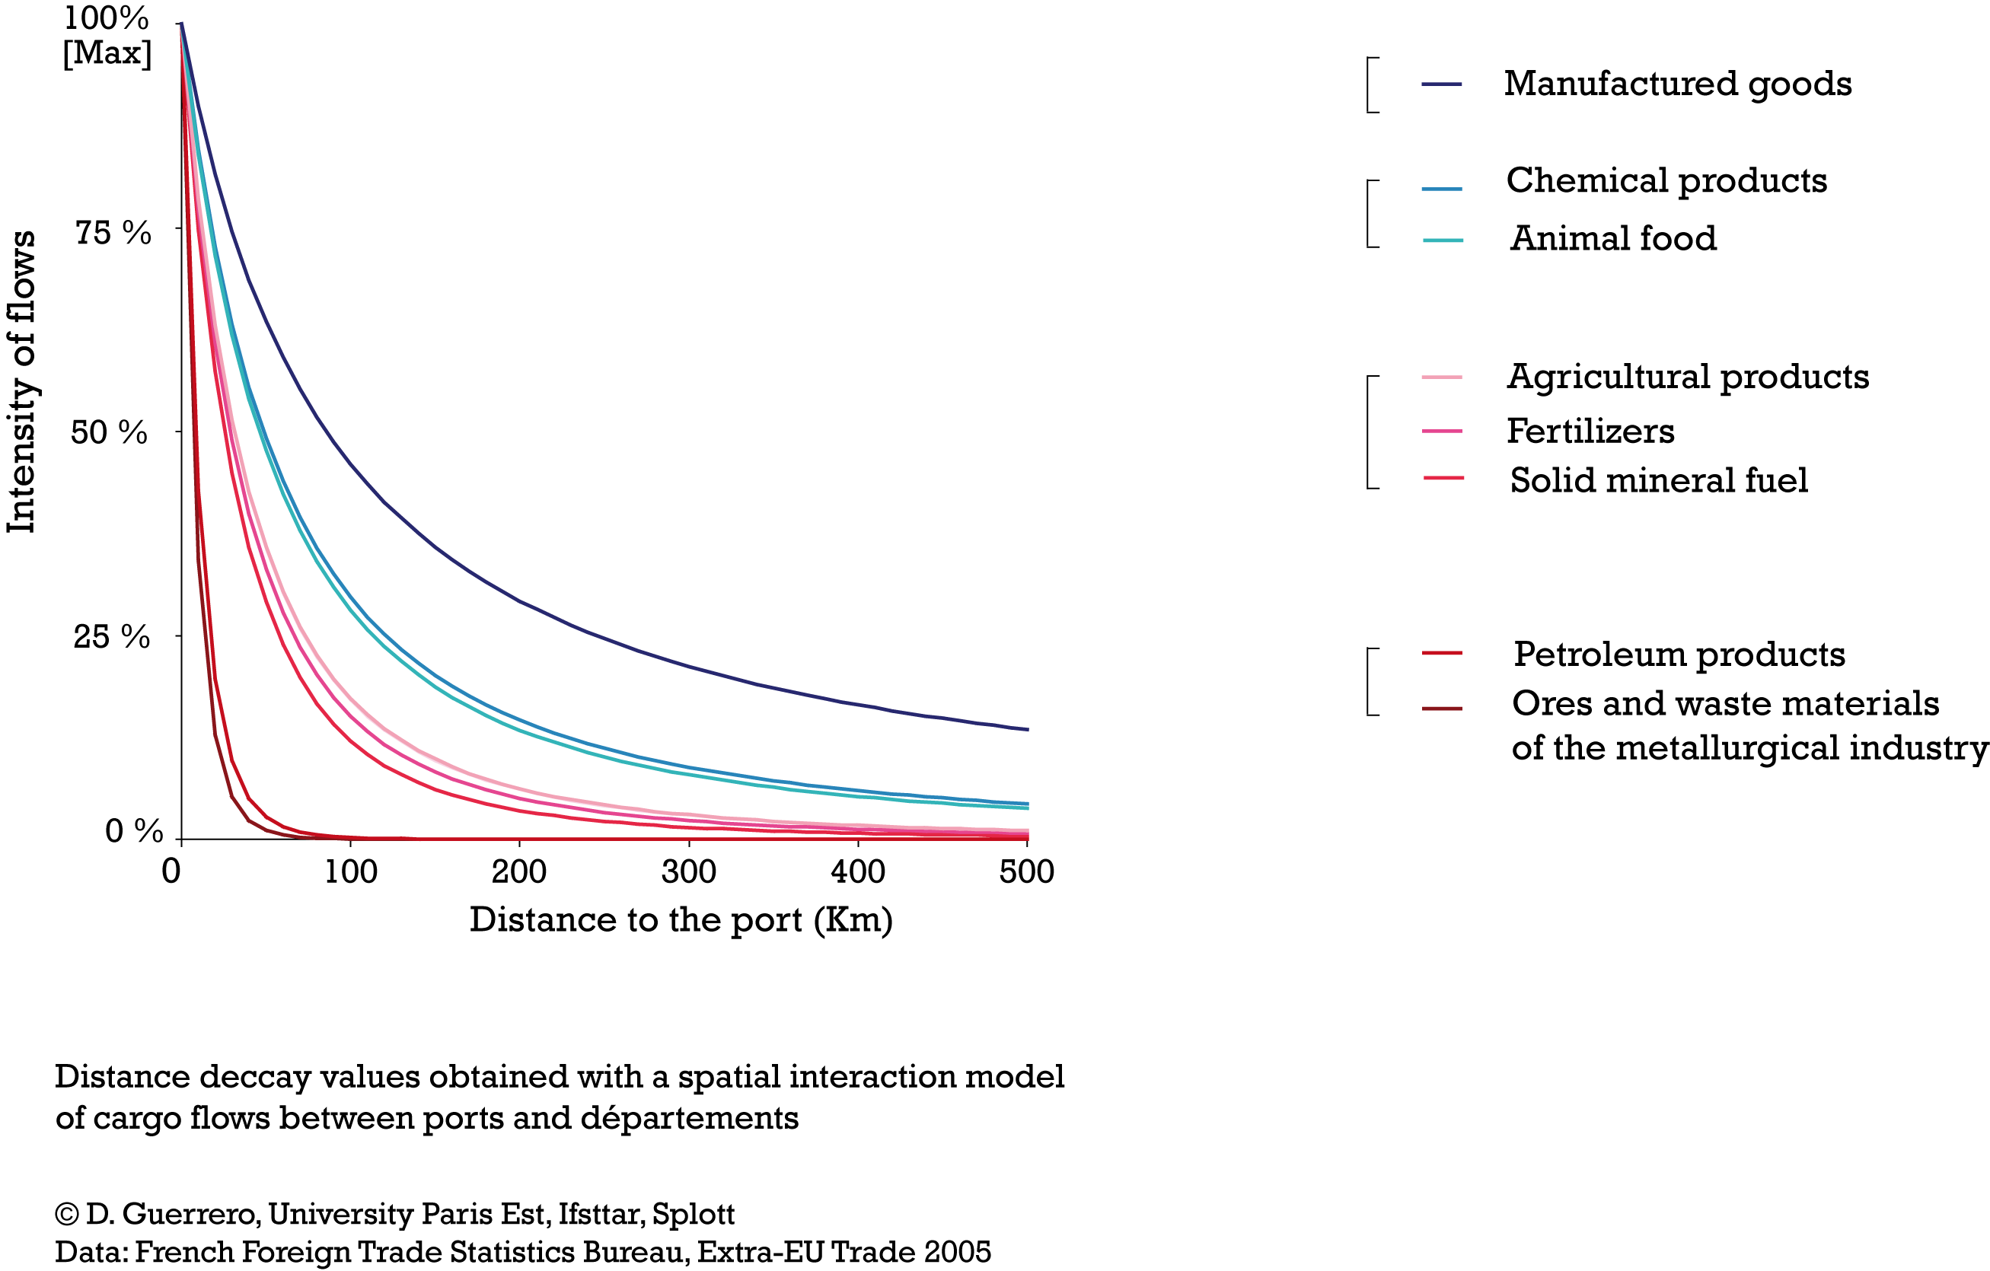
Results: distance matters (a lot)

Slide 15
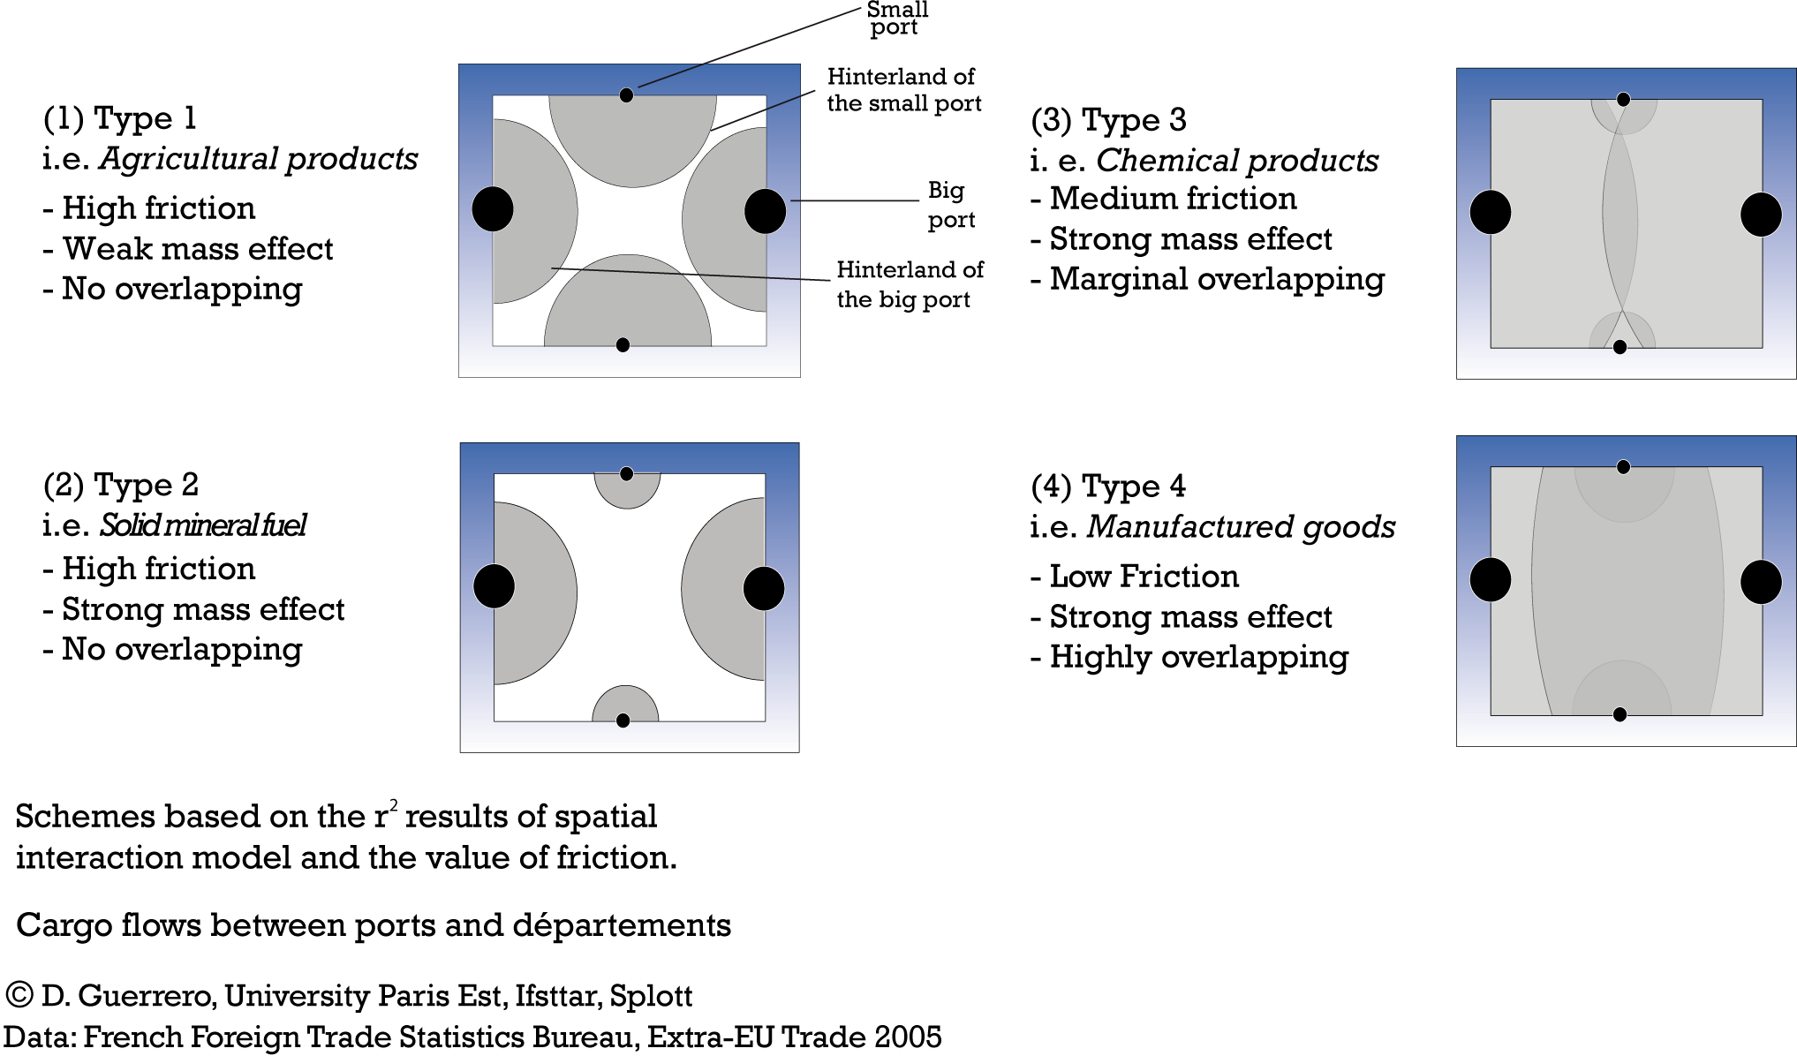
A typology of hinterlands depending on size, distance-decay and overlapping

Slide 16
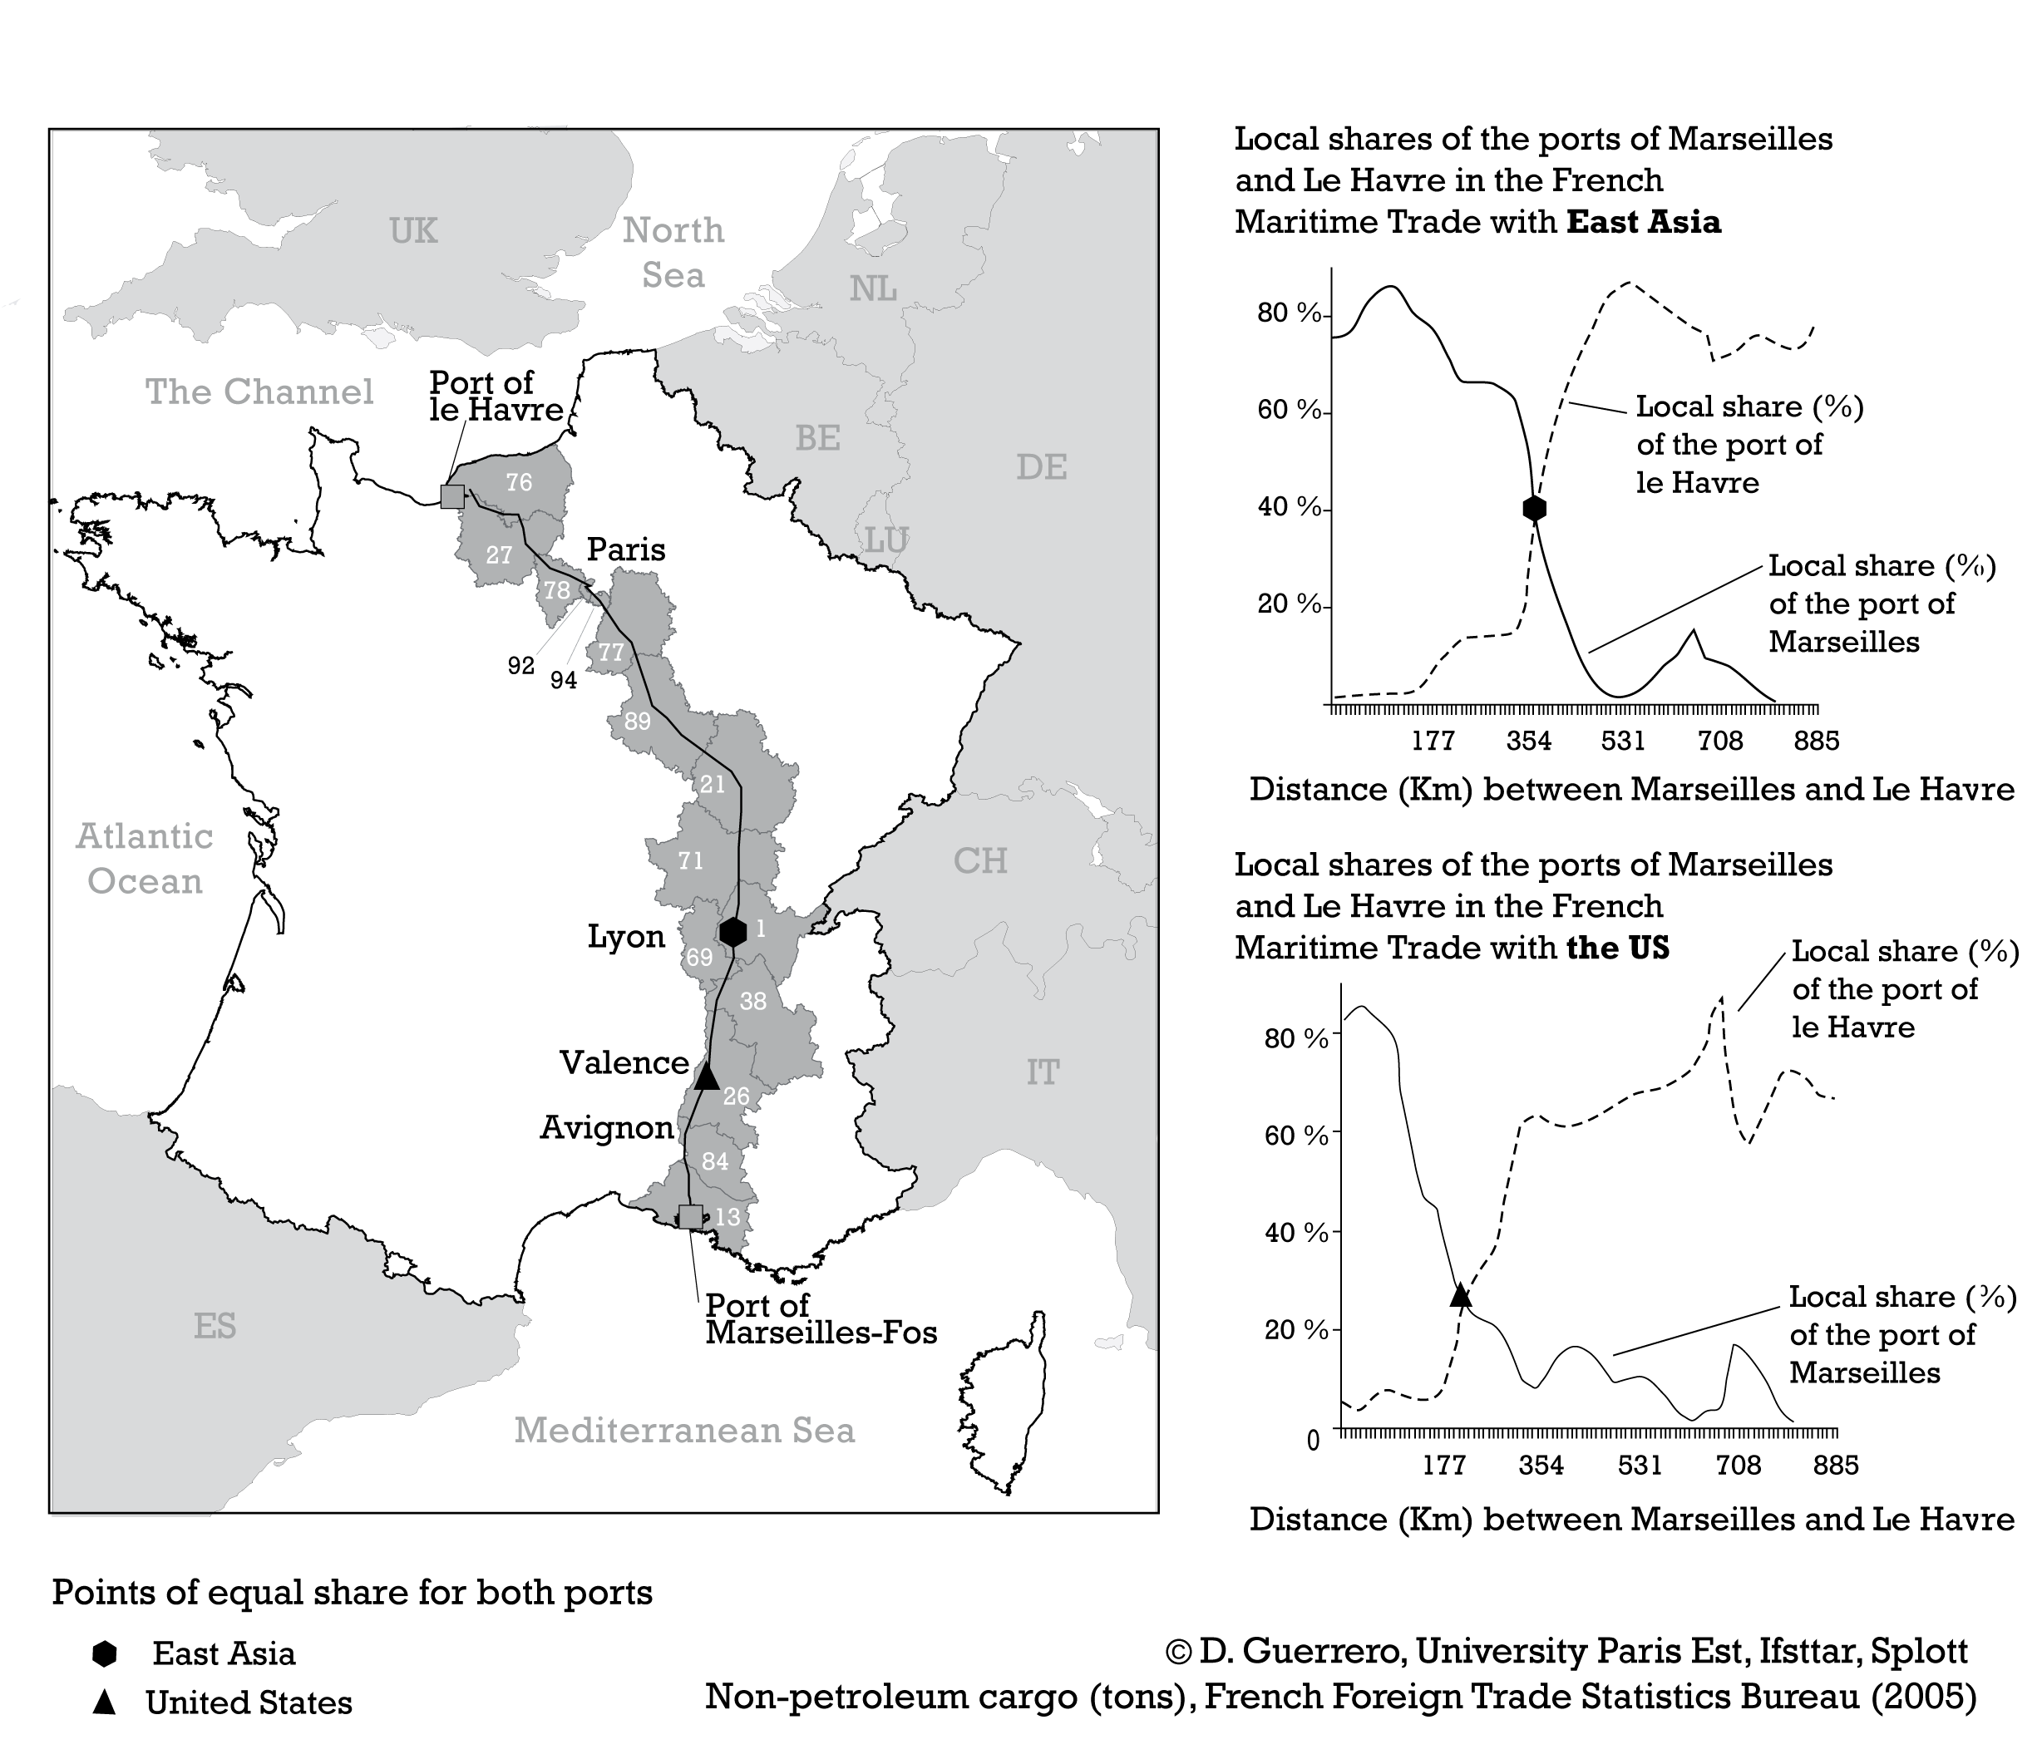
Robinson was right: Foreland also matters a lot!

Slide 17
Conclusion: Containerization has transformed hinterlands… but less than expected
Main cargo flows take place between ports and local regions
The combined effect of mass (traffic) and distance accounts for 86% of the variation of total flows, 69% for manufactured cargo flows
The rest is probably due to foreland differenciation, strategies pursued by transport operators and governments, specific geographies of niche markets,…
In the light of previous works (Charlier, 1981), French hinterlands are rather stable and path dependent over the long term.

Slide 18
Implications
Immediate hinterlands are not captive. The demand of local shippers must be taken seriously by port authorities.
Hinterlands go beyond national borders. This suggests the need for a more cohesive European port policy (complementarity)
Our model quantified distance decay values for several types of cargo. These results provide empirical support for making scenarios (i.e. forecasting port traffic, measuring vulnerability of activities and territories in case of stop of port activity)

Slide 19
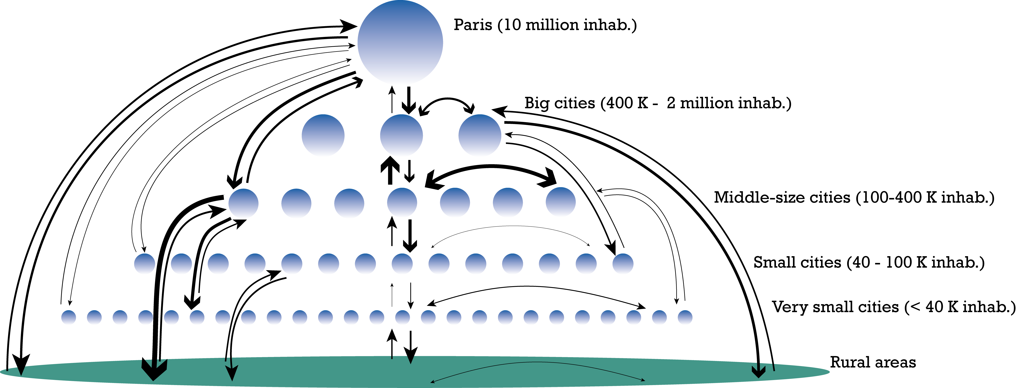
Follow-on projects
Detailed sectoral analysis (i.e. wine)
How wine producers and importers organize their maritime shipments?
Indirect hinterlands
How and where imports are redispatched inside the country? (French ECHO survey)

Slide 20
Thank you
David Guerrero,
Université Paris-Est, Ifsttar, Splott
Le Descartes II
2, rue de la Butte Verte
93166 Noisy-le-Grand, France
Tél. +33 (0)1 45 92 56 85
Fax. +33 (0)1 45 92 55 01
www.ifsttar.fr
david.guerrero@ifsttar.fr

