Slide 1
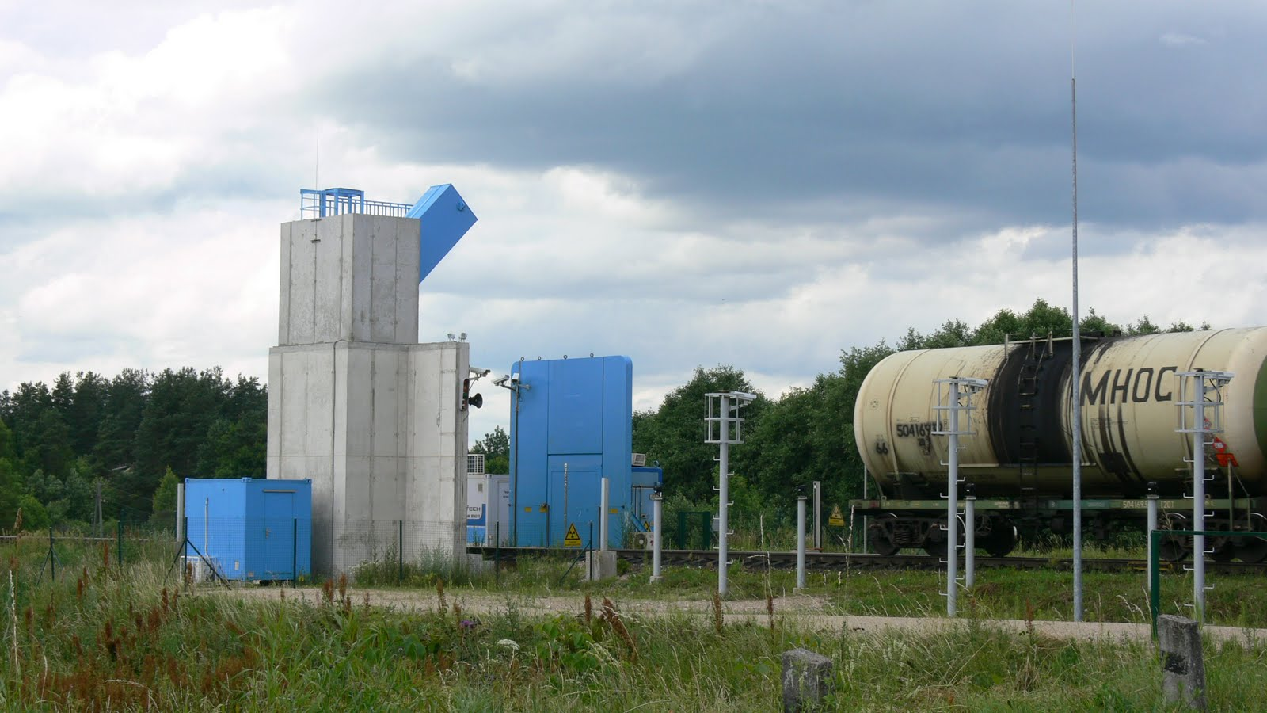
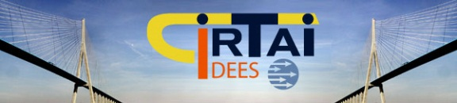
The Russian-Baltic states boundary: a limit between peripheries or a link between European Union and the post-soviet states
Arnaud SERRY – Pierre THOREZ

Slide 2
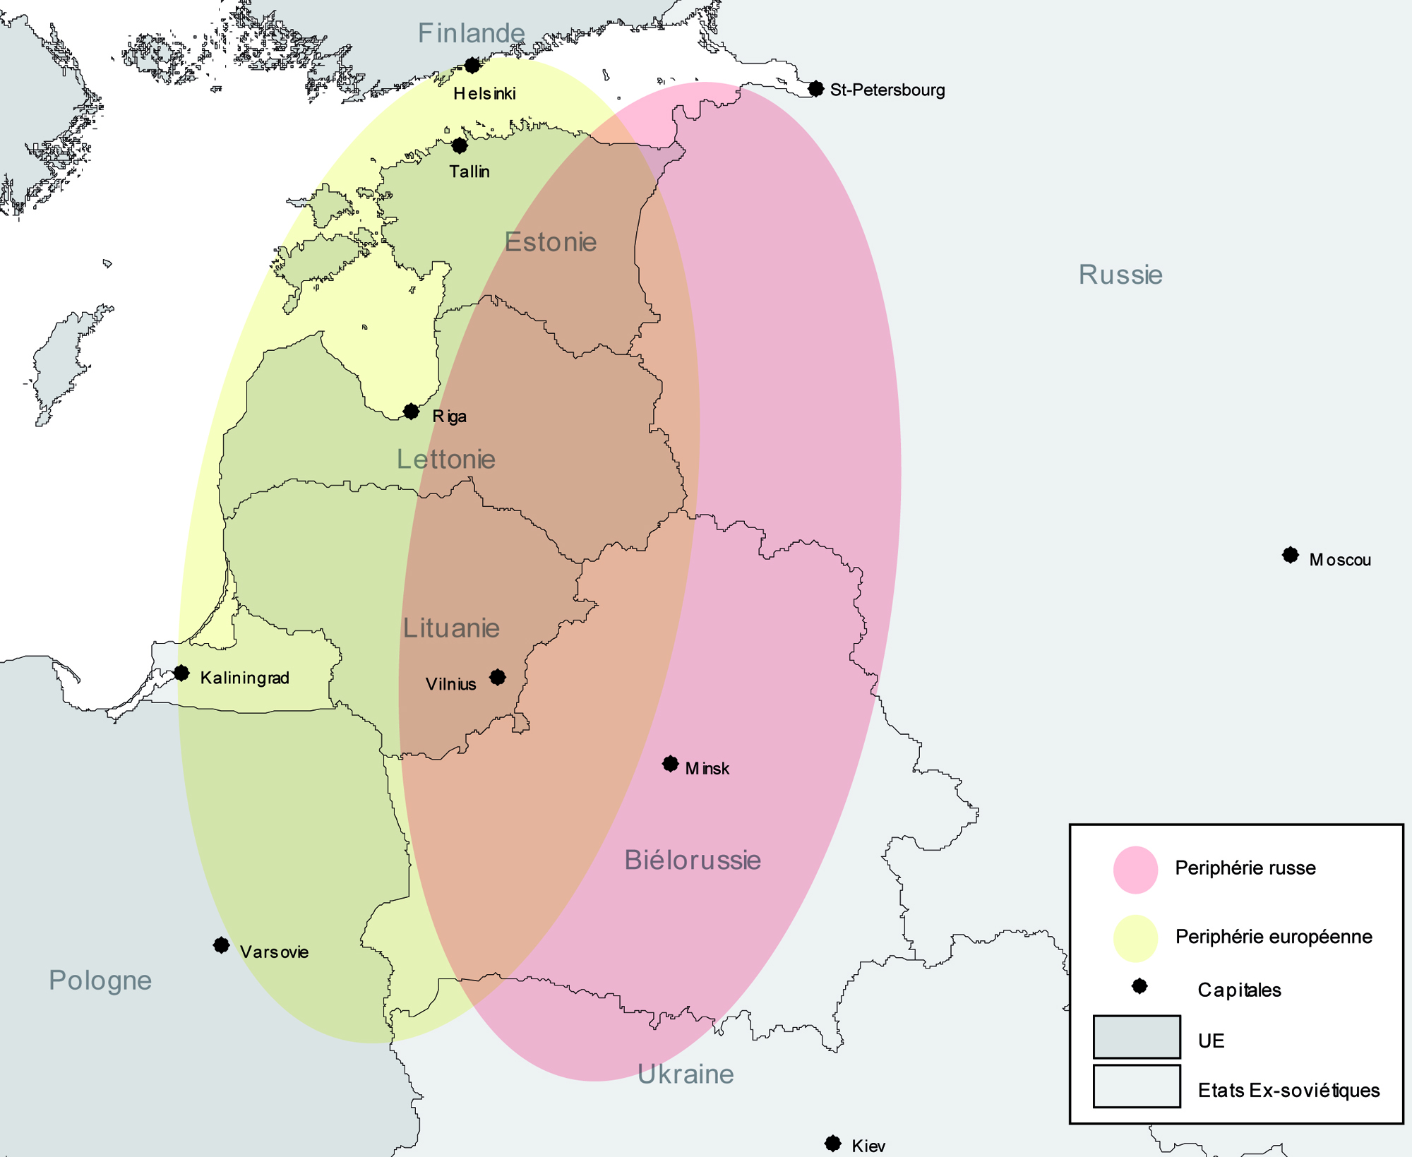
Introduction

Slide 3
The past

Slide 4
Modal repartition of freight transport
Part of road in fret transportation (%)
 | 1998 | 2000 | 2005 | 2009
EU |  | 73,7 | 76,4 | 77,5
Estonia | 32,7 | 37,3 | 35,4 | 47,3
Latvia | 24 | 26,5 | 29,8 | 30,2
Lithuania | 40,4 | 46,6 | 56,1 | 59
Part of rail in fret transportation (%)
 | 1998 | 2000 | 2005 | 2009
EU |  | 19,7 | 17,7 | 16,5
Estonia | 67,3 | 62,7 | 64,6 | 52,7
Latvia | 76 | 73,5 | 70,2 | 69,8
Lithuania | 59,5 | 53,4 | 43,9 | 40,1
Source : Eurostat

Slide 5
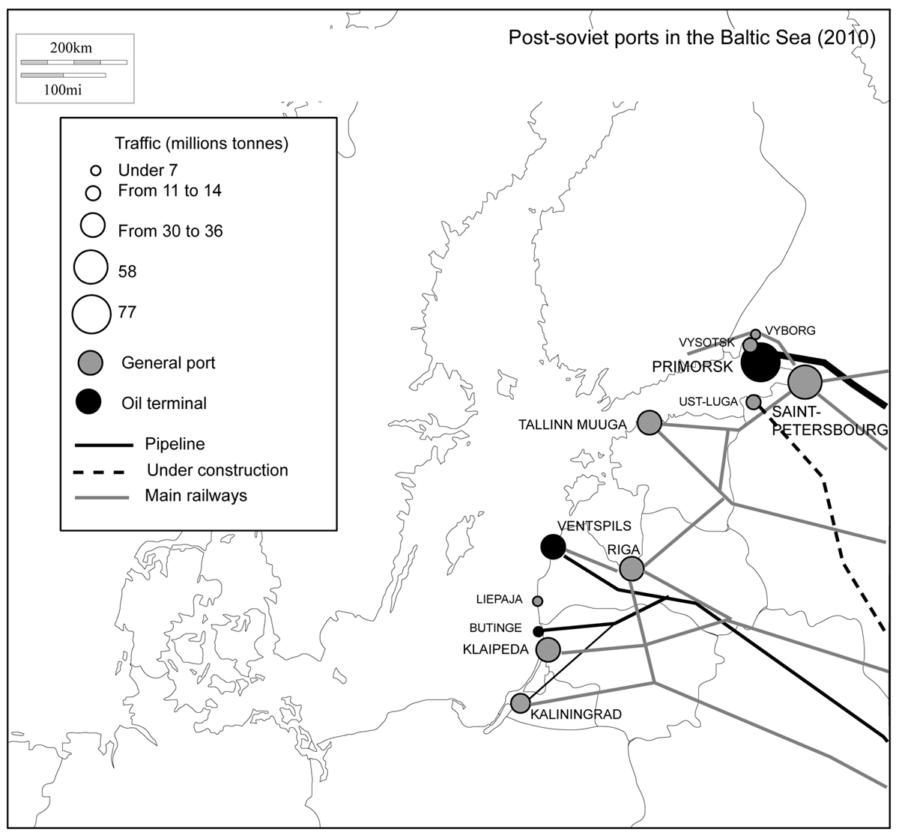

Slide 6
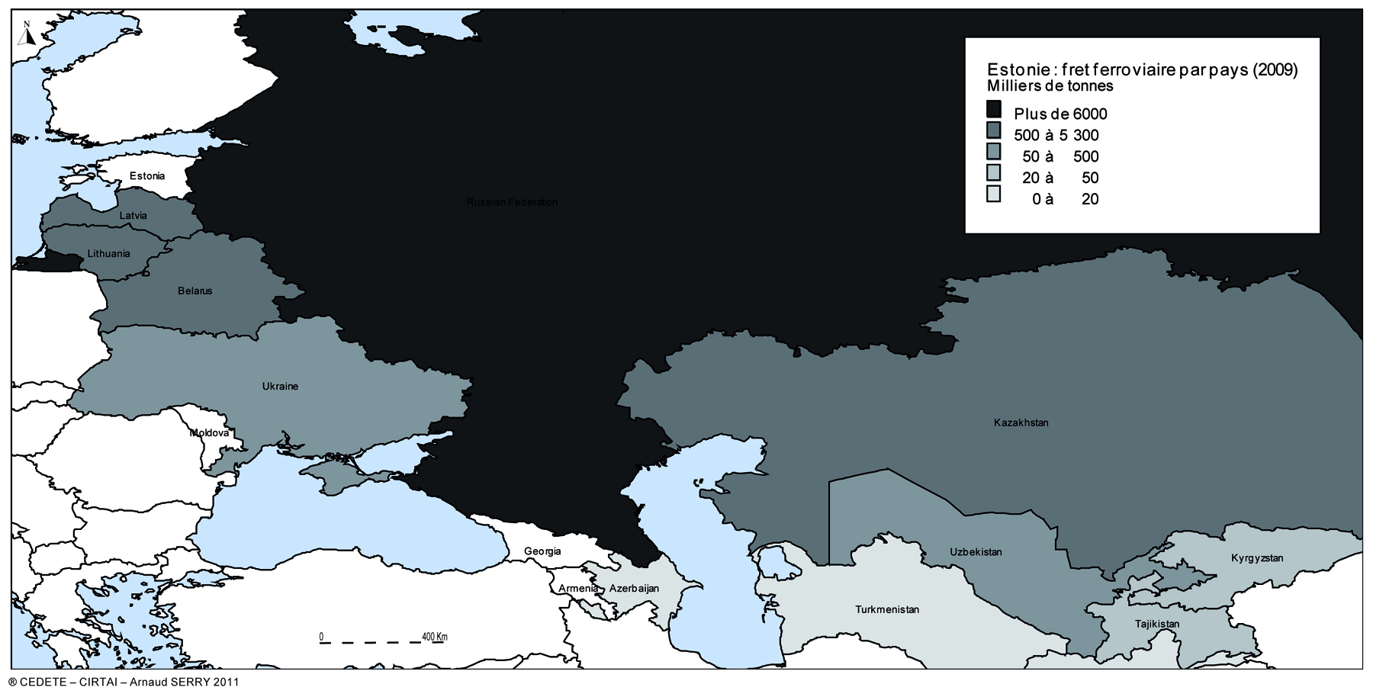
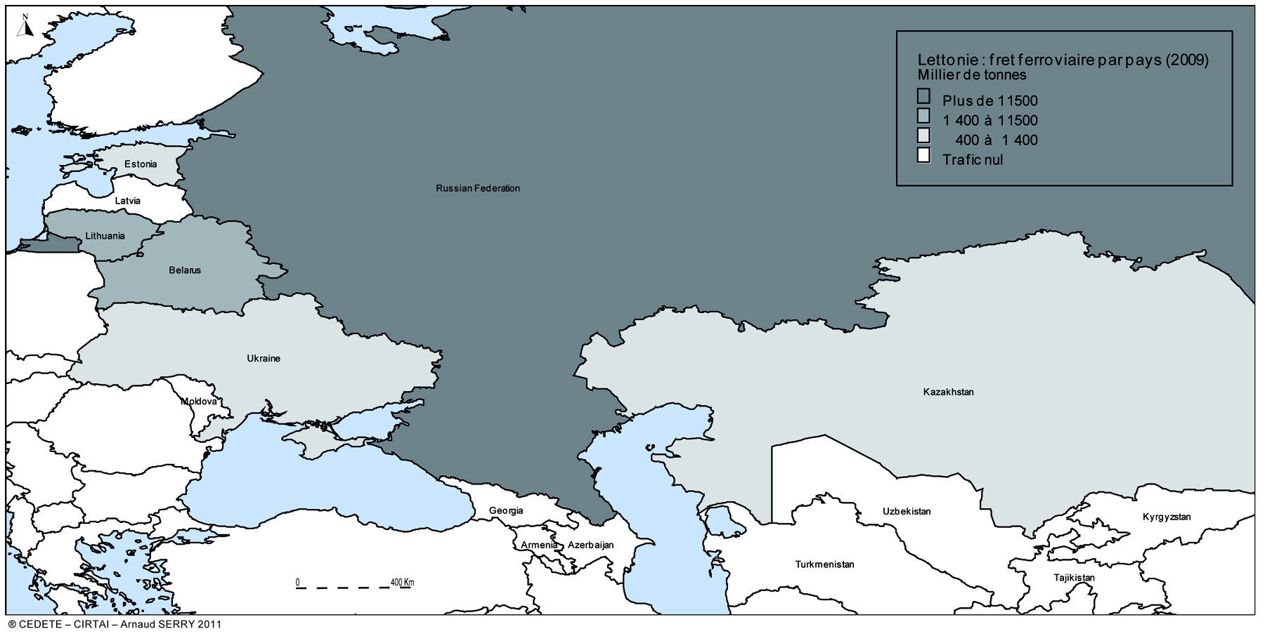
Goods carried by rail in 2009

Slide 7
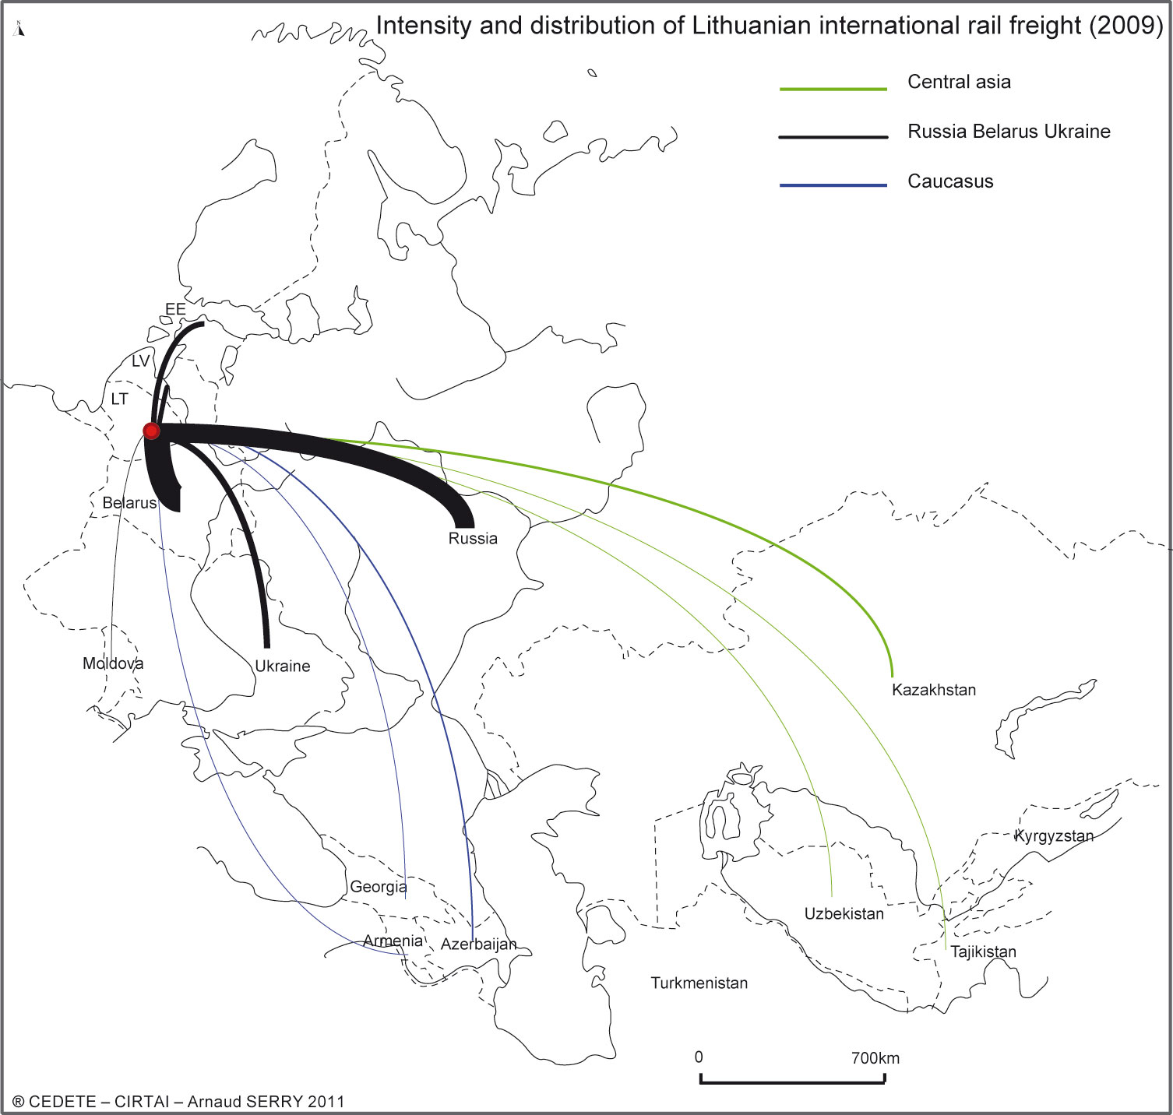
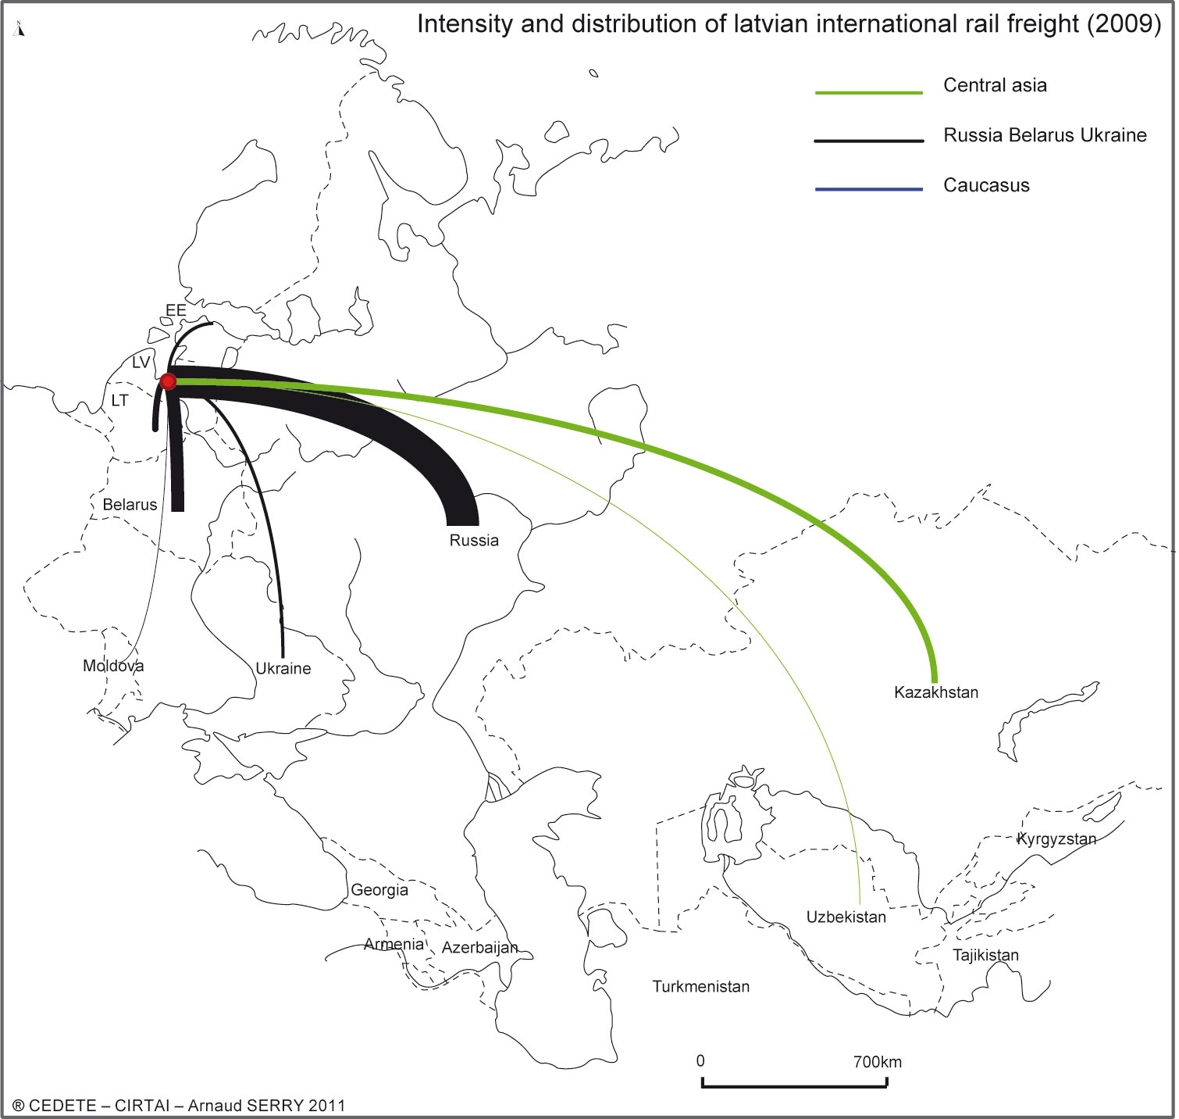
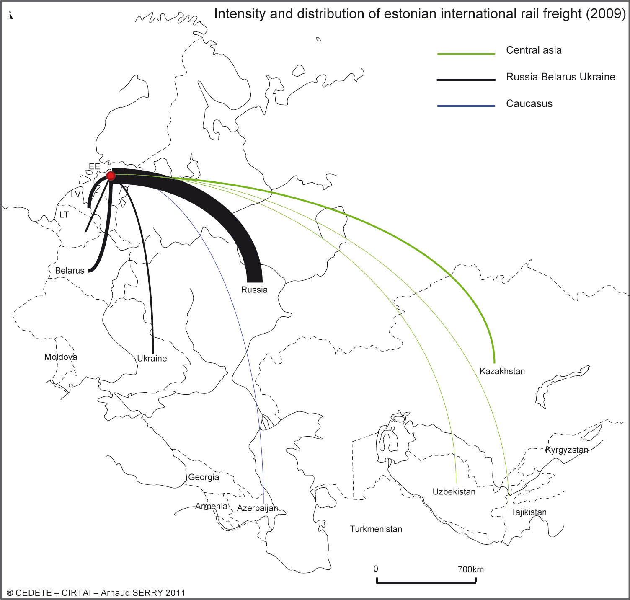

Slide 8
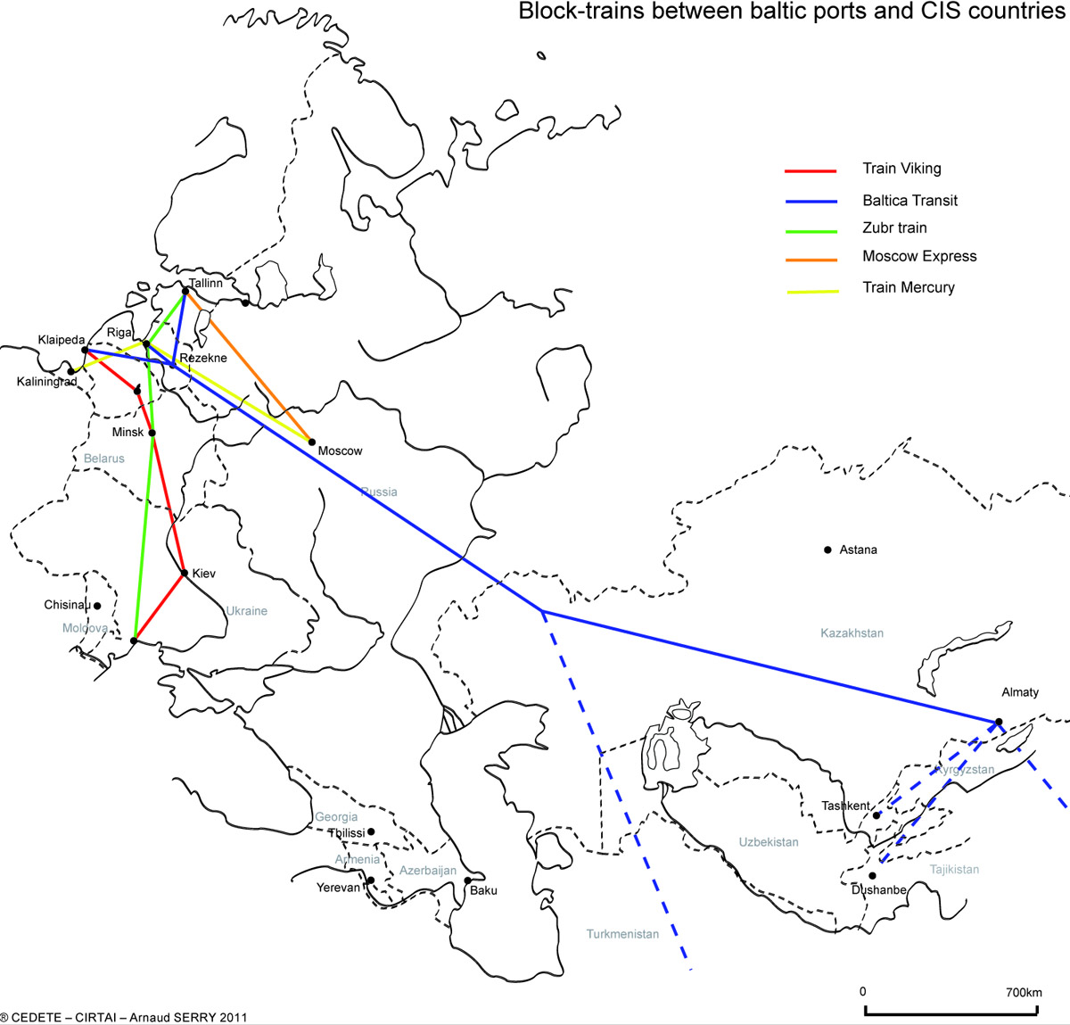

Slide 9
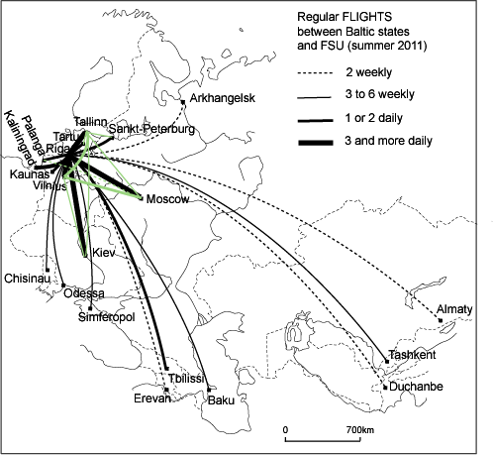
Passenger air traffic: flights and destinations
Destina-tions from | Total | FSU | % FSU
Riga | 86 | 19 | 22
Tallinn | 32 | 5 | 16
Vilnius | 23 | 4 | 17

Slide 10
Air traffic evolution.

Slide 11
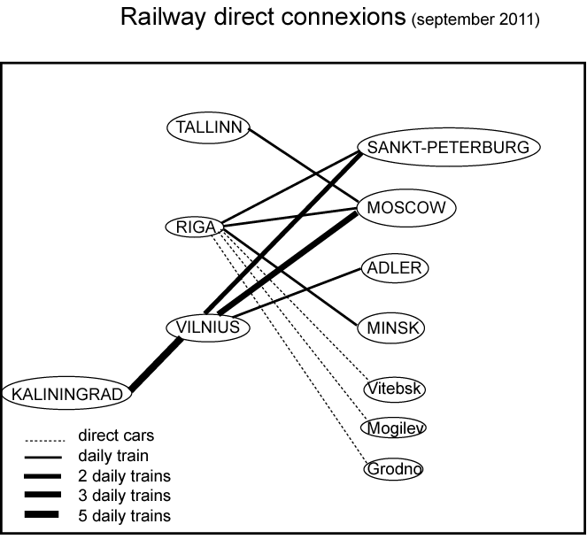
Passengers by rail
International passengers by rail (Thousands)
 | 2004 | 2007 | 2008 | 2009
 | Belarus
Estonie | 58 | 75 | 79 | 49
Lettonie |  | 161 | 150 | 121
Lituanie | 164 | 182 | 172 | 131
 | Russia
Estonie | 66 | 75 | 83 | 47
Lettonie | 149 | 167 | 141 | 115
Lituanie | 110 | 163 | 160 | 143
 | Ukraine
Estonie | 0 | 0 | 0 | 0
Lettonie | 14 | 7 | 0 | 0
Lituanie | 10 | 23 | 16 | 7

Slide 12
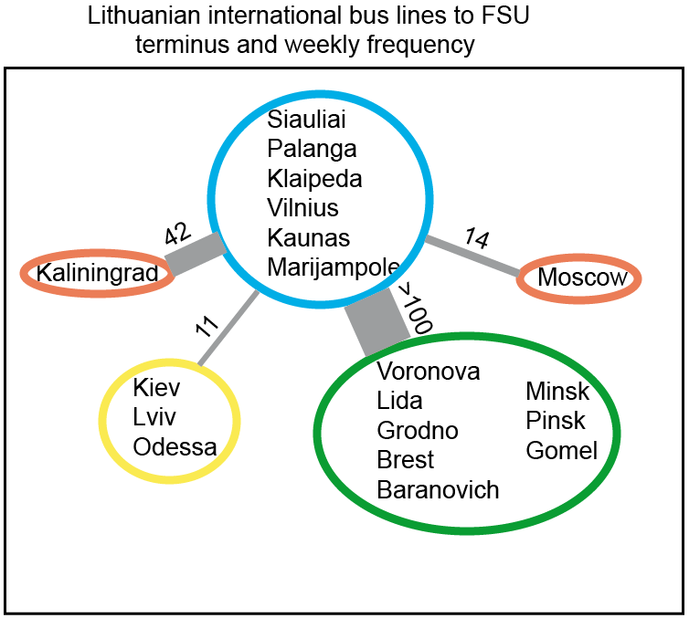
Road Transport
International passengers carried by bus (thousand)
 | 2000 | 2005 | 2010
Lithuania | 1628,6 | 1546,1 | 575,9
Estonia | 753 | 638,1 | 796,4
Latvia | ND | ND | ND

Slide 13
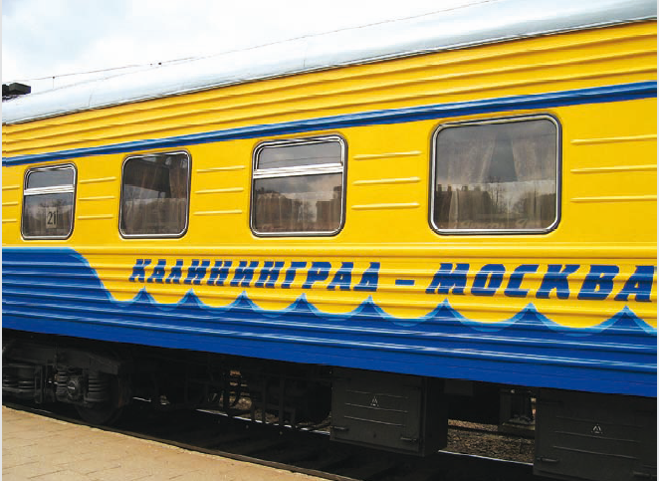
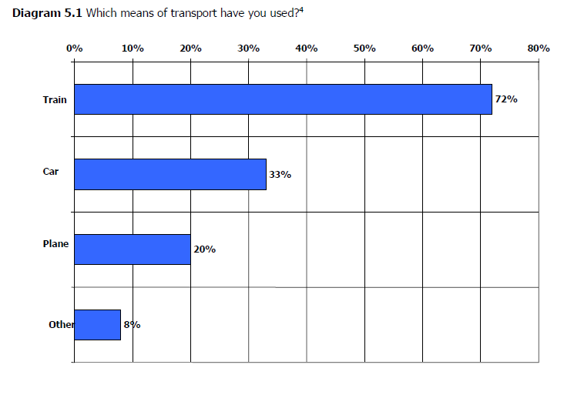
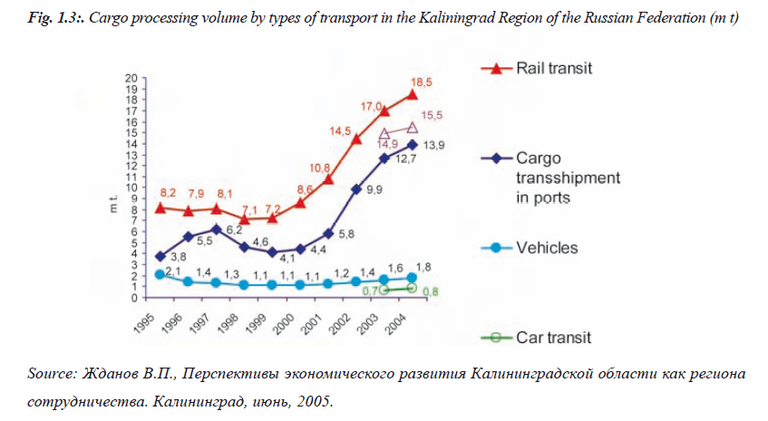
The case of Kaliningrad

Slide 14
Conclusion
the border is a cut and a seam.
Business against political borders.
Ports are positioned as gateways between Russia and Europe and participate in the building of a single integrated reticular regional space.
At local scale the border became a frontier.
We could conclude that the border is a seam in global transport system, but a cut in local mobility.

