Slide 1
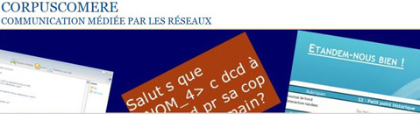




The CoMeRe French CMC corpora and their modeling in TEI
http://comere.org
http://hdl.handle.net/11403/comere
Thierry Chanier, Céline Poudat, Ciara Wigham
ird-cmc-rennes :
International Research Days: Social Media and CMC Corpora for the eHumanities
23-24h October 2015
SIG
TEI-CMC
Open Resources and
TOols for LANGuage
Consortium Corpus-écrits

Slide 2
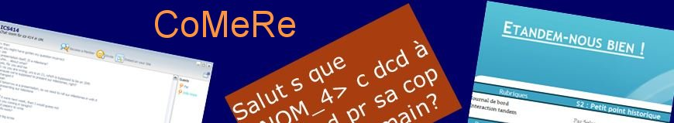



CoMeRe (Communication Médiée par les Réseaux): a reference corpus of French CMC (2013-14)
http://comere.org
http://hdl.handle.net/11403/comere
Project supported by the national consortium Corpus-écrits, sub-part of Huma-Num, and Ortolang
Consortium Corpus-écrits
People: 14 researc. from 8 research units. Coord: Chanier, T (Clermont), Poudat, C. & Sagot, B (Paris), Longhi, J. (Cergy), Antoniadis, G. (Grenoble)
Objective: Kernel corpus assembling existing corpora of different CMC genres and new corpora build on data extracted from the Internet. These heterogeneous corpora will be structured and processed in a uniform way, complemented with metadata. CoMeRe will be released as OpenData through the national infrastructure Ortolang, following constraints which will be reused for the forthcoming “Corpus de Référence du Français”.
Variety + Standards + Open Access

Slide 3
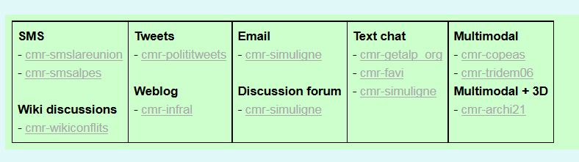
Variety + Standards + Open Access

Slide 4
Variety + Standards + Open Access
People often wonder: "what did you choose the Text Encoding Initiative to encode multimodal interactions?
These interactions can be viewed as text
  Baldry & Thibault (2006) consider “texts to be meaning-making events whose functions are defined in particular social contexts,” following Halliday (1989:10) “any instance of living language that is playing a role some part in a context of situation, we shall call it a text. It may be either spoken or written, or indeed in any other medium of expression that we like to think of.”
Mainstream of oral corpora are encoded into TEI
TEI offers a very rich way to describe the project corpus (on top of the interactions set)
Opportunity to wrok at a European level

Slide 5
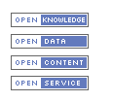
Variety + Standards + Open Access
“Availability and Access: the data must be available as a whole and at no more than a reasonable reproduction cost, preferably by downloading over the internet. The data must also be available in a convenient and modifiable form.
Reuse and Redistribution: the data must be provided under terms that permit reuse and redistribution including the intermixing with other datasets. The data must be machine-readable.
Universal Participation: everyone must be able to use, reuse and redistribute – there should be no discrimination against fields of endeavor or against persons or groups. For example, ‘non-commercial’ restrictions that would prevent ‘commercial’ use, or restrictions of use for certain purposes (e.g. only in education), are not allowed. “OpenDefinition.org
Opendata criteria
Notes:
There exist 3 main criteria that research data should follow in order to be considered OpenData.
Besides being obviously available, the interesting perspective is the fact that data can be access in order to be reuse and mix with other data and licence should explicitly mention this.
Second interesting point is that the constraints for reuse should be reduced to a minimum, then the definition stipulate that non-commercial’ restrictions that would prevent ‘commercial’ use, or restrictions of use for certain purposes are not allowed

Slide 6



Example of CoMeRe licences
Falaise, A. (2014). Corpus de français tchaté getalp_org. [cmr-getalp_org].
Antoniadis, G (2014). Corpus de SMS réels dans les Alpes, smsalpes . [cmr-smsalpes].
Longhi, J., Marinica, C., Borzic, B., Alkhouli, A. Polititweets. (2014). Corpus de tweets provenant de comptes politiques influents. [cmr-polititweets]
Ledegen, G. (2014). Grand corpus de sms smslareunion . [cmr-smslareunion]
Yun, H. & Chanier, T. (2014). Corpus d'apprentissage FAVI (Français académique virtuel international). [cmr-favi].
Abendroth-Timmer, D., Bechtel, M., Chanier T. & Ciekanski, M. (2014). Corpus d'apprentissage INFRAL (Interculturel Franco-Allemand en Ligne). [cmr-infral]
Reffay, C. Chanier, T. Lamy, M.-N. & Betbeder, M.-L. (2014) Corpus d'apprentissage Interactions Simuligne (Simulation en ligne en apprentissage des langues). [cmr-simuligne]

Slide 7
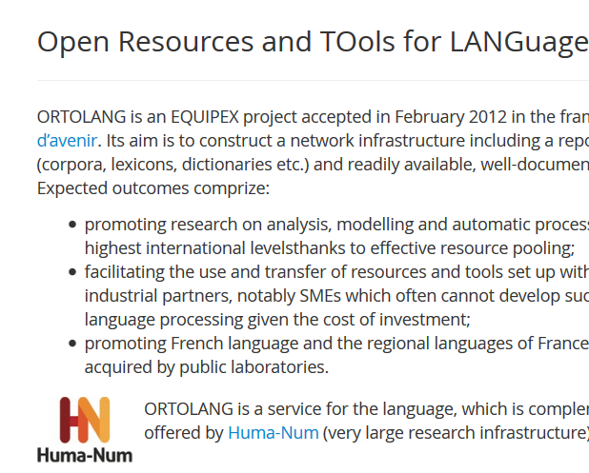
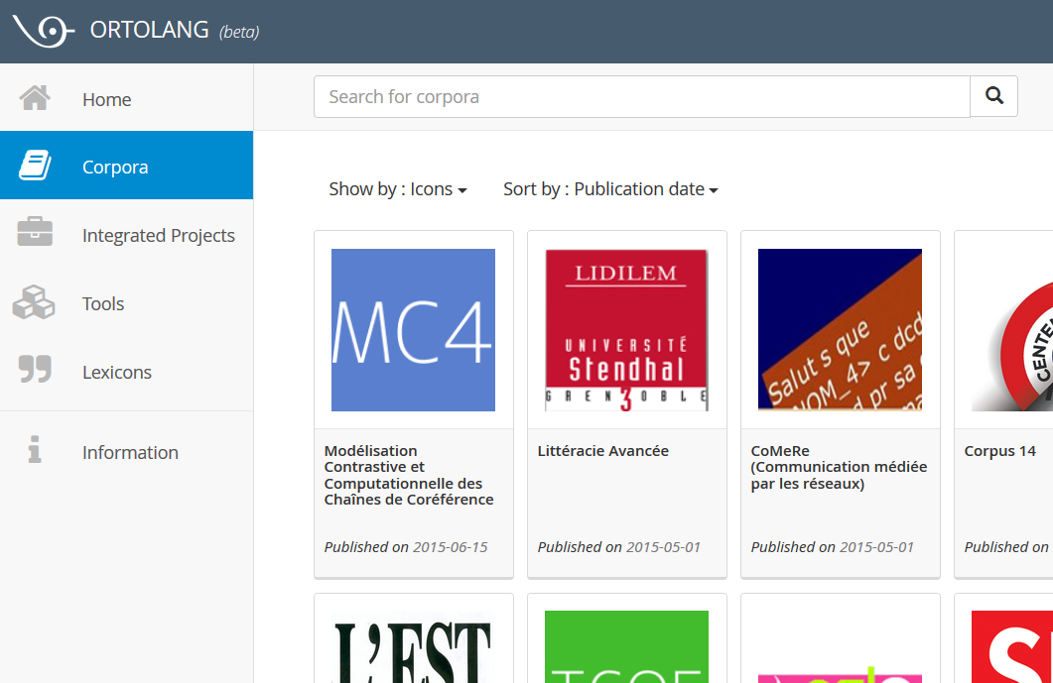
Corpora repository in ORTOLANG
http://hdl.handle.net/11403/comere

Slide 8
Cuurent list of corpora
1) Antoniadis, G (2014). Corpus de SMS réels dans les Alpes, smsalpes [corpus]. In Chanier T. (ed.) Banque de corpus CoMeRe. Ortolang.fr : Nancy. [http://hdl.handle.net/11403/comere/cmr-smsalpes ]
2) Falaise, A. (2014). Corpus de français tchaté getalp_org [corpus] . In Chanier T. (ed) Banque de corpus CoMeRe Banque de corpus CoMeRe. Ortolang.fr : Nancy. [http://hdl.handle.net/11403/comere/cmr-getalp_org]
3) Ledegen, G. (2014). Grand corpus de sms SMS La Réunion [corpus] ….
4) Reffay, C. Chanier, T. Lamy, M.-N. & Betbeder, M.-L. (2014). Corpus Interactions Simuligne (Simulation en ligne en apprentissage des langues) [corpus]…
5) Yun, H. & Chanier, T. (2014). Corpus d'apprentissage FAVI (Français académique virtuel international) [corpus…
6) Abendroth-Timmer, D., Bechtel, M., Chanier T. &Ciekanski, M. (2014). Corpus d'apprentissage INFRAL (Interculturel Franco-Allemand en Ligne). [corpus]…
7) Longhi, J., Marinica, C., Borzic, B. & Alkhouli, A. (2014) Corpus de tweets provenant de comptes politiques influents. [corpus]…
8) Chanier, T. & Audras, I. (2015). Tridem06 corpus: intercultural competence in online exolingual group exchanges [...]
9) Chanier, T. & Wigham, C.R. (2015). Archi21 corpus: collaborative language and architectural learning in Second Life [...]
10) Chanier, T., Reffay, C., Betbeder, M-L., Ciekanski, M. & Lamy, M-N. (2015). Copéas corpus: online language learning within an audiographic environment [...]
11) Poudat,C., Grabar , N. Kun, J. & Paloque-Berges, C. (2015). Corpus wikiconflits, conflits dans le Wikipédia francophone [...]
Notes:
Parler des citations / références

Slide 9
Corpora composed of verbal acts
Ref | Tokens | Partici. | Posts | Envir.
(Antoniadis,2014) | 449 313 | 359 | 22 052 | SMS
(Falaise, 2014) | 35 M | 25 000 | 3 M | textchat
(Ledegen, 2014) | 357 000 | 850 | 22 000 | SMS
(Reffay et al., 2014) | 600 000 | 67 + 4 groups | - textchat: 6 790 - emails: 2 030 - forums: 2 686 | LMS
(Yun, Chanier, 2014) | 77 605 | 31 + 2 courses | 7 750 | textchat
(Abendroth-Timmer et al., 2014) | 273 546 | 26 + 4 groups | 1 200 | Blog
(Longhi, Marinica, 2014) | 567 851 | 205 | 34273 | Tweet
(Poudat et al., 2015) | 489 000 | 3971 | 4456 | Wiki discussions
Informal
business
Informal
Informal
education
education
education
politics
science

Slide 10
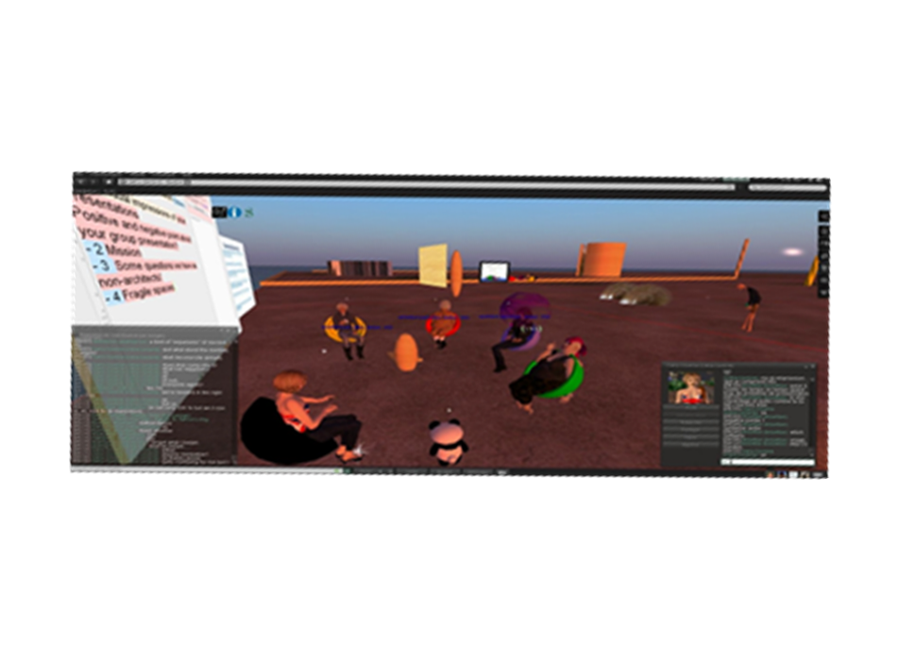
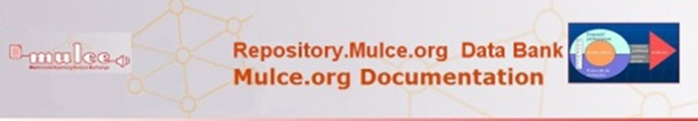
verbal & non-verbal acts (LETEC corpora)
Ref | Tokens | Partici. | Posts, U, Prod | Envir.
(Chanier & Audras, 2015) | 184 594 | 62 + 12 groups | - audio: 2 809 - chat: 248 - non-verbal: 1 058 blog: 779 | Conference system
(Chanier & Wigham, 2015) | 27 912 | 18 + 4 groups | - audio: 1 690 - chat: 669 - non-verbal: 2 452 | 3D environment
(Chanier , Reffay et al., 2015) | 127 228 | 16 + 2 groups | - audio: 7 718 - chat: 1 566 - non-verbal: 5 790 | Conference system

Slide 11
Interaction Space Model
Implementation in CoMeRe corpora

Slide 12
Environments
Verbal
Verbal & Non-verbal
Mono
Mode
Modality
Multi
Modalities
Multi
Modes
Conference system,
3D environment
Etc.
Audiochat
Textchat
Icones
Collec prod
Whiteboard
Word proc.
Semantic maps
Avatars
…
Textchat
Forum
SMS
Tweets
Email
Blogs
(image
not means of interaction)
LMS:
- email
- forum
- chat
Conf system:
Audiochat
Textchat

Slide 13
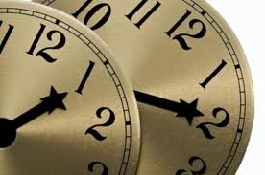
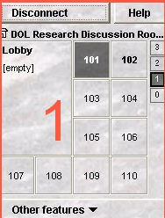
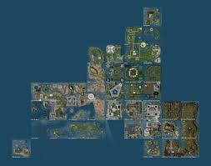
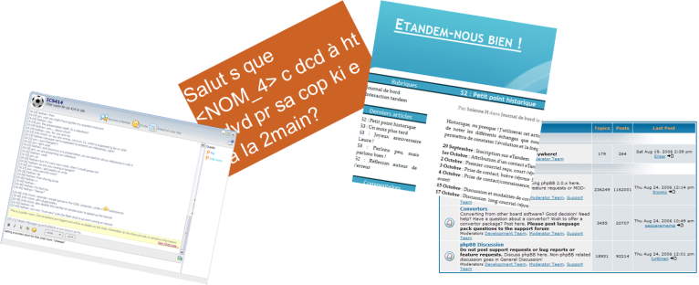
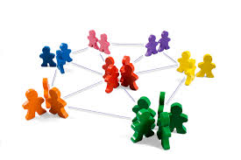
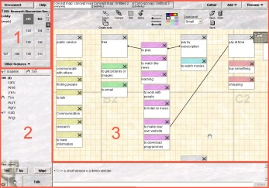
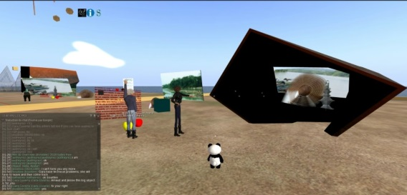
Interaction Space Model
Time(s)
Course
Session
Channel
Simultaneity
Locations
Interaction
Space
Participants
Environments
Author
Adresse(s)
Group
Network
Notes:
An Interaction Space is an abstract concept, located in time (with a beginning and ending date with absolute time, hence a time frame) where interactions between a set of participants occur within an online location . The online location is defined by the properties of the set of environments used by the set of participants

Slide 14
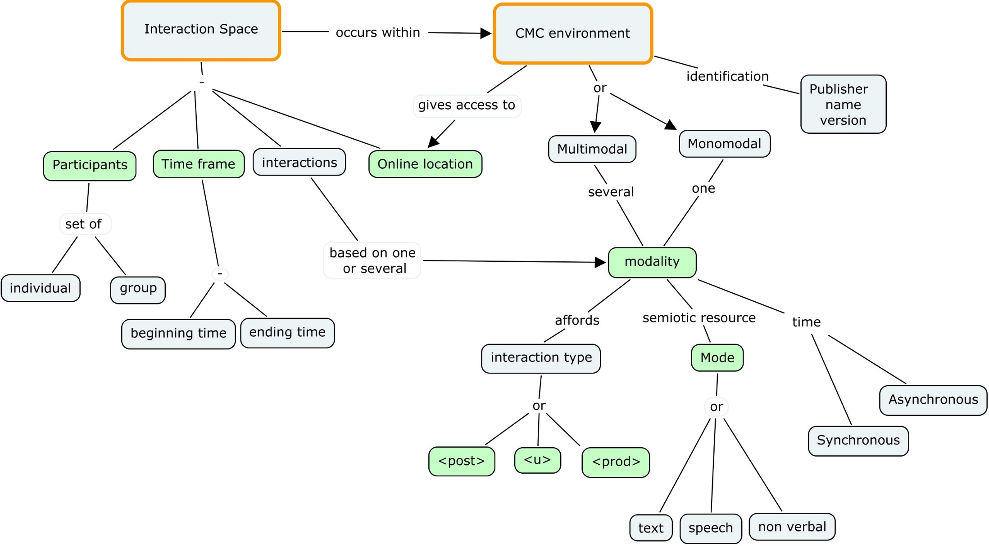
http://wiki.tei-c.org/index.php/SIG:CMC/Draft:_A_basic_schema_for_representing_CMC_in_TEI
New macro-level elements

Slide 15
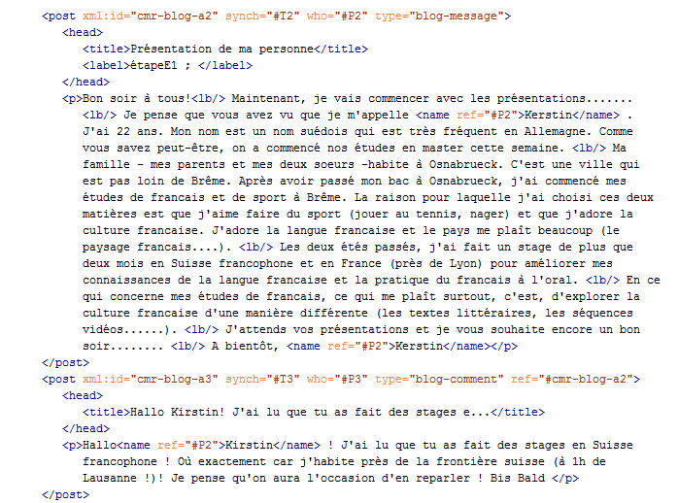
Blog: message and comment
Title
label
message
Contents
/ body
comment

Slide 16
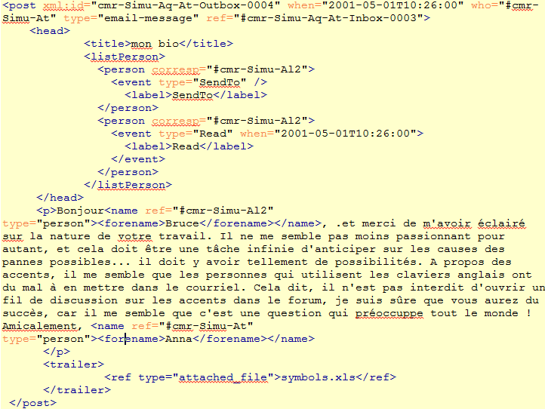
More complex (cumbersome?): email (here), forum
Response to what?
Sent to whom?
Read by whom?
May contain
HTML,
Table,etc.
Attached doc

Slide 17
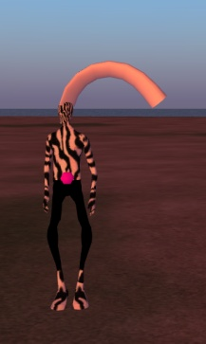
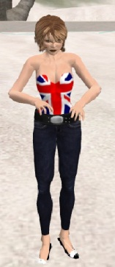
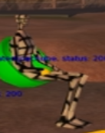
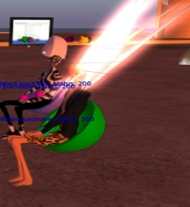
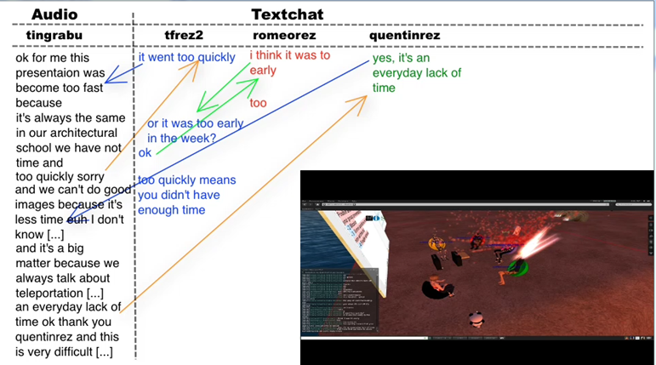
Modality interplay
1.5 mn video
* Paper: (Wigham & Chanier, 2013) CALL journal
* Data: (Wigham, 2013) LETEC corpus
Notes:
In one of our paper, which will appear in the CALL journal, and the corresponding data are already online in Mulce, Ciara Wigham discusses the interplay between audio and textchat.
Here is an extract from Archi21. In the left column you have the transcription of the audio of one learner, who presents his feeling related to the on-going process of his architectural project. He is a French native and speaks in English as his L2. In the 3 other columns on the right, you find textchats turns coming from the tutor and two other learners belonging to the same architectural project group.
Let me show you a short video.
**** In this example of conversation doubling, the acts in the text chat respond to the voice chat (blue arrows) but equally acts in the voice chat respond to the text chat (orange arrows) and text chat acts respond to interaction in both voice chat and text chat modalities and prompt interaction in both modalities
17

Slide 18
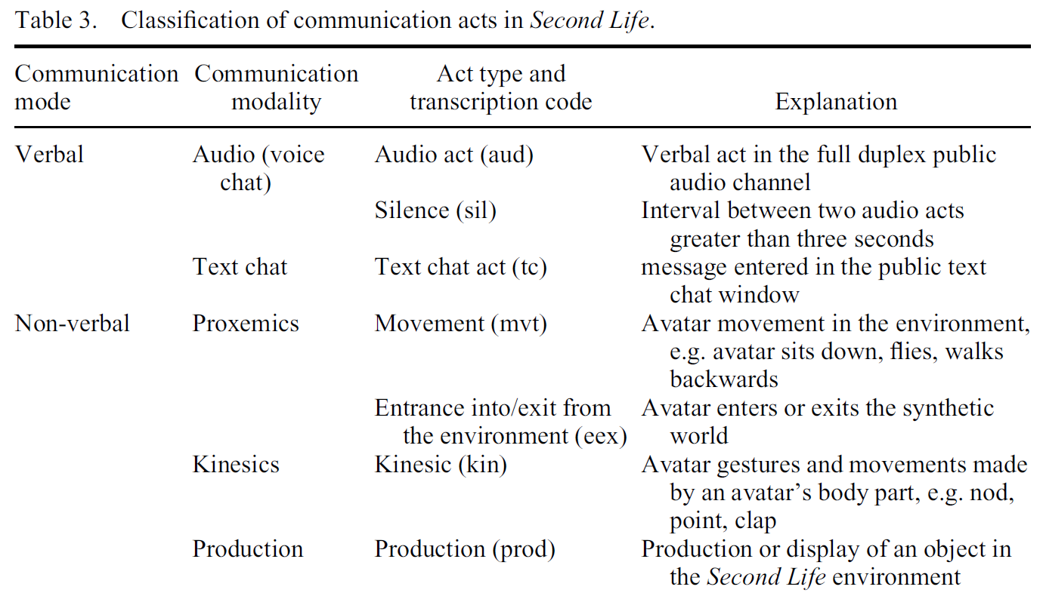
Multimodalité : Verbal et non verbal
(Wigham & Chanier, 2013)

Slide 19
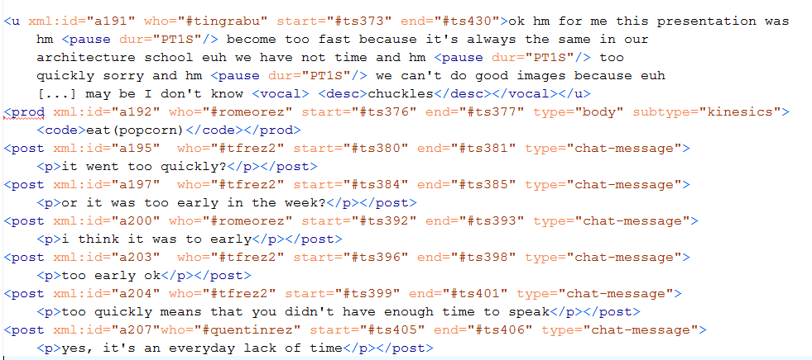
Modality interplay
Audio
kinesics
chat
chat
chat
chat
chat
chat

Slide 20
Detailing the corpus project in TEI
To support resuse by other researchers
Using TEI header

Slide 21
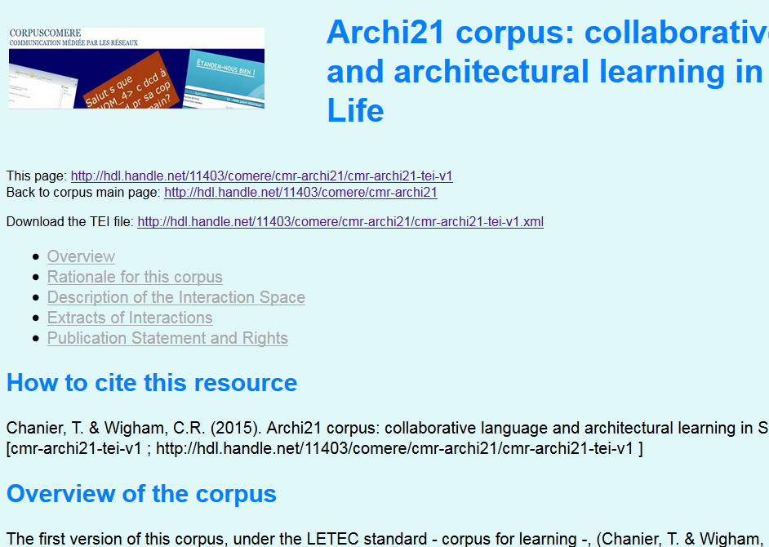

Slide 22
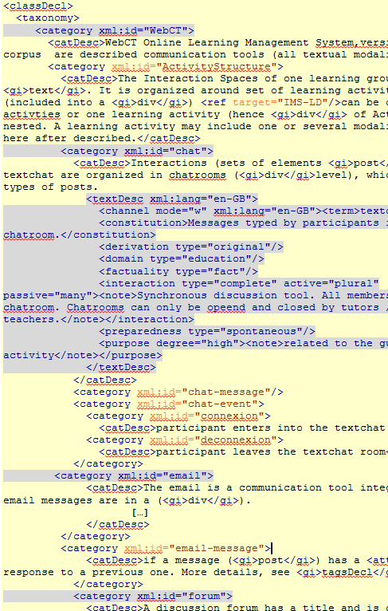
Multimodality environment: general features and affordances
(LMS- Learning Management System)
LMS
textchat
email
forum

Slide 23
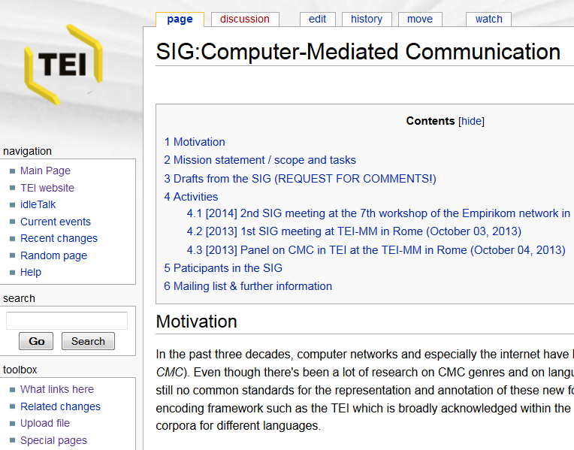
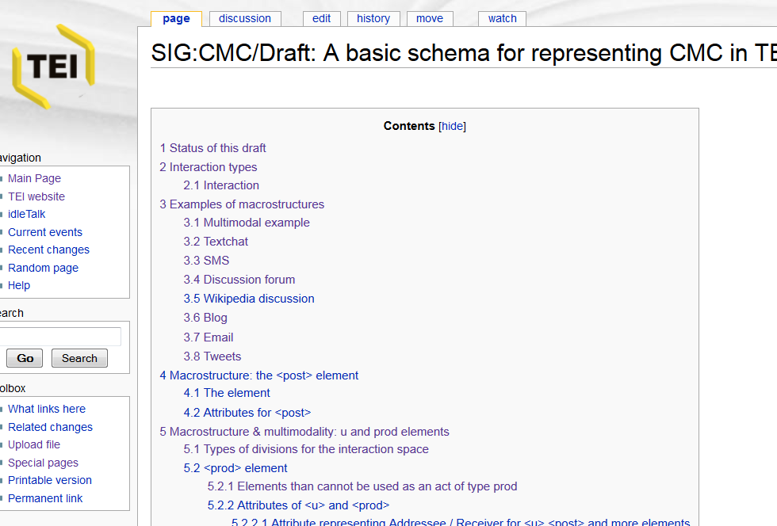
CoMeRE model (ODD)
Many more
examples here
http://wiki.tei-c.org/index.php/SIG:CMC/Draft:_A_metadata_schema_for_CMC
http://wiki.tei-c.org/index.php/SIG:CMC/CoMeRe_schema_draft_for_representing_CMC_in_TEI_%282014%29

Slide 24
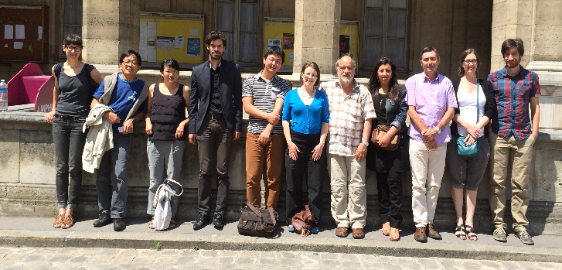
CoMeRe team
Documentation and events : http://comere.org
Repository: http://hdl.handle.net/11403/comere

