Slide 1
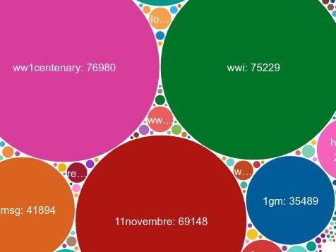
#ww1. Feedback from a data-driven research led by a non-data-scientist historian
Frédéric Clavert – Université de Lausanne
frederic.clavert@unil.ch - 26 mai 2016 - MASHS

Slide 2
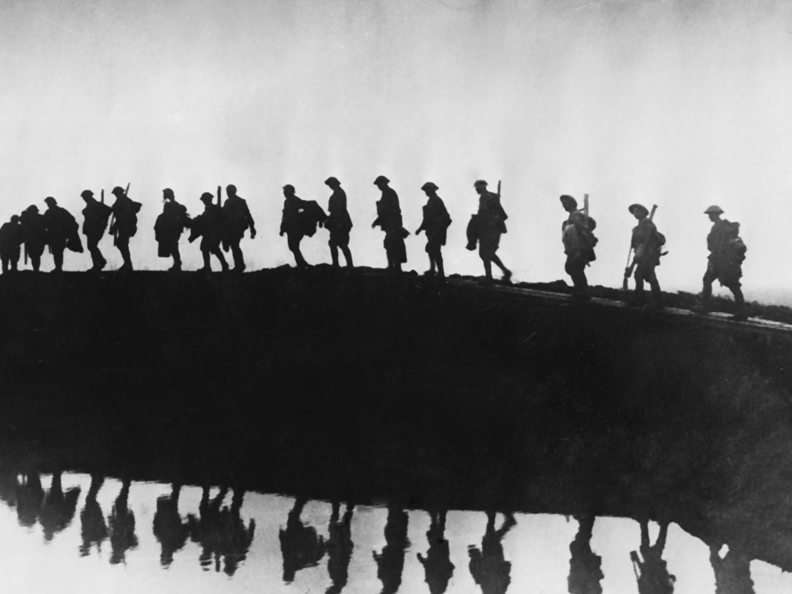
Introduction

Slide 3
A bit of self-history
Trained as a narrative historian
coming from (mostly narrative) political sciences
International/monetary history
Long-running interest for computing
  Database
Turned to Digital Humanities starting from 2008
  European integration history digital library

Slide 4
Genesis of a project: learning to collect Tweets
Use of Twitter since 2008
REAL use of Twitter since 2009
  Academic interest: following several sessions of the same conference
  Talking with other researchers
  Interdisciplinary

Slide 5
Genesis of a project: collecting #ww1
Collecting tweets since 2012
  During conferences (Search API)
  For my own interest: #ledebat/#manifpourtous (Streaming API)
11 November 2013
launching of the Centenary in France
  Rendez-vous de l’Histoire de Blois
  Strong suggestion by two ww1 historians

Slide 6
What is at stake?
Memory/Past/History
Memories of the ‘historical’ past is an important research field since the 1970s
  See Pierre Nora (Lieux de Mémoire, 1980s)
Strong media exposure from time to time
  Example: 1990s and Vichy
  cf. Rousso / Conan, Vichy, un passé qui ne passe pas)
  2000’s and slavery/French colonial Empire
  “Memory laws“ / Competition between memories
Memories of the past also depend on the nature of media
  Notion of ‘régime d’historicité’ (F. Hartog): presentism/memory of the past

Slide 7
Hashtags?
Hashtags: user-generated functionality of Twitter
  A keyword with a # (#ww1)
  Have several significations: emphasizing a concept, contributing to a global discussion, being a member of a community, etc.
Popularity of #ww1 or #pgm
  First use of ww1: 16 April 2007
  First use of #ww1: 11 March 2009
  Imperial War Museum: first Centenary-dedicated account (March 2011, first tweet: 8 July 2011)

Slide 8
Collected hashtags
ww1, wwi, wwiafrica, 1gm, 1GM, 1wk, wk1, 1Weltkrieg, centenaire, centenaire14, centenaire1914, GrandeGuerre, centenaire2014, centenary, fww, WW1centenary, 1418Centenary, 1ereGuerreMondiale, WWIcentenary, 1j1p, 11NOV, 11novembre, WWI, poppies, WomenHeroesofWWI, womenofworldwarone, womenofww1, womenofwwi, womenww1, ww1athome, greatwar, 100years, firstworldwar, Verdun, Verdun2016, Somme, PoilusVerdun

Slide 9
The current state of the corpus
1 April 2014 - 13 April 2016
2,096,968 tweets
  Around 2/3 of retweets
542,570 Twitter accounts
    private individuals, institutions, project-based account, bots and many others
124,424 hashtags
    54,566 used only once
    84,936 three times or less
    107,047 tenth times or less
Not a lot of noise, except for three hashtags: #11Nov/Verdun/Somme

Slide 10
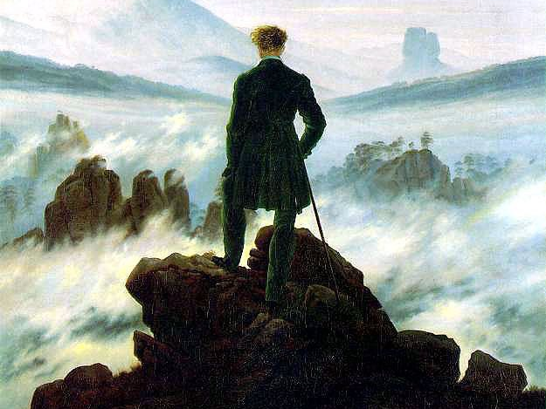
A historian facing a sea of data
How to read two million tweets when you are not
a trained data-scientist?

Slide 11
Key concept of distant reading
Franco Moretti, Graphs, Maps and Trees, Verso, 2007.
  Graphs (Annales School)
  quantitative approach of litterature
  Maps (Geography)
  mapping literature
  Trees (Evolution theory)
  families of novels
Articulation of close reading/distant reading

Slide 12
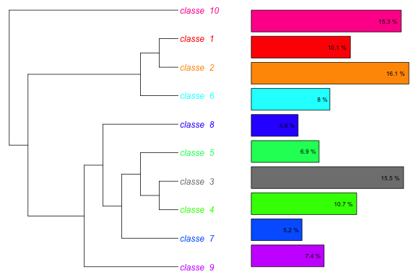
I. Available tools

Slide 13
Distant reading of tweets
What kind of distant reading techniques are required?
  Very basic statistical tools
    number of tweets per day for instance
  Data / Text mining
  Network analysis
Imply to deal with not-that-structured data

Slide 14
Numerous tools are at our disposal…
…to start a data-driven research
  See Digital Research Tools (DiRT), maintained by Lisa Spiro
  86 tools in the ‘Analyse Data’ section alone
How to choose them?
  The good: reading research production (articles, etc.) that ground the tool
  The bad: choosing a tool because its results are easier to interpret
  The ugly: choosing a tool because it’s a tool we already know
How to compare them?
Notes:
Rajouter le nombre d’outils « fouille de texte » dans ce wiki. Collecte de données.

Slide 15
Tools for #ww1: harvesting data
LAMP server
  From a home-based server to a more professionalised one
PHP script: 140dev.com
  Other candidates: DMI-TCAT
  Collects tweets from the public streaming API (json) and parse it to a MySQL database
    Under the 1% of the firehose: no need to use the full API (commercial way)
  Some data are not harvested
    profile’s icons for instance – only URLs to the image are stored

Slide 16
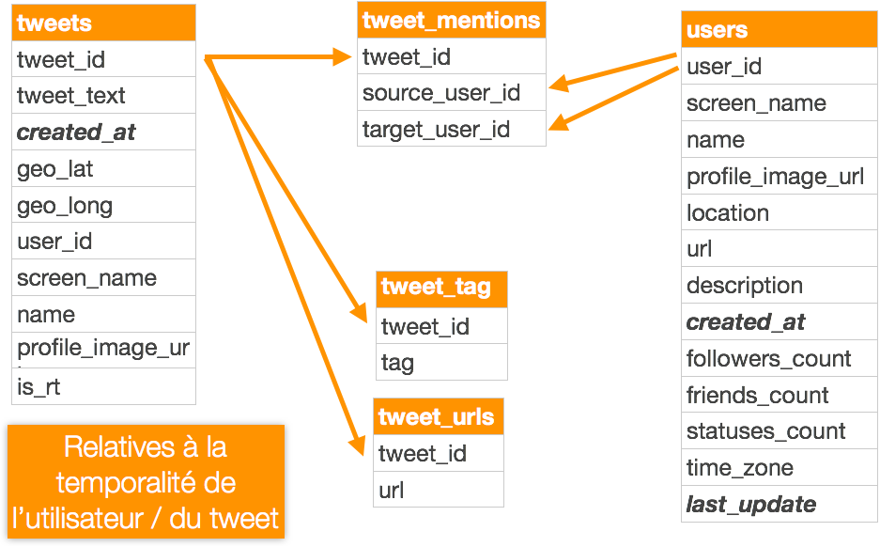
Storing data: data-model

Slide 17
Exporting and preparing data
SQL dump => non-dynamic database on laptop
  Faster to deal with data
  No real-time data treatment
Export through SQL queries to CSV
  Basic preparation with a combination of LibreOffice/OpenRefine/text editor
  The magic of RegEx

Slide 18
What kind of exports?
Tweet-texts with metadata for text-mining
  Original tweets only (No RTs)
  Removal of hashtags, user names and URLs
Different kinds of relations
  RTs/mentions/hashtags…
URLs
  Lengthened through OpenRefine
  Harvested, cleaned and text-mined
Dates
  Number of tweets/day
Subparts of the corpus
  Hashtags (#1j1p/#11novembre) - Iramuteq generated profiles

Slide 19
Text-mining
IRaMuTeQ
  Based on Max Reinert’s Théorie des mondes lexicaux
  Open source implementation vs commercial one (Alceste)
  Can deal with quite a large amount of texts/segments of text
Grounded on the French researcher Max Reinert’s ‘mondes lexicaux’

Slide 20
Text-mining: clustering
Clustering: classification hiérarchique descendante
  See: Reinert Max, « Les “mondes lexicaux” et leur “logique” à travers l’analyse statistique d’un corpus de récits de cauchemars » », Langage et société 66 (1), 1993, pp. 5‑39
Mondes lexicaux: « Il s’agit, non pas de comparer les distributions statistiques des “mots” dans différents corpus, mais d’étudier la structure formelle de leurs cooccurrences dans les “énoncés” d’un corpus donné. »
  Analyse du discours/speech analysis
  ‘Mondes’: to be understood as social representations
  ‘Lexical worlds’ are opposed to one another

Slide 21
Un énoncé traduit donc davantage un point de vue particulier plutôt qu'une représentation, le point de vue : impliquant en son centre l'existence d'un "sujet' dans une certaine modalité du faire ou de l'être. Cette notion n'a donc rien d'absolu. Elle est relative à l'activité ou à l'état d'un sujet et ne renvoie pas obligatoirement à un système de références préétabli, celui-ci pouvant l'être ou non, reconstruit, imaginé. . . Notre hypothèse principale consiste justement à considérer le vocabulaire d'un énoncé particulier comme une trace pertinente de ce point de vue il est à la fois la trace d'un lieu référentiel et d'une activité cohérente du sujet-énonciateur. Nous appelons mondes lexicaux, les traces les plus prégnantes de ces activités dans le lexique.

Slide 22
Text-mining: similitude analysis
How the words relate to each other? How are they connected?
  Clustering is a way to see differences between different lexical worlds
  Similitude analysis is a way to see how words are linked to each other

Slide 23
Network analysis
Gephi
In the case of network analysis, the difficulties are the following:
  It requires a sense of aesthetics
  It requires to study sociological studies that are grounding it

Slide 24
Other and less used software
Tableau Public
Tropes
VoyantTools
  No lemmatisation, a lot of gadgets’ dataviz
  Better with structured data (XML-TEI)
Some tries with MALLET
  Difficult to interpret

Slide 25
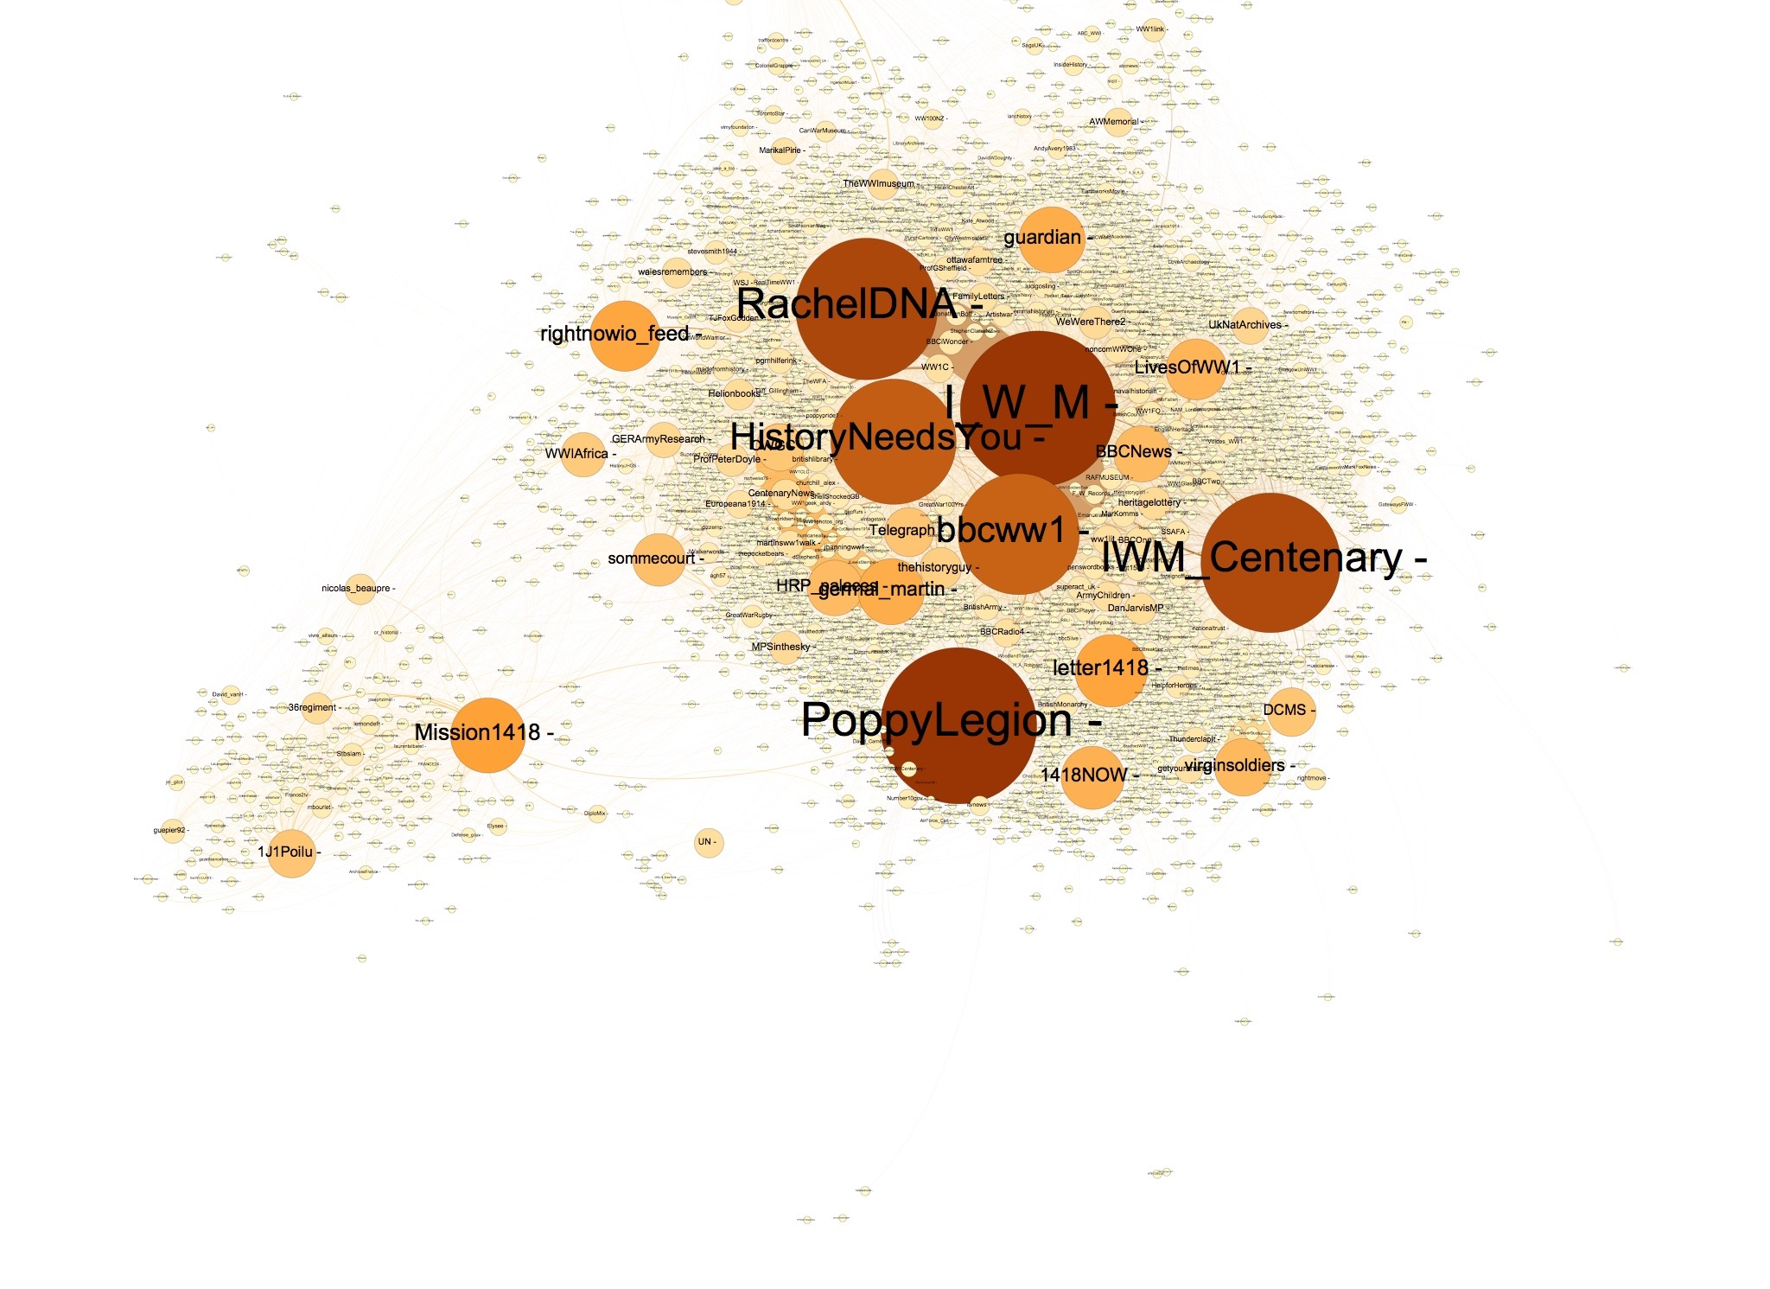
II. Some results

Slide 26

A. Topics
& Temporalities

Slide 27
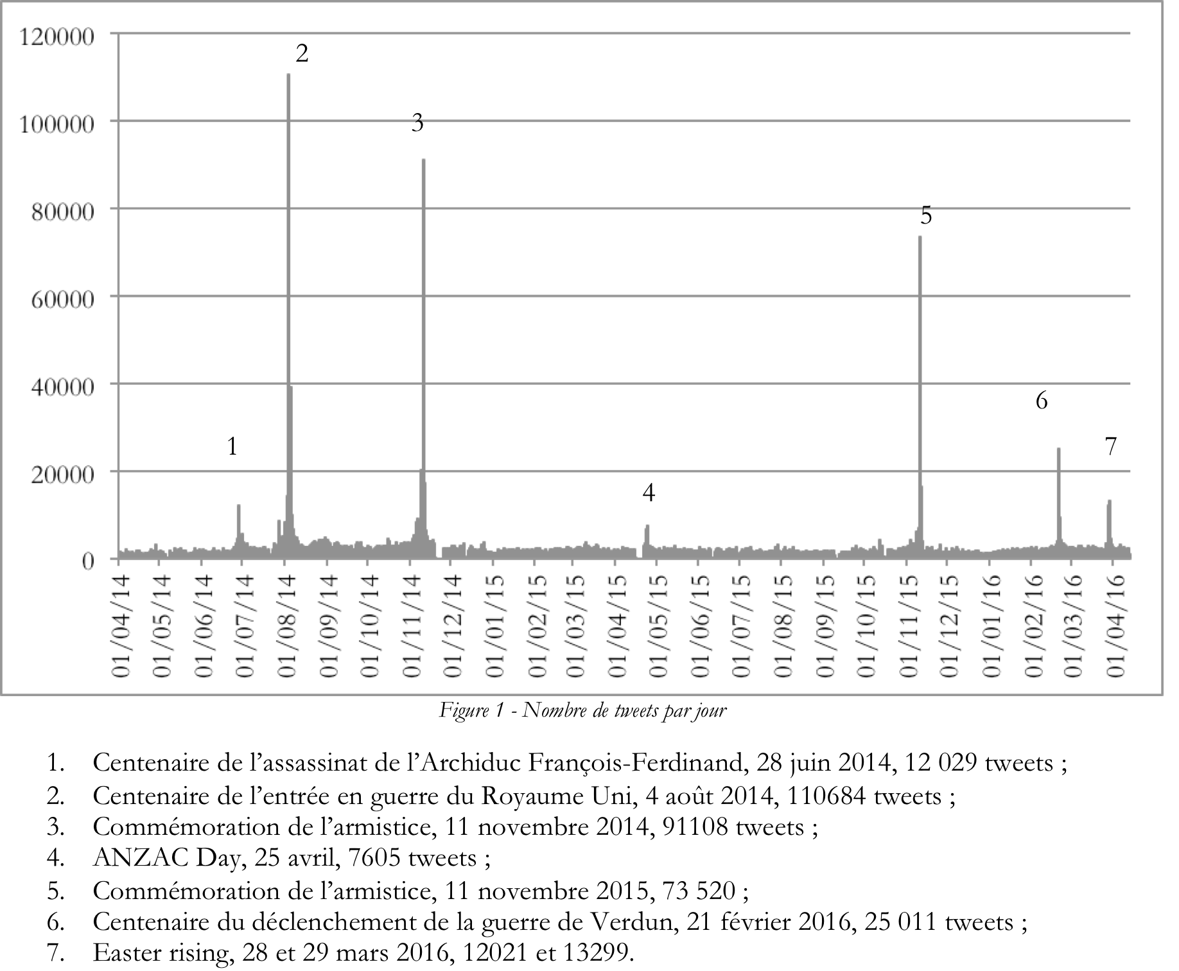

Slide 28
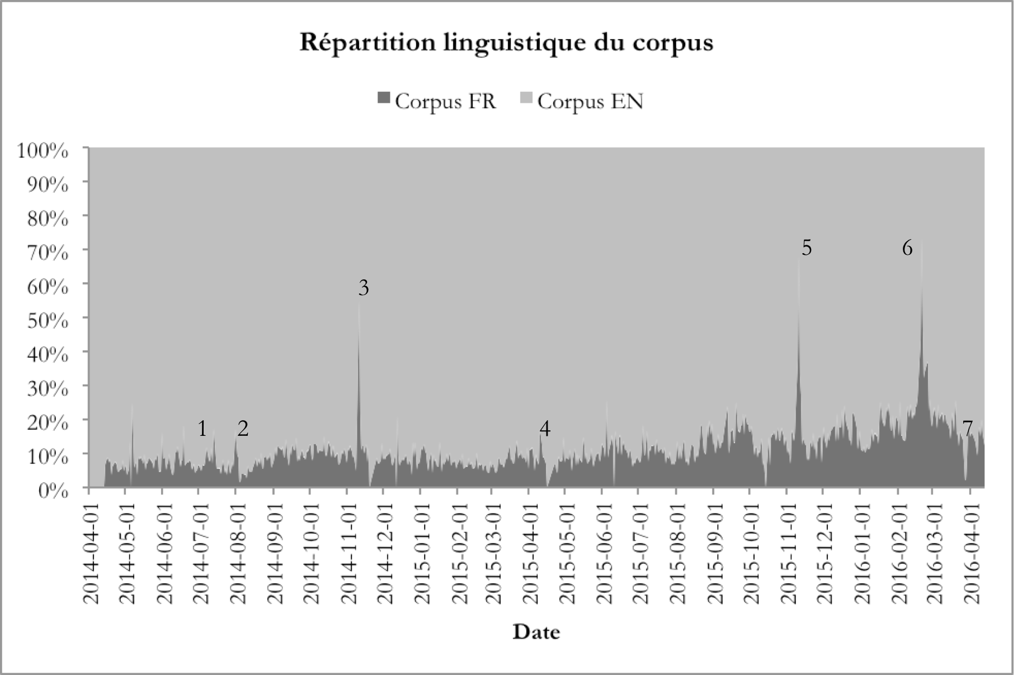

Slide 29
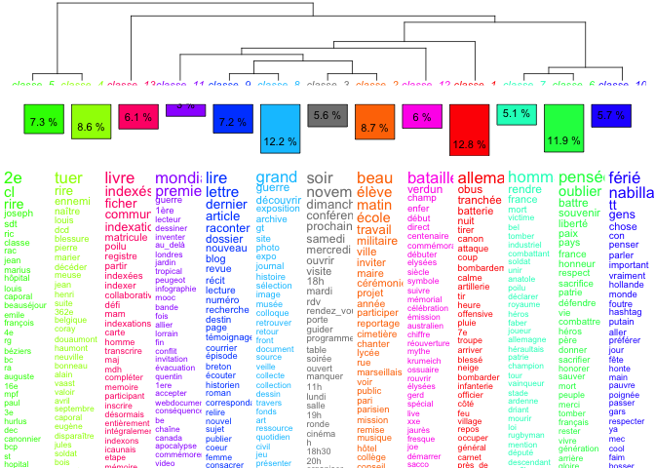
French topics

Slide 30
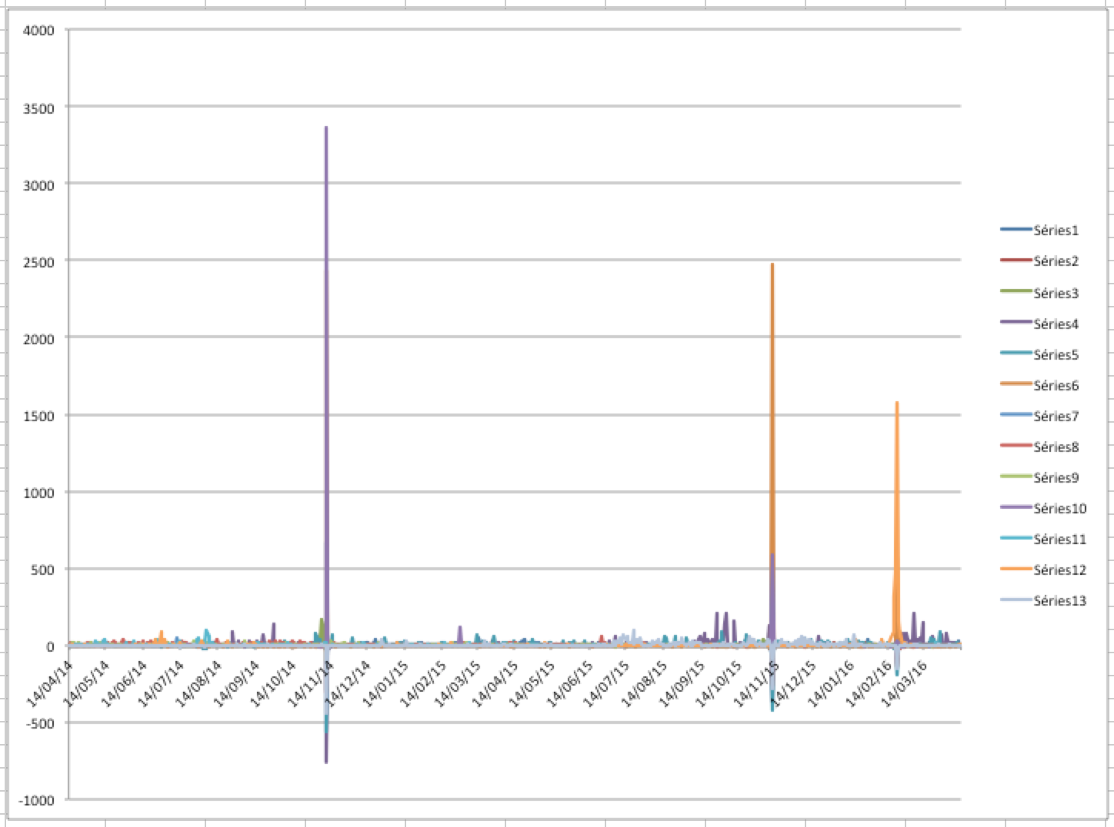

Slide 31
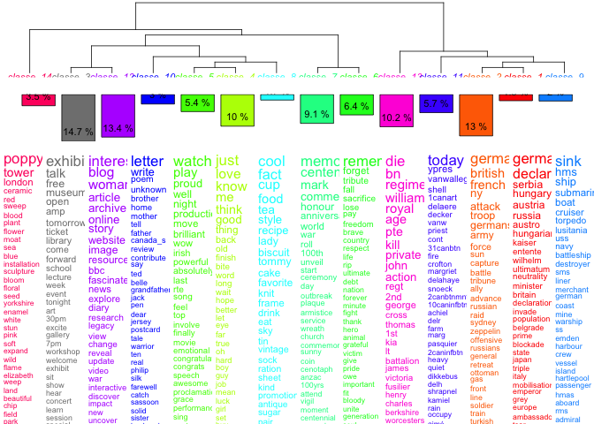
English topics

Slide 32
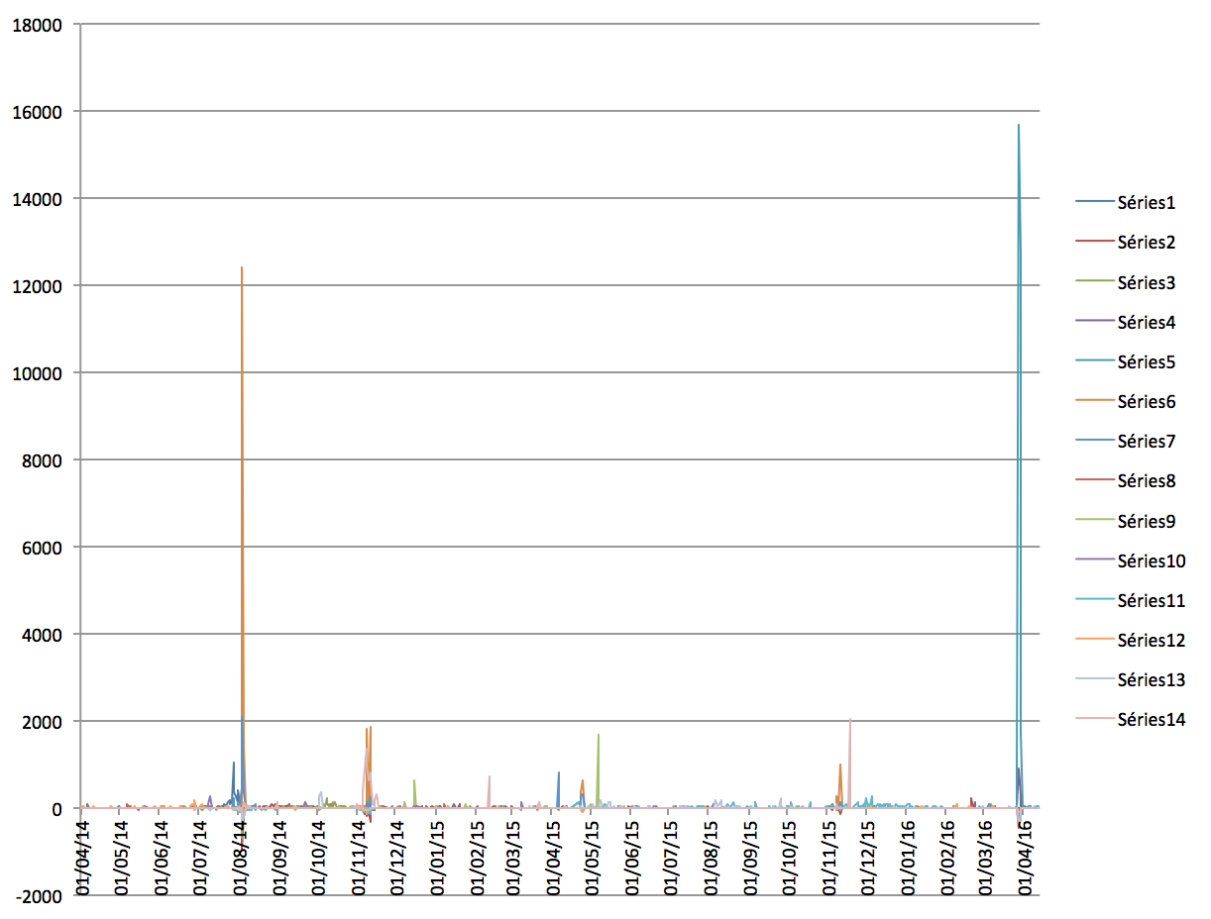

Slide 33
The missing temporality
Artifacts of times within tweets
‘jadis’/‘yore’
≠ ‘Il y a cent ans’/‘on this day in history’
≠ 11/11/1918
Are those different ways to express ‘time’ reflecting different kinds of perceptions of time/different kinds of memories?
Need to use NLP/Named Entities Recognition

Slide 34
The poverty of time-based metadata

Slide 35
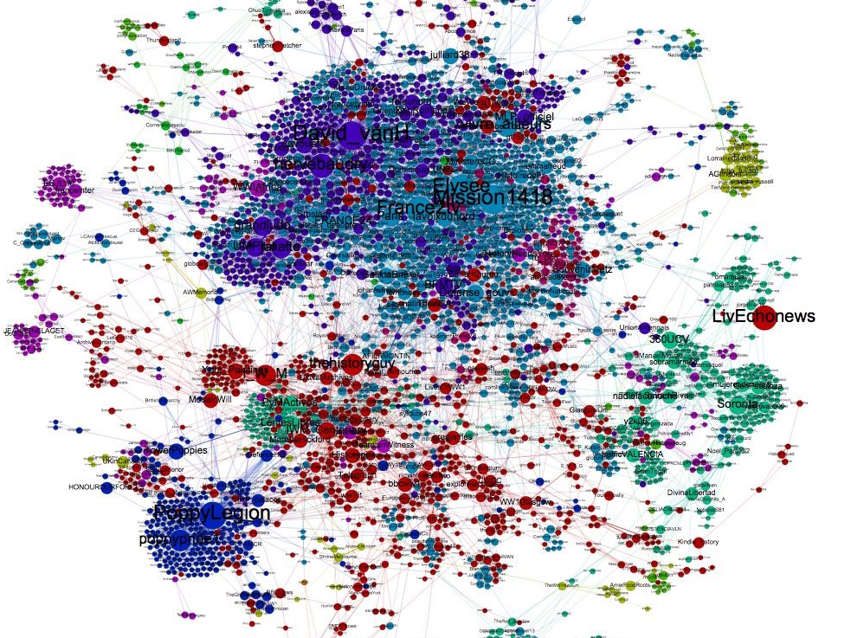
B. Networks

Slide 36
The (already seen a million time) network dataviz
Networks dataviz are based on
  aesthetics
  Strong sociological theory
Difficult not to be YAND
  ‘yet another network dataviz’

Slide 37
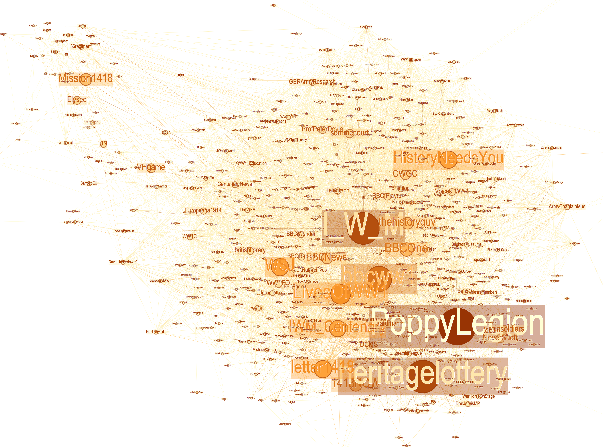
Frenchs, Englishs and others

Slide 38
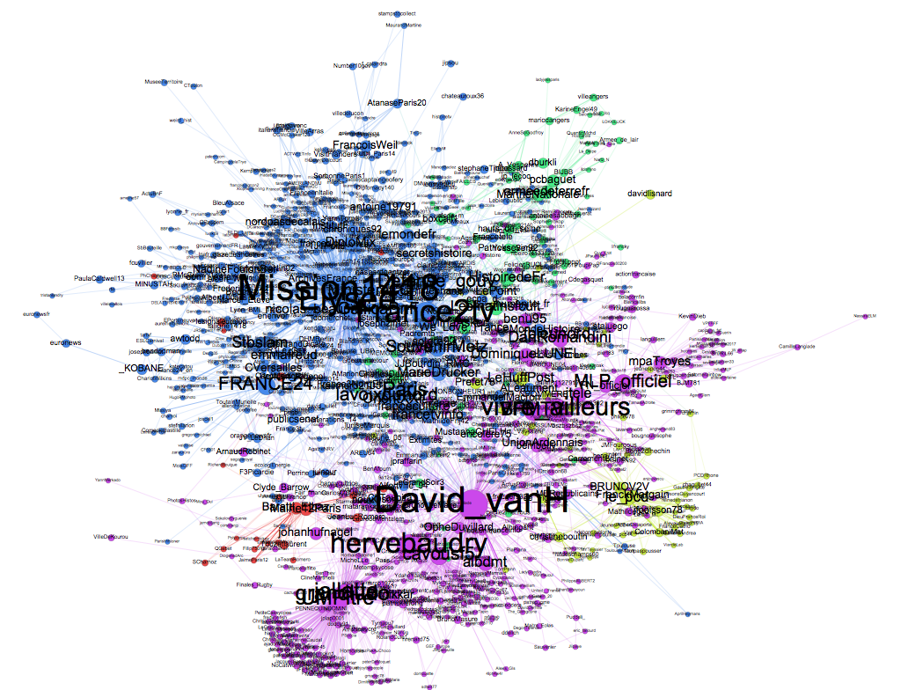
11.11.2014

Slide 39
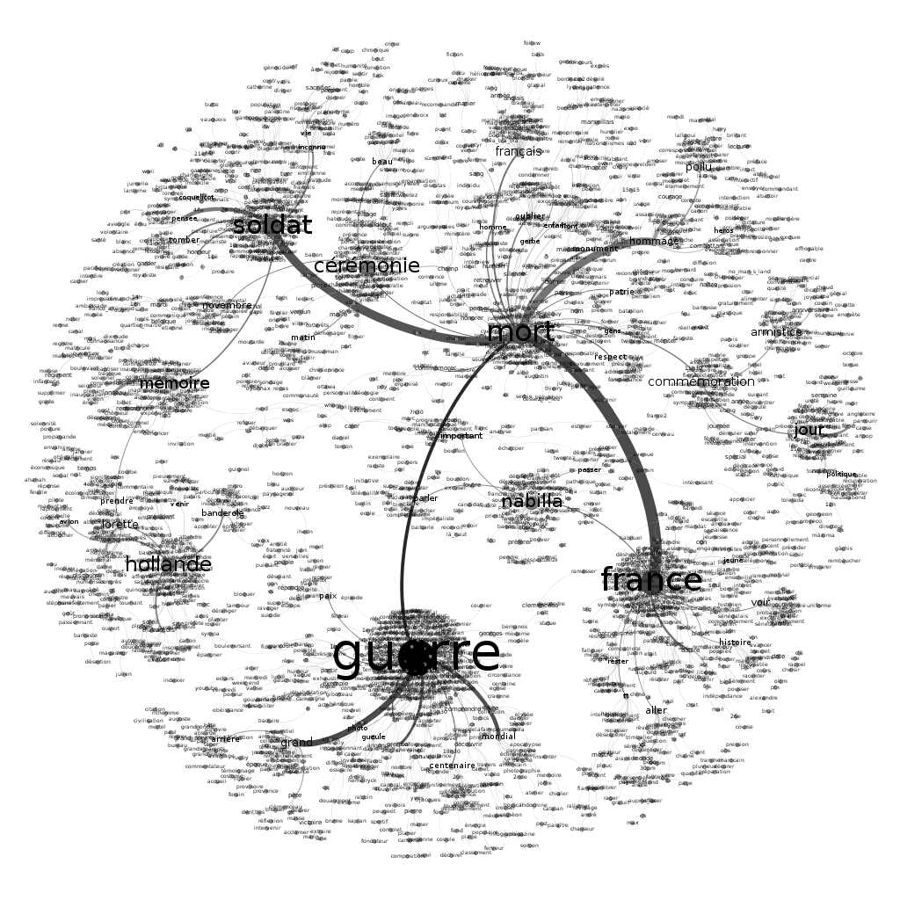
Networks of words

Slide 40
Intense “Wavelets”
Black M’s cancelled concert at Verdun

Slide 41

Conclusion
Questionning my research

Slide 42
Neither computing nor statistics but…
Why Twitter?
  Because we can
  A rather open API system
Would have needed a developer for other kinds of source
Risks
  Algopol and Facebook: arbitrary politics of APIs
  My aim is to collect tweets up to 2019 (Centenary of the Versailles Treaty)
  Twitter might change or shut down its API, might disappear…

Slide 43
Limits of home-based Big Data analysis
Big Data from a historian’s point of view
  When Gnip Inc plays with ‘small data’, they handle 5 to 6 million tweets…
Those pieces of software have a limited ability to analyse massive data corpora
  Are their way to do statistics outdated with regards to today’s massiveness of data?
Questions the historian’s training
Questions her status in the historical narrative / social memory production chain

Slide 44
How to go through the data analysis jungle?
Too many tools
  Too many unflexible tools
Too many tools that do not answer researcher’s needs
  An example: based on words and not on expressions/groups of words
Too many tools that are standardizing research

Slide 45
How to understand weak signals?
All my analyses are about Poilus (France) or battlefields (UK)
  What about all the other ones?
  Women, prisoners, inhabitants of occupied lands, soldiers from colonies, sentenced to death, dissenters…
  Are they subjects of memories for smaller communities that my tools (my methods) are not able to see?
  What about weak signals? How to see snippets within the feed of information?

