Slide 1
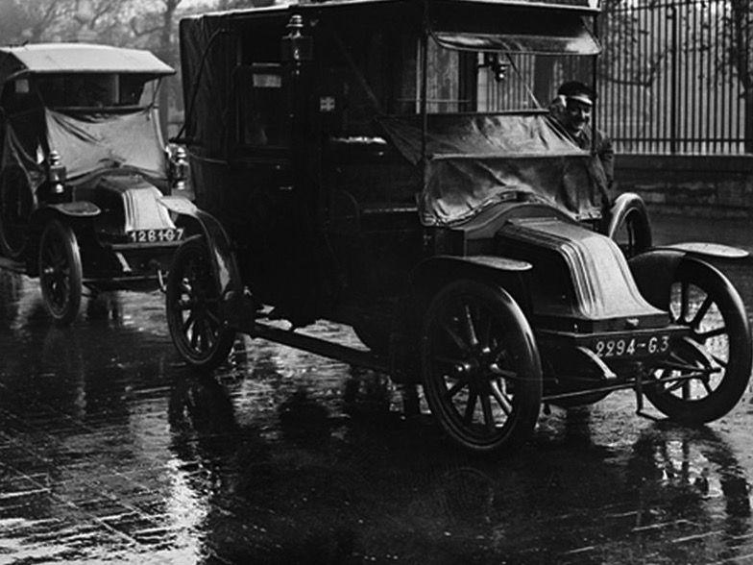
#ww1 and the Centenary of the Great War on Twitter
Frédéric Clavert, unil, Journées suisse d’histoire, 9-10 juin 2016 @inactinique / frederic.clavert@unil.ch

Slide 2
A corpus of (yet) two million tweets
April 2014-April 2016
2 096 968 tweets
Few noise but #11Nov #Somme #Verdun
730 111 without retweets
542 570 accounts
Of all sorts
Individuals, memory-based institutions, media, research projects, bots…
124 424 hashtags
54 566 just once in the database
107 047 ten times or less in the database
Harvesting still on-going

Slide 3
Technical infrastructure
LAMP server
PHP script: 140dev
Connects to Twitter Public Streaming API
Collect tweets based on keywords (#ww1, #1gm, #ewk and many others)
Parse JSON into MySQL
Export to CSV for data anlyses
No «real time» analysis

Slide 4
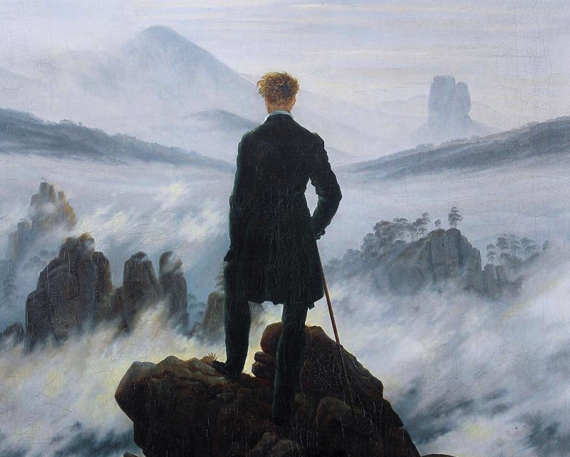
Historian facing a sea of data
How to read two millions tweets?

Slide 5
Basic statistics
Number of tweets per day

Slide 6
Clustering
Text as statistics (text-mining)
Software: Iramuteq
Groups similar tweets in clusters
Similarity = co-occurrences of words
Tree diagram (dendogram)
Words that are shown are the most typical words of each cluster

Slide 7
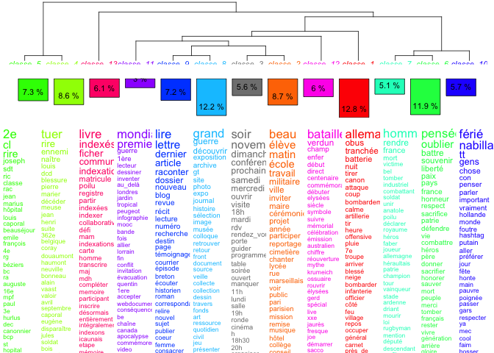

Slide 9
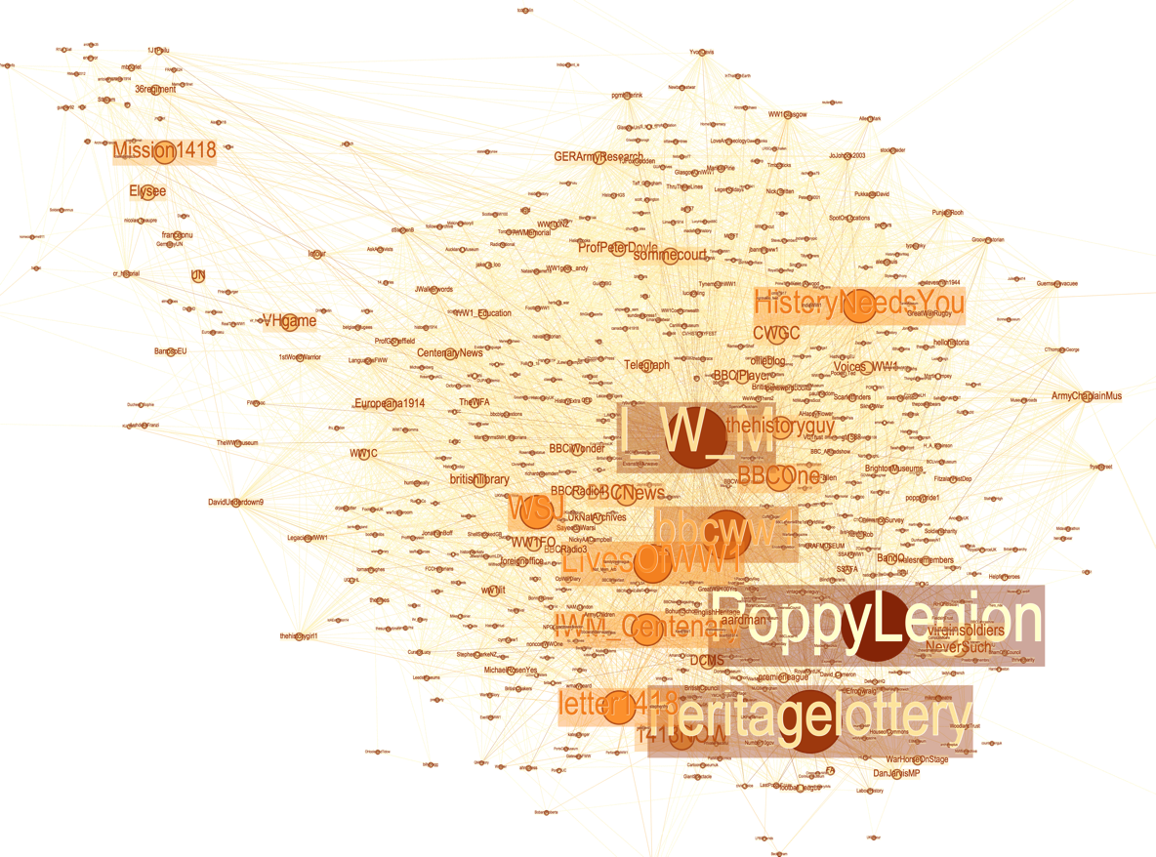
Network analysis / visualization

Slide 10
As a conclusion
Understanding the missing parts
Where are the German Twitter accounts?
Where are prisoners, women, colonial troops, soldiers who did not fall on the battlefield?
Where are other war fornt than the West-European one?
Where are the weak signals?

