Slide 1
Place and value of the Logic at Louis Couturat
Anne-Françoise Schmid
Associate searcher at Chair Theory and Methods for Innovative Design, MinesParistech and in the Poincaré’s Archives (UMR 7117 of CNRS)

Slide 2
Background on Couturat
Edition de la Correspondance entre Bertrand Russell et Louis Couturat (1897-1913) sur la politique, la logique et la philosophie, (735 pages), Paris, Kimé, 2001.
"Couturat's Reception of Leibniz", in Ralph Krömer & Yannick Chin-Drian eds., New Essays on Leibniz Reception in Science and Philosophy of Science 1800-2000, Basel, Birkhaüser, Springer, 2011, pp. 65-84.
« La notion de critique chez Couturat et ses eﬀets dans sa philosophie des mathématiques », in : Michel Fichant & Sophie Roux eds., Louis Couturat (1868-1914). Mathématiques, langage, philosophie, Paris, Classiques Garnier, 2017, p. 65-85,
et pp. 335-339, avec Oliver Schlaudt, « Annexe II _ Sur le projet d’édition de la correspondance de Couturat ».

Slide 3
The topic
Couturat's work is varied, universal and international language, general philosophy of science, philosophy of mathematics
Our purpose is to show how these great ensembles fit together and to understand the place they make for logic

Slide 4
Plan of the talk
1) The rationalism of Couturat
2) Principles for choosing a good philosophy and its exclusions
3) First approach of Logic, between philosophy and science
4) Position of the Logic, Couturat reading Leibniz
5) Position of the Logic, Couturats reading Russell
6) The meaning of “logicism” between logic and mathematics
7) The struggle between Logic and algebra of logic
8) Conclusion: the heart of the problem: the lack of degrees of liberty in the relationship between philosophy and science

Slide 5
1) The rationalism of Couturat

Slide 6
Couturat’s philosophical perSonnality I
"Perpetual parallelism" between science and philosophy (an expression of Leibniz)
Meaning of his rationalism: to every scientific concept corresponds a philosophical idea
“…the mathematical idea of relation is simply the arithmetic translation of the philosophical idea of relation” (Couturat, 1896a, p. 426).

Slide 7
Couturat’s philosophical personnality II
Principle according to which "all philosophy consists in choosing, between several purely logical alternatives, the most rational" of IN: De l’infini Mathématique, P. X.
Criticism of Russell about this principle as "Intellectual capitulation" in Mind 6 (1897) 112-119.

Slide 8
Couturat’s rationnalism 1/ on the scientific side
There are two demands inherent to Couturat’s rationalism. The first consists in justifying mathematical constructions through their relationship to philosophical thought, a position that is evident in his conception of truth:
“…truths, whether logical or scientific, are relative to the thinking mind, and are true only insofar as they are consistent with rational principles” (Couturat, 1896a, p. IX).

Slide 9
Couturat’s rationalism: 2) on the philosophical side
"the other demand, that which requires philosophy to also remain informed of new scientific knowledge and not to engage in rearguard battles
A philosophy that does not support contemporary science is a "latecomer philosophy"

Slide 10
Logic and rationnality
In this way, Couturat was able to distinguish between what is “logically” constructed and that which is the “rationally” constructed (Couturat, 1896a, p. 134 or p. 425). The “logical” is that which can be constructed without philosophical consideration in a particular science, and the “rational” that which can correspond with philosophical ideas.
Logic therefore has relative independence from philosophy. But does it have its place in the series of scientific disciplines?

Slide 11
2) Principles of choosing a good philosophy and its exclusions

Slide 12
philosophy must support modern science
Couturat's choices lead him to exclude a number of postures and positions in philosophy of science.
Similarly, he excludes any philosophy that does not support modern science.

Slide 13
And science is justified by philosophy
Any arbitrariness in science is to be excluded, and that, only philosophy can guarantee the validity of a scientific concept or principle, with, for example, the principle of continuity
This excludes many postures in philosophy of mathematics
He calls what he excludes his “bêtes noires“ (C 7/6/98)

Slide 14
Couturat’s « Bêtes noires » 1
1) Nominalism (passim, against Edouard Leroy, (Couturat, 1900b), against Poincaré, against mathematicians who do not found their constructions rationally).
To Russell: “… I am delighted to agree with you on most points, especially concerning philosophical principles, and to have found a precious ally against the nominalist tendency which reigns among mathematicians.” (Russell, 2001, Couturat 3 December 1899, p. 146).

Slide 15
Couturat’s « bêtes noires » 2
2) Symbolism that does not give rise to algorithms (Russell, 2001, Couturat 3 January 1901, p 216). Couturat wrote two articles on Peano (Couturat, 1899b and 1901d). His predilection for the algebra of logic led him to prefer the “algorithms” of algebra and logical equations to Peano’s symbolism and the system of implications between propositions. For Couturat, the logic of classes came before the logic of propositions, and what mattered was their equivalence.
On Peano’s symbolism: “… I do not believe that the symbolism applied has great utility, nor that it is essential and indispensable. Furthermore, from the point of view of formal logic, I find it inconvenient; and in Mathematics, I see it as not much more than a stenography enabling to write formulas briefly, but in a horribly obscure and complicated form, for all intents and purposes illegible.” (Russell, 2001, Couturat 3 January 1901, p. 216).

Slide 16
Couturat’s « bêtes noires » 3
4) The systematic search for paradox, because “a logical system must produce everything which good sense produces”. Couturat characterises “common sense” as our spontaneous logic, rationality compatible with a rationalism whereby any principle must have intuitive clarity.
To Russell: “...paradox is your péché mignon, and I acknowledge that most of your paradoxes are just and suggestive.” (Russell, 2001, Couturat 12 May 1903, p. 290).
Couturat states this in relation to the multiplicative axiom: “And then, seeing that you cannot prove something which seems so simple and so easy, I wonder if it is not the fault of the definitions or the principles of your system. You understand and excuse this attitude of a critical mind: but I believe that a logical system must be able to produce everything which good sense produces.” (Russell, 2001, Couturat 10 July 1905, p. 512).

Slide 17
Couturat’s « bêtes noires » 4
5) Commentators: “I abhor commentators, who generally obfuscate their author. If I have found anything new by studying Plato and Leibniz, it was by reading the texts themselves, without the fuss of interpreters.” (Russell, 2001, Couturat, 31 October 1903, p. 314).
6) The adoration of the past (Russell, 2001, Couturat 31 October 1903, p. 314): Couturat asserts his position against the “...straggling philosophers who ignore the contemporary scientific movement and waste their energies in the study of past authors and the adoration of the past.” ( Russell, 2001, Couturat, 31 October 1903, p. 314).

Slide 18
3)First approach of Logic between philosophy and science

Slide 19
The question of Logic
It is in this very few liberty between science and philosophy that logic will find its place
Nevertheless, the logic is broader than the rational
it represents the possible and not what is philosophically founded
Thus logic has a special place among the sciences, it does not belong to the following disciplines which make the sciences concerned by its philosophy, from arithmetic, to algebra, to analysis, to geometry.

Slide 20
The question of the classification of sciences
For Couturat, quantity and order are the two general concepts that organize the mathematical sciences
The best definitions are static

Slide 21
Couturat’s knowledge of Logic
Couturat had a very great culture in the history of logic, his work on Leibniz and his lectures in “Collège de France” bear witness to this, not only Whitehead, Peano, Schröder, Russell and the logician of his time.

Slide 22
3) Position of the Logic, reading Leibniz

Slide 23
What led Couturat to take an interest in the logic of Leibniz
1) In De l’Infini mathématique, Couturat quotes Leibniz several times for his idea of actual infinity, his principle of continuity, and the De Arte Combinatoria (1666)
2) Readings of Whitehead, Universal Algebra and Grassmann, Geometry Analysis of 1847 (C 13.05.1900)
3) Opportunity given by Giovanni Vacca (OF, I)
4) These are not the same reasons as those of Russel for The Philosophy of Leibniz (R 21.06.1900) "... result of a purely philosophical course"

Slide 24
Couturat reading Leibniz on Logic
1) Logic is the center, the focus and the heart of its system (C 13.05.1900)
2) His metaphysics is a "panlogism" LL XI
3) Logic is hidden in its system, it is like an “Arianne’s thread"
4) No particular science (geometry, mechanics, theology) can be understood as the source of its system, even if all offer a point of view on the whole (OF)

Slide 25
Modern aspects of Leibniz thinking
Critic of syllogism
Universal Language
Characteristic
Logical Calculus
Geometrical Calculus
Logic of relations
Logical definition of number (CPM 27)

Slide 26
Leibniz cannot bring them to term
Because (Conclusion LL 438-440):
1) of his attachment to Aristotle (C 01.10.00)
2) his attachment to Euclid (Couturat will appreciate Russell's short article in the International Monthly 4 (july 1901) 83-101: "Recent Work on the Principles of Mathematics")
The Organon and the Elements are two works too perfect to allow the invention

Slide 27
The myths of Leibniz according to Couturat(cf. De platonicis Mythis, 1896)
In Leibniz, there are texts which manifest this logic (De Arte combinatoria, 1666, Le Discours de Métaphysique, 1686, the Opuscules and Fragments brought back from Hanover),
Others are like the novel of the system (The Monadology - "late and almost unintelligible summary of the doctrine" (C 20.10.00), The Principles of Nature and Grace, ...)
The cause is an inversion in the system, we go from monads to logic rather than the reverse in these last texts

Slide 28
inversion was a philosophical argument at that time
Poincaré criticized logicians for inversing the order of problems:
Assuming the sets of numbers given in the form of definable totalities and accepting the infinite numbers of Cantor, the logicians also make a inversion in the method
Poincaré wrote on the pre-established harmony in postface to the edition made by Emile Boutroux of the Monadologie de Leibniz (Delagrave, 1881)

Slide 29
4) place of the logic, Couturat reading Russell

Slide 30
One difference between Russell and Couturat on Principles
According to Couturat, the principles have a certain monumentality, they act directly on the interpretation of mathematical beings
The principle of continuity is justified in the construction of sets of numbers, because it would be arbitrary for a point or a number to appear or disappear from the space or sets of numbers
Is it a philosophical or mathematical principle? The interpretation of the universality of Couturat makes him interpret the principle as valid everywhere
According to Russell, these principles make the difference between philosophy and mathematics. For Russell, the characteristic is a mathematical idea, not a philosophical

Slide 31
The foundamental divergences
These differences express a divergence between the two philosophers in their way of seeing relations between logic and mathematics. In Couturat’s work, logic is a sort of rational foundation for mathematics, whereas for Russell logic is in a way more experimental than foundational, seeking what is most elementary in mathematics. On this point, they were later to be in disagreement, as Russell attested to indirectly in a article that appeared in the Revue de Métaphysique et de Morale (Russell, 1906).

Slide 32
For Couturat
Necessity to have Great Principles to Identify Progress in the Moral and Science Fields
"Go ahead and faith will come to you,“ (d’Alembert) he wrote to Russell about the axiom of choice.
While Russell radically distinguishes his work as a logician and that of moral philosophy, Couturat makes them follow the same principles.
See his letters against Russell's imperialism during the Boer War

Slide 33
For Russell
“The Logistic method is essentially the same as in any other science. It contains the same fallibility, the same uncertainty, the same blend of induction and deduction, and the same necessity to contest, in order to confirm principles, so that they concur with results calculated through observation. Its object is not to ban “intuition”, but to check and systematise its use, to eliminate the errors which its unchecked use gives rise to, and to discover the general laws from which one can, through deduction, obtain results never contradicted by intuition, and, in crucial cases, confirmed by it. In all of that, Logistics is exactly on the same footing as astronomy for example, except that, in astronomy, verification takes place not through intuition but through sense.” [Russell, « Les Paradoxes de la logique », in/ RMM1906, 630].

Slide 34
Logic and good sense
“It would be unfortunate for Logic should there be, in its foundations, so complete a divorce between rigour and obviousness. (As you know, this criticism was once directed at Euclid’s Geometry.) It seems that the basic elements of mathematical thought and all thought should present themselves to the mind with dazzling clarity, and not resemble subtle and thankless puns.” (Russell, 2001, Couturat, 4 June, 1903, p. 295).
this in relation to the multiplicative axiom: “And then, seeing that you cannot prove something which seems so simple and so easy, I wonder if it is not the fault of the definitions or the principles of your system. You understand and excuse this attitude of a critical mind: but I believe that a logical system must be able to produce everything which good sense produces.” (Russell, 2001, Couturat 10 July 1905, p. 512).

Slide 35
Couturat’s criticism of « The Principles of Mathematics » (1903)
1) The use of symbolism. Peano’s symbolism is an abreviation. He prefer the algorithms of Algebra of Logic
2) The number of principles
3) The character ununderstandible of the principles, whithout relationship to common sense

Slide 36
Why the « manual of Logistic » was not published?
Logic as new or old science?
For Couturat, Russell is an inventor and he diffuses it in France. But he resists Russell's continual work of precision in symbolism and the conception of logic as structure of structure. From 1907, he stops following Russell.
In the Preface of the Manuel de Logistique, Couturat writes:
“We wish to say immediately and very loudly that it is not a new and special logic, a heretical or paradoxical science. Logistics is nothing other than formal logic as we have always heard”
Russell in his letters constantly corrected Couturat.
Maybe that's why the manual was not published

Slide 37
Couturat’s Commitments
For Couturat, logistics was a way of allowing logic to “fusion" with mathematics, and thus to find a place for logic, not at the heart of science, but at the beginning.
For him, it was a way of illuminating the sciences, making them understandable and diffusible
He was never skeptical, always in commitment with this idea

Slide 38
7) The struggle between Logic and algebra of Logic
He reads logic in algebra, "... having learned logic in Schröder" (C 6.11.03)
He shows great distrust of symbolism (Frege: "an invincible repugnance for his symbolism" (C 11.02.04) - Peano: "I do not taste his symbolism" (C 01.10.1900 and C 3.01.01)
He prefers Algebra of Logic who is for him set theory put into algorithms. He prefer equivalences and equations as implications
This choice was compatible with his strictly extensional point of view

Slide 39
Couturat abandons Russell's logic
When he gives up Russell, he returns to the algebra of logic in his last publication: “The Principles of Logic”, in: Encyclopedia of the Philosophical Sciences, Macmillan , London, 136-198.
At the same time, he said to Russell about Principia Mathematica vol. 2:
“Men are not angels, far from it. And I'm afraid you only work for angels” (C 20/03/1912)

Slide 40
8) Conclusion: the heart of the problem
Couturat hesitates as to the place of logic. Does it bet from the suite of scientific disciplines? Is it at the beginning? in the heart? Is it a discipline? A habitus rather than an knowledge?
This is a normal problem concerning logic, at least before its institution as "mathematical logic" as we know it.
But it is also a problem related to the philosophy of Couturat, which left little degrees of liberty between philosophy and science which must correspond each other
It was much more convenient for him to see the elementary set theory in the algebra of logic, despite his commitment to "the principles of mathematics" (1905)

Slide 41
The commitments without concessions of Couturat
Couturat died at 46 years old. The end of his life was sad. He was disappointed at the reception of his book on Leibniz as a history of philosophy, when he thought it would support for modern ideas in science. He founded an international language, the IDO, and quarreled with Peano and with many other (see Claude Gacon and Ubaldo Sanzo)
The end of his life is a succession of abandonments and breaks, as his commitment to the Delegation for an International Language was uncompromising

Slide 42
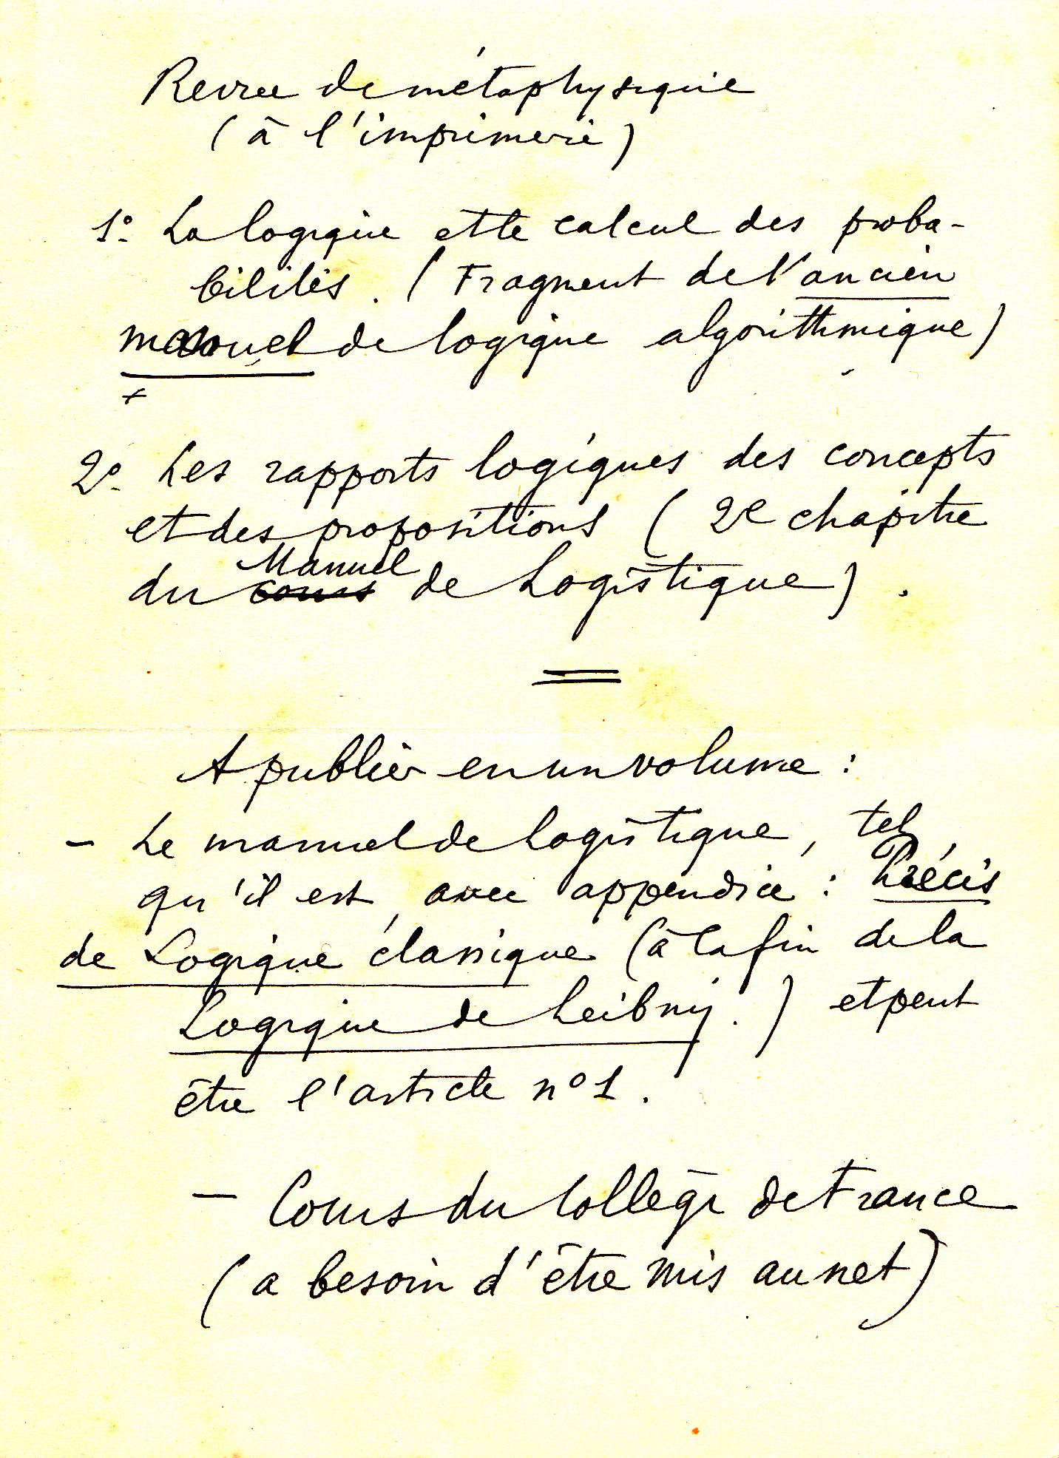

Slide 43
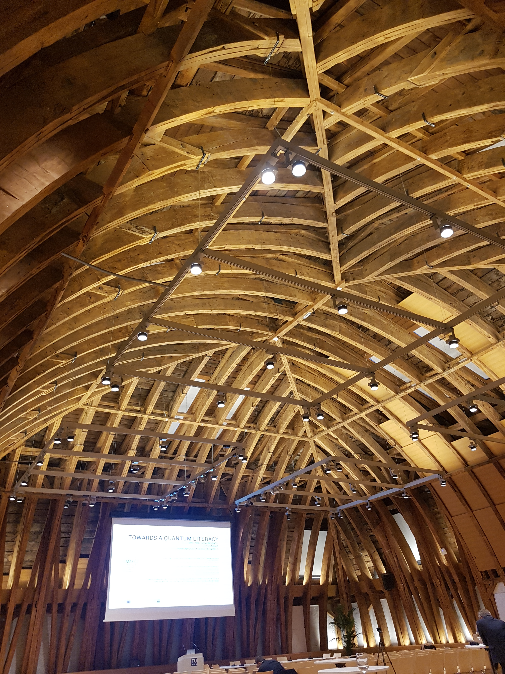
Thank you very much for your attention

