Slide 1
Fairs and merchant networks: new data and features of the CoMOR database
Marta gravela – università di torino

Slide 2
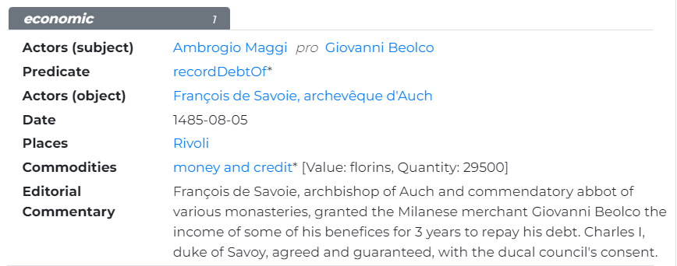
MILANESE MERCHANTS (Lyon, 15th c.)
financial agents who do not appear in the studies on Milanese merchants
New people
New actions → predicates

Slide 3
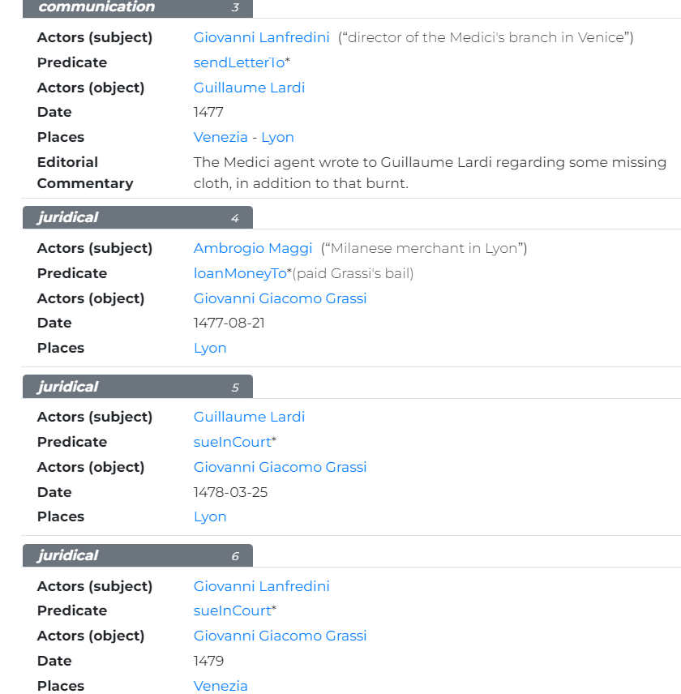
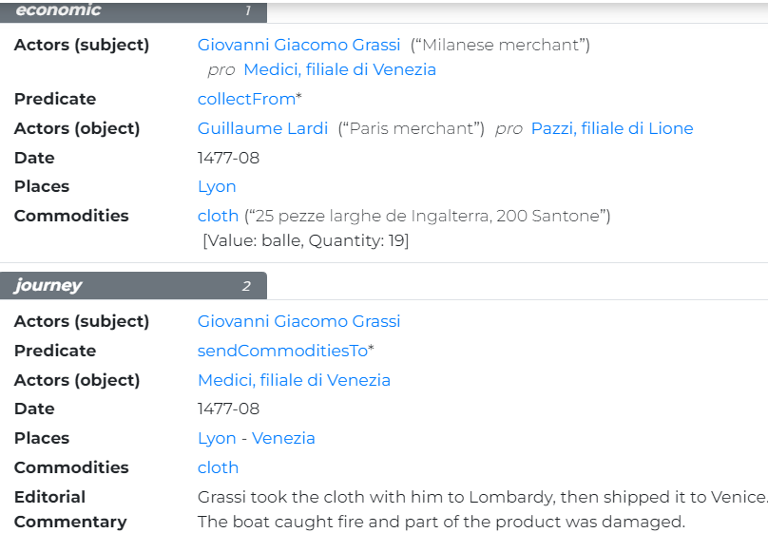
SRC123, SRC232
Ambrogio Maggi: financial agent of various Milanese merchants in Lyon

Slide 4
Vicentine silk merchants (Lyon, 16th c.)
Names of scarcely known merchants of great importance: e.g. in the 1550s-1580s the Pellizzari sent to Lyon silk for the value of 70-80000 ducats each year before going bankrupt (SRC226)
Merchant networks: trade with other Italian merchants (Milanese, Florentine) as well as Lyon merchants
Investment in local silk production in view of Lyon fairs
Indication of storage facilities: e.g. Antonio Maria di Anselmo Bonanome stored silk 'in Molitello appresso diece over dodice miglia a ditto Lion in el fontico del sopradetto messer Antonio Maria’ (SRC229)
SRC225

Slide 5
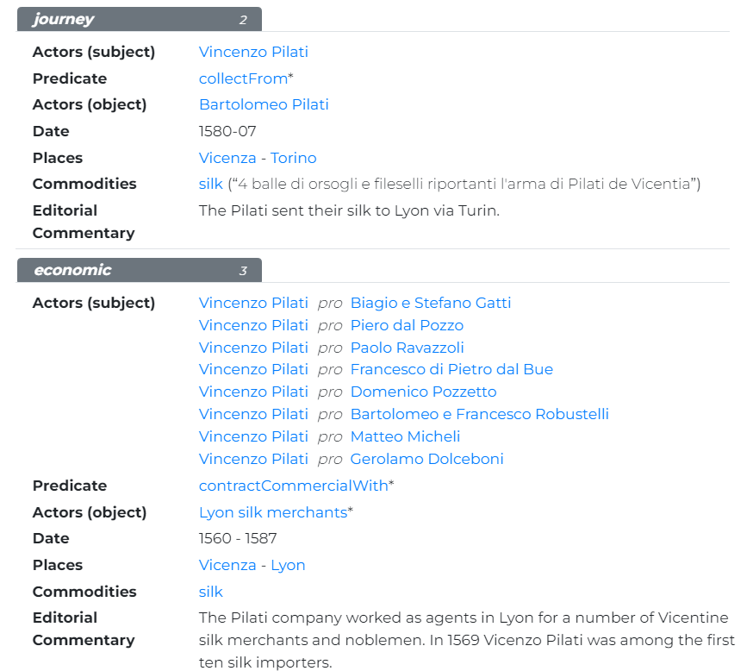
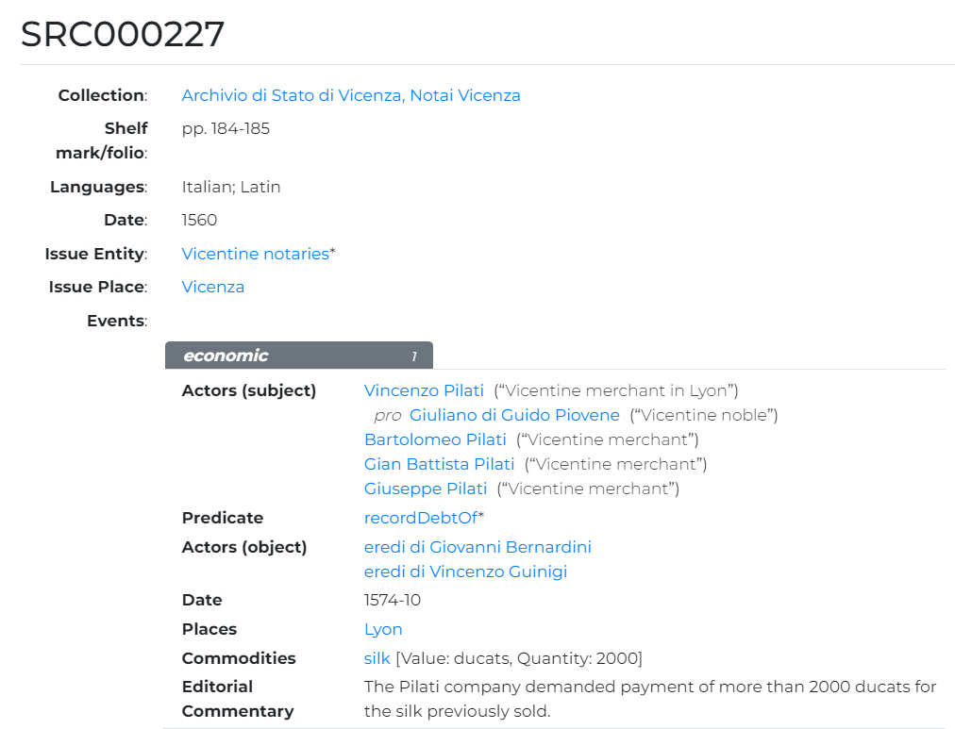
Vincenzo Pilati, silk merchant
Routes

Slide 6
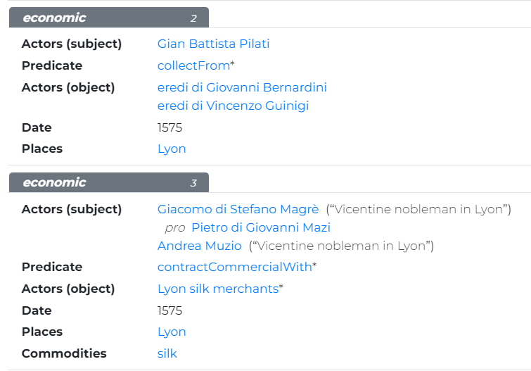
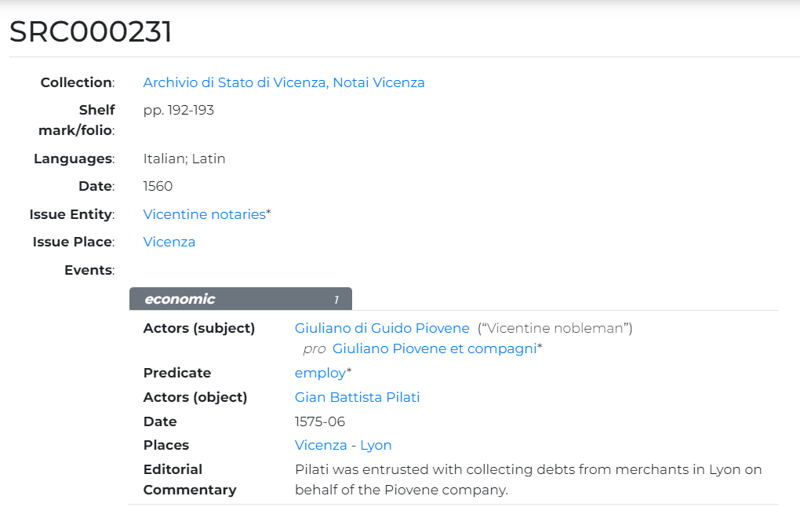
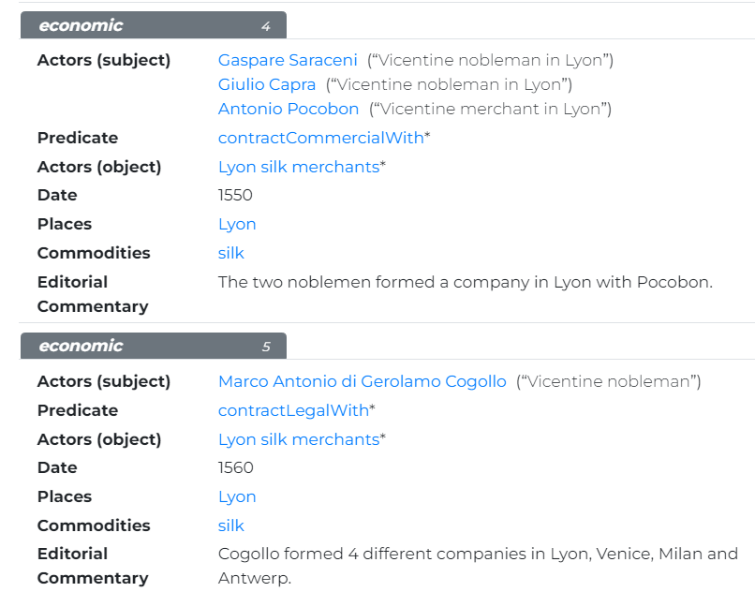
Vicentine silk merchants
New companies
Involvement of Vicentine noblemen

