Slide 1
Some characteristics of gbaya ideophones
Paulette Roulon-Doko
LLACAN (UMR 8135 du CNRS)-INALCO-EPHE

Slide 2
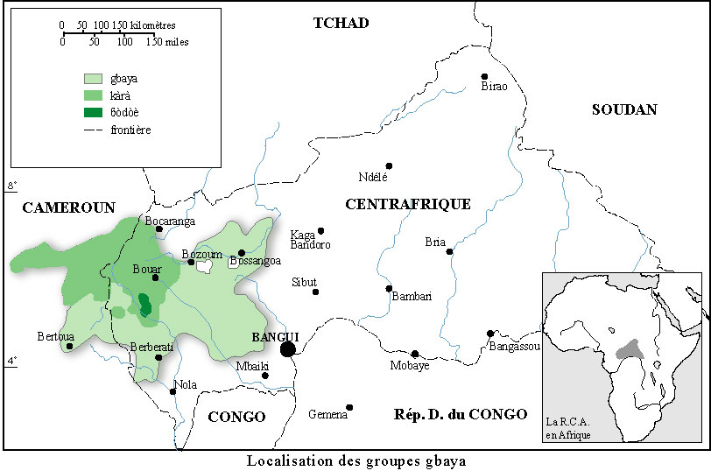
Localisation of gbaya languages
Gbáyá ɓòdòè, an Ubanguian language (Niger-Congo family) spoken in the northwest part of the Central African Republic

Slide 3
Ideophones: a subcategory of adjectives
An open class that constitutes the numerically most important subgroup of adjectives (2040 items, that represent 30% of the lexicon).
Original terms that cannot be related to other terms in the language.
They use the existing phonological potential by giving it a different distribution and have many reduplicated forms.
They can express all semantic domains, and are used in all types of speech.
On the syntactic level, they behave in the same way as two other main subcategories of Adjectives.
They constitute a part-of-speech class that I call ‘adjective-adverbs’ (AA).

Slide 4
Syntactic uses of the various subcategories of Adjectives
Specificities ↓ | Subcatégories of Adjectives
 | A (21) | VA (167) | AA (2040) | RA (89) | < N (21)
Semantism of quality | primary state | resultative | all qualities | relational | prototype
Expressive modulations |  |  | x
Nominalization (-à) | x | x | x | x | x
Attributive use | x | x | x | x | x
Placed before Noun | x | x | x [+ tr] | x | x
Absolute superlative |  | x
Modified by aug / dim |  | x
Placed post Noun | x [nɛ̀ X.mnlz] |  | x
Adverbial use | x [nɛ̀ X.mnlz] |  | x
Predicative uses
Post copula verb ʔɔ | x [nɛ̀ X.mnlz] |  | x
In junxtapositive predication A/B | x [nɛ̀ X.mnlz] |  | x / x [nɛ̀ X.mnlz]
Holophrastic use |  |  | x [lh.AA]
Abbreviations:
A adjective, VA Verbal adjective, AA Adjective-adverb, RA relational adjective, N noun, AUG augmentative, DIM diminutive, TR Tonal raising, NMLZ nominalisation

Slide 5
The tonal structure of AAs
The lexical tonal pattern of AA is either high or low, it remains unchanged in most uses. There are three cases of syntactic regular changes.
In attributive use, when placed before the noun, the tonal pattern is raised (rt). The high-scheme AAs are not modified, the low-scheme AAs are modified as follows: (ɓɔ̀rɔ̀ŋ and ɓɔ̀m-ɓɔ̀m)
A HL scheme on AAs in adverbial use as a specific mark of topicalization.
A LH scheme can characterize the holophrastic use of any AA, whatever its lexical tonal pattern
 | 1. | ɓɔ̀rɔ́ŋ | zùmɛ́ | 2. | ɓɔ̀m-ɓɔ́m | tɛ̀mɛ́
 |  | long and pointed:rt | head:mt:2sg |  | swollen on small piece:rt | body:mt:2sg
Egg-shaped head Swollen and small body

Slide 6
Overview on AAs syntactic uses
Occurrences of AAs in a reference corpus of spontaneous speech of 4.5 hours.
I will present the holophrastic use which is a specificity of AAs
Syntactic uses : | Nbr | % | Constructions | % in each use
Attributive use | 20 | 7,2%
 |  |  | Placed before Noun (Dt Dé) | 9 | 45%
 |  |  | Placed post Noun (Dé Dt) | 11 | 55%
Adverbial use | 219 | 79,1%
 |  |  | At the beginning of a clause | 58 | 26,5%
 |  |  | At the end of a clause, post verbal group | 161 | 73,5%
Predicative use | 38 | 13,7%
 |  |  | Post copula verb ʔɔ | 27 | 71%
 |  |  | In juxtapositive predication A/B | 3 | 7,8%
 |  |  | Holophrastic use | 8 | 21,2%
Total | 277 | 100%

Slide 7
Holophrastic use of AAs
The ability of AAs to function as complete, autonomous utterances. A LH scheme caracterizes this use.
a) AA in a subordinated clause (gbèngèm « resonating loudly »)
She walks as usual, so that it resonates loudly. (ankle bells)
b) Clause with juxtapositive predication (bììt « in short pieces »)
The ears of animals make a bunch of short pieces
ʔḭ᷅ḭ́ bá kú sɔ́k ʔòwáà wɔ̀ɔ́ŋ Everyone takes his leg, plugs it in, and off they go.
Unlike AAs, onomatopoeias are never used holophrastically, they are always placed after the verb "to do" or certain speech verbs.
Interjections, on the other hand, have a holophrastic use when they are used in response, in interlocution.
Finally a few rare adverbs have a holophrastic use (hɔ̰́gɔ̰́)
ʔà̰ | nɛ́ | kàá | nɔ̀ | kà | gbèngém
3sg | inac:go | rep-add | walk | so that | lh:resonating loudly
zěr | sàɗì | hɛ̰̀ | bìít
ear:mt | animal | prox | lh:in short pieces

Slide 8
Semantic domains of AAs
On the basis of the 2235 AAs collected (cf. Roulon-Doko, 2008), I was able to distinguish that they supported very varied semantic domains.
Group A 15% - 17% Group B 5% - 8%
Group C 1% - 5% Group D 0,5% - 0,8 %
Semantic domains | Nbr. | Semantic domains | Nbr. | Semantic d. | Nbr.
movement | 383 | quantity | 93 | fill_in | 24
size-shape | 352 | drink-eat | 88 | cooking | 22
position-attitude | 198 | color | 86 | wet-dry | 19
occupation_of_space | 178 | feeling-sensation_speech | 82 | how_to_tie | 18
sound | 178 | speech | 46 | hot-cold | 18
fall-break-flow | 136 | pain | 46 | swelling | 17
aspect | 125 | opening | 39 | hit | 17
consistency | 109 | cleanliness-dirt | 30 | smell | 15
 |  | light | 29

Slide 9
Organization of the meanings
AAs support certain types of meanings on a regular basis, such as: 1) the quantitative degree such as very, too, a little, etc., 2) a relationship to a specific medium (men, round objet, etc.), 3) an association of meanings, often two, sometimes more than two.
For example, « big » can be expressed by an A "big, important" gbà - an essential value -, by an VA "big, big" gásá - a value defined at the base as expressing the result of a process (< gasi "to grow") -, and five AAs which take into account various values built from 'big'.
AA | Meaning | Specificity
rùkpùtù-rùkpùtù | too big, too tall | degree
tàlàngàzàŋ | big for a child of 10-12 years old | specific medium
hèr-ngèzèŋ | big and tall | 2 values
kpɛ́ngɛ́m | not too big and straight | 2 values
zòlòɓòtò | big and heavy | 2 values

Slide 10
AAs for ‘cold’
AAs for ‘hot’
AA | Sens | Spécification
ɓún-ɓún | cold | neutral
yìngbìngbì | very cold [sp. house ] | specific medium
pɔ̀sɔ̀p | refreshing | degree
ɲɛ̀ɛ̀ | cool | degree
dɔ̀mìì | quite cool, chilled | degree
ngìt-ngìt | very cold | degree
AA | Sens | Spécification
kpóróró | hot | neutral
fáɗáŋ | warm | degree
gìwìŋ-gìwìŋ | warming up | degree
fátátá | well heated | degree
kpóyóyó | very hot | degree
gɛ̀zɛ̀-gɛ̀zɛ̀ | overheated | degree
hìò-hìò | burning, feverish | degree
gòsì-gòsì | warm [sp. house] | specific medium
wòsì-wòsì | warm and cozy [sp. house] | specific medium
kpóngóngó | very feverish [sp. body] | specific medium

Slide 11
AAs for « soft »
tactile contact |  |  | Taste contact
soft without spring |  |  | specific for pastes (pumpkin, sesame…)
ɓɔ̀l-ɓɔ̀l | soft |  | mbɔ̀làɛ̀-mbɔ̀làɛ̀ |  | in soft mass
mbɔ́r-mbɔ́r | uniformly soft |  | tùlàì-tùlàì |  | ramolli [casava dough]
yɔ̀kɔ̀-yɔ̀kɔ̀ | softened |  | ɓùtùkùyù |  | softened [oleaginous paste]
yɔ̀kɔ̀tɔ̀ | dampened |  | hɔ̀wɛ̀ɛ̀ |  | too soft
tṵ̀fɛ̰̀ɛ̰̀ | softened by cooking |  | yɔ̀lɔ̀p-yɔ̀lɔ̀p |  | smooth and flowing
ɓùlàɛ̀ | soft and white |  | specific for meat and tubers
soft with spring |  |  | mùdɛ̰̀-mùdɛ̰̀ | tender
fùkàm | elastic |  | mùɗɛ̀kɛ̀ | melt-in-the-mouth
gbɔ̀ɔ̀l | flange |  | yɔ̀r-yɔ̀r | delitescent by cooking
doughy |  |  | ʔɛ́tú-ʔɛ́tú | too soft
hèɗè-hèɗè |  | in paste | fùfùp ; fùp-fùp | spongy
bɛ̀tɛ̀-bɛ̀tɛ̀ |  | in liquid paste | specific for leaf-vegetables
dèkpè-dèkpè |  | in a muddy mass | mbɔ̀r-gɔ̀ɗɔ̀ | smooth
hɔ̀làì |  | soft as shit | hɔ̀r-gɔ̀ɗɔ̀ | very creamy
 |  |  | rɛ́kɛ́-rɛ́kɛ́ | too creamy

Slide 12
Conclusion
Thus, AAs carry semantic values that are always related to a specific notional framework in which the elements considered relevant are defined. This is difficult to translate into a single term in the target language and produces in translation various meanings, each of which has one or more specificities whose unity is difficult to identify. Thus, for example, the expression of degree, which is often rendered by morphological procedures, is here largely lexicalised, producing for each degree a term of its own without relation to any other term in the language. The same is true of the multiplicity of AAs to express the same value, but in different media, which reveals the speakers' conceptualisation of the world.
The holophrastic use of AAs confirms that they have a well-defined meaning, sufficient to reconstruct the situation of which they express a specific characterisation.
To conclude, AAs which are the largest group of gbaya adjectives, offer a great lexical variety representative of all culturally conceptualised semantic domains.

