Slide 1
Feminist reclaiming of
water metaphors
Ann Coady
Université Paul-Valéry, Montpellier
ann.coady@univ-montp3.fr
Notes:
Women’s symbolic relationship to water is as old as recorded history.
A great number of origin myths conceptualise the world as springing forth from water, very often in the form of a woman.
In Ancient Egypt, for example, the goddess Nu (lit. “the watery one”) is the personification of the primordial watery abyss from which all life arose.
Water has been personified as a female figure for 1000s of years.
However, the metaphor that connect water and women have changed shape and been used in various ways over the centuries.

Slide 2
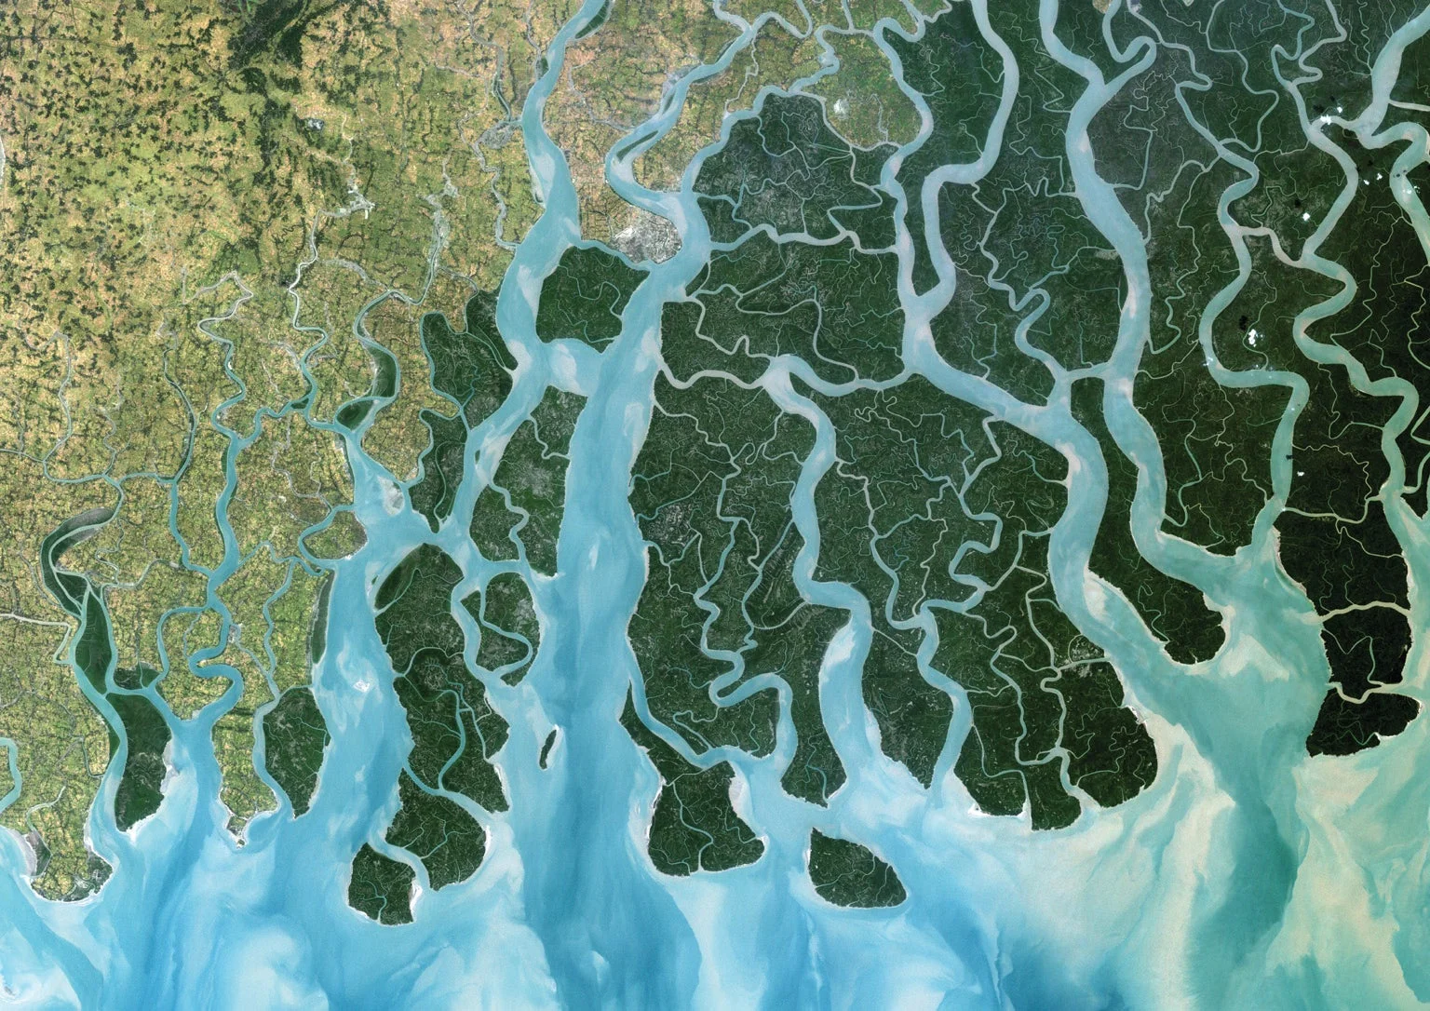
How both water and women have been conceptualised as resources to be exploited.
How feminists have reclaimed water metaphors as a symbol of subversive and indirect resistance.
How they are currently spearheading an epistemological revolution in our conception of water itself.
Notes:
In my presentation I propose to examine 3 main points…

Slide 3
Theoretical framework:
Feminist theory + cognitive metaphor theory
Corpus:
Feminist literature + feminist historiography + critical geography articles + policy documents on water scarcity.
Methodology:
Charteris-Black (2004). Corpus Approaches to Critical Metaphor Analysis.
Notes:
Critical b/c I begin from the assumption that metaphors play an essential role in how we understand reality and that this construction of reality is not neutral.
It benefits some groups over others. My analysis is therefore critical in the sense that it highlights the gender power dynamics involved in water metaphors.

Slide 4
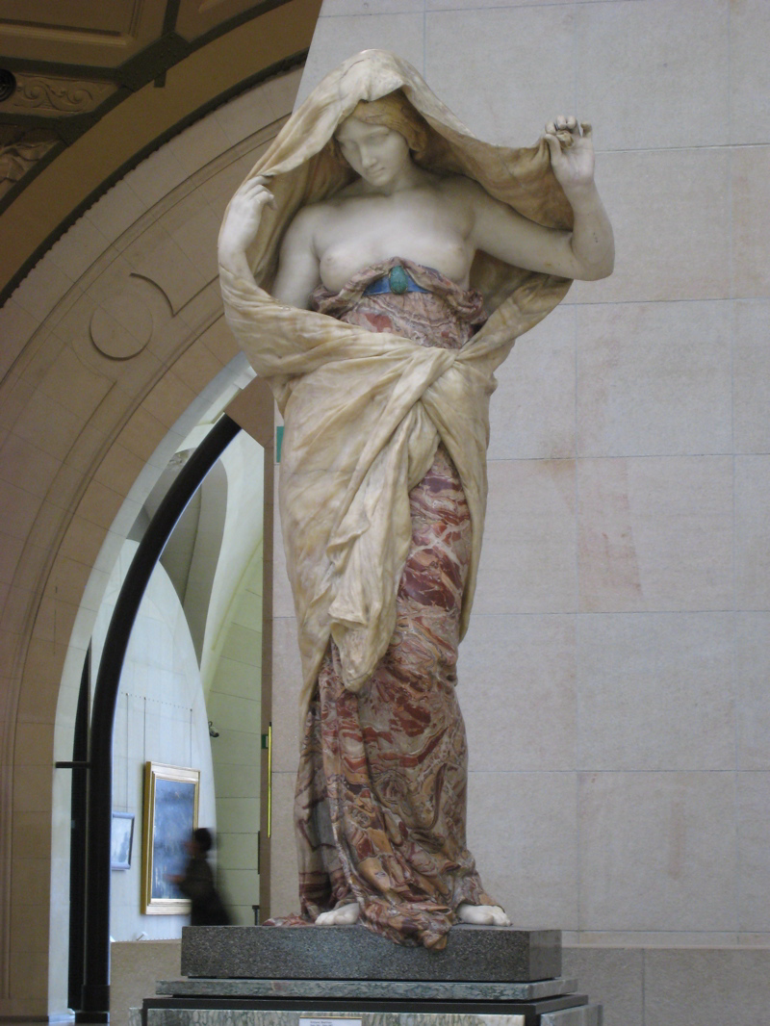
WATER IS (+ NATURE in general) A WOMAN (—> a resource to be exploited)
Nature Unveiling Herself Before Science (1899), Louis-Ernest Barrias
Musée d’Orsay, Paris
Notes:
PART I
Because water is part of the natural world, women have been traditionally associated with Nature as a whole, not just water.
The Scientific Revolution (that took place during the 16th & 17th C) fundamentally changed our conceptualisation of Nature (and therefore water).
Nature went from being conceptualised as a nuturing mother, “a living, growing, self-actualizing being” (Merchant, p170) to a “bride” (p.9), or a “common harlot” (p170) whose “primary function was to comfort; nurture, and provide for the well-being of the male.” (p;9).
Science (dominated by men) would be the tool to enable men to extract Nature’s secrets so that she could be dominated and exploited.
This statue is a perfect example of this metaphor. It is called “Nature unveiling herself before science” and is an excellent example of what feminist film theorist Laura Mulvey has termed “the male gaze” (= seeing the world through the eyes of a heterosexual man).
If Nature is personified as a half-clothed, timid, submissive woman, who is science? Although it is not explicit, we can guess that science would be personified as “a fully clothed man, whose gaze […] is bold, direct, and keen, the penetrating gaze of intellectual and sexual mastery” (Literary critic Elaine Showalter 1992: 145). So, if NATURE IS A WOMAN, the corollary is that SCIENCE IS A MAN. Leading to the common stereotype of women being closer to nature and more intuitive, and men being more rational, more scientific.

Slide 5
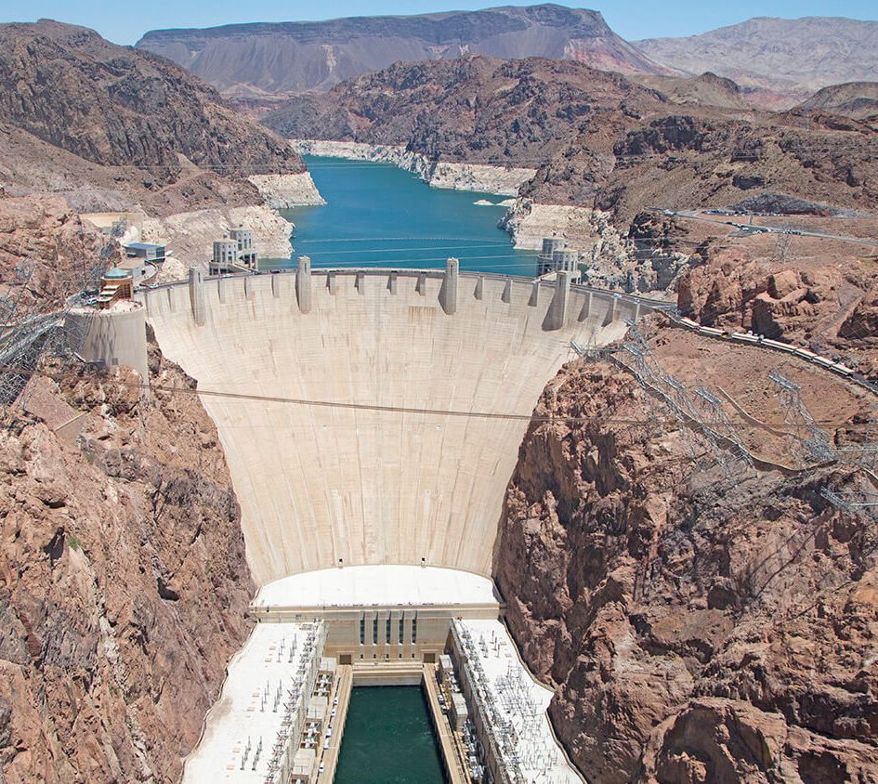
“the belief that nature ought to be controlled — indeed could be controlled — through the melding of scientific study, large-scale technology, and appropriate government structures. The utilitarian aspects [...] came from a deeply ingrained belief among specialists in both countries that water had an obligation to humanity, indeed, a moral duty, to fulfil many missions before it flowed wastefully into the sea.” Josephson, Paul (2002: 68). Industrialised Nature, quoted in Goatly, Andrew (2007: 291). Washing the Brain.
The Hoover Dam, Arizona-Nevada border, USA
Notes:
Once science had provided the tools to better understand and therefore
control water, men could build dams and divert rivers. They could control water. The large dam-building projects in the USA and USSR post-WWII were based on
* QUOTE
Feminists have highlighted the link between this view of water as a “neutral, and passive resource […] as an inanimate commodity to be regulated and managed” (Hayman, 2012: 23), and the way that the female body has been conceptualised in similar ways.

Slide 6
“I can’t think of myself, my body, sometimes without seeing the skeleton: how I must appear to an electron. A cradle of life, made of bones; and within hazards, warped proteins, bad crystals jagged as glass. Women took medicines, pills, men sprayed trees, cows ate grass, all that souped-up piss flowed into the rivers.”
“I cannot avoid seeing, now, the small tattoo on my ankle. Four digits and an eye, a passport in reverse. It’s supposed to guarantee that I will never be able to fade, finally, into another landscape. I am too important, too scarce for that. I am a national resource.
Atwood, Margaret (1985). The Handmaid’s Tale.
Notes:
Margaret Atwood, draws on this link in The Handmaid’s Tale:
Offred, the main character, says:
* 1st QUOTE
Offred’s body was once a cradle of life, just like water. Humans’ over-exploited and pollutes the rivers, which has resulted in the pollution of human bodies and a dramatic rise in infertility.
This exploitation is then transferred to women’s bodies that have a duty to produce children for the nation.
Women’s bodies have become a national resource
* 2nd QUOTE

Slide 7
Conceptual metaphor: WATER IS A WOMAN
Metaphor | Aspects of target (water) | Aspects of source (women / the female body) | Potential inferences
WATER (NATURE in general) IS A WOMAN (therefore SCIENCE / CULTURE IS A MAN) (Nature Unveiling Herself Before Science, Barrias 1899) | Nature holds many secrets to be explored. Science is the tool which will allow men to conquer nature (e.g., dam-building projects). | The female body was/is a mystery to science. Women’s behaviour is a mystery to men. | Women’s bodies are there to be explored, enjoyed, exploited by men. Women are passive (men are active). Women are intellectually inferior, more intuitive (men are more intellectual, more logical, more scientific).
WATER IS A NATIONAL RESOURCE (“my body […]. A cradle of life […]. I am a national resource.” (Atwood (1985). The Handmaid’s Tale. | Water is a national resource that has a duty to sustain human life and growth. | The female body is (usually) capable of carrying and giving birth to children. Nations need population growth (or at least stability) to retain political and military power. | It is women’s duty to the nation to have babies.
Notes:
SUMMARY OF PART I
Conceptual metaphor = WATER IS A WOMAN
Source = women / the female body
Target = water

Slide 8
FEMINIST RESISTANCE IS WATER
“Because you linguist women don’t go in a straight line from A to B to C. You go this way a while, and that way a while, and this way again, instead. And you go gently and quietly. But you get there, always! You meander, as water meanders, headed for the oceans … and then you arrive.”
Haden Elgin, Suzette (1994). Earthsong.
“I knew it would do no good to try to eject my unwanted suitors, or to bar the palace doors against them. If I tried that, they’d turn really ugly and go on the rampage and snatch by force what they were attempting to win by persuasion. But I was the daughter of a Naiad; I remembered my mother’s advice to me. Behave like water, I told myself. Don’t try to oppose them. When they try to grasp you, slip through their fingers. Flow around them.”
Atwood, Margaret (2005). The Penelopiad.
Notes:
In my second part, I’d like to focus on how feminists have reclaimed water metaphors and used them as a symbol of resistance.
Many feminist writers have used the metaphor of water in order to invoke a particular kind resistance, which is indirect and subversive.
In her feminist dystopian novel Earthsong (1994), Suzette Haden Elgin describes a world in which women have no power, no legal rights, and are completely oppressed by men. One of the characters (who, not coincidentally is a Native American) names a group of linguist women the “Meandering Water Tribe”. When asked why, he replies,
* 1st QUOTE
Margaret Atwood also draws on the same idea in The Penelopiad (2005). When Penelope is trying to protect herself from her suitors’ unwanted advances, she remembers the advice of her mother (who was a Naiad, or water nymph)
*2nd QUOTE
Interestingly, the word “naiad” derives from an Ancient Greek word meaning “to flow” or “running water”. Here water is not static, it is dynamic and fluid and hard to contain.
On the one hand, this is good advice for feminists and for women in general. When in a powerless position, use more indirect, subversive techniques to achieve your goals.
The advice to be like water has its practical utility, but I think that Atwood is also criticising a world in which women have to use these tactics b/c they are in a non-dominant position.
We live in a world in which women have to be careful about how they resist men. Often if they openly resist, things can “turn really ugly” (Atwood). In a world where women were more powerful, they wouldn’t need to employ such tactics.
Not just women using these subversive tactics, but other non-dominant groups are also using the metaphor of water as resistance.

Slide 9
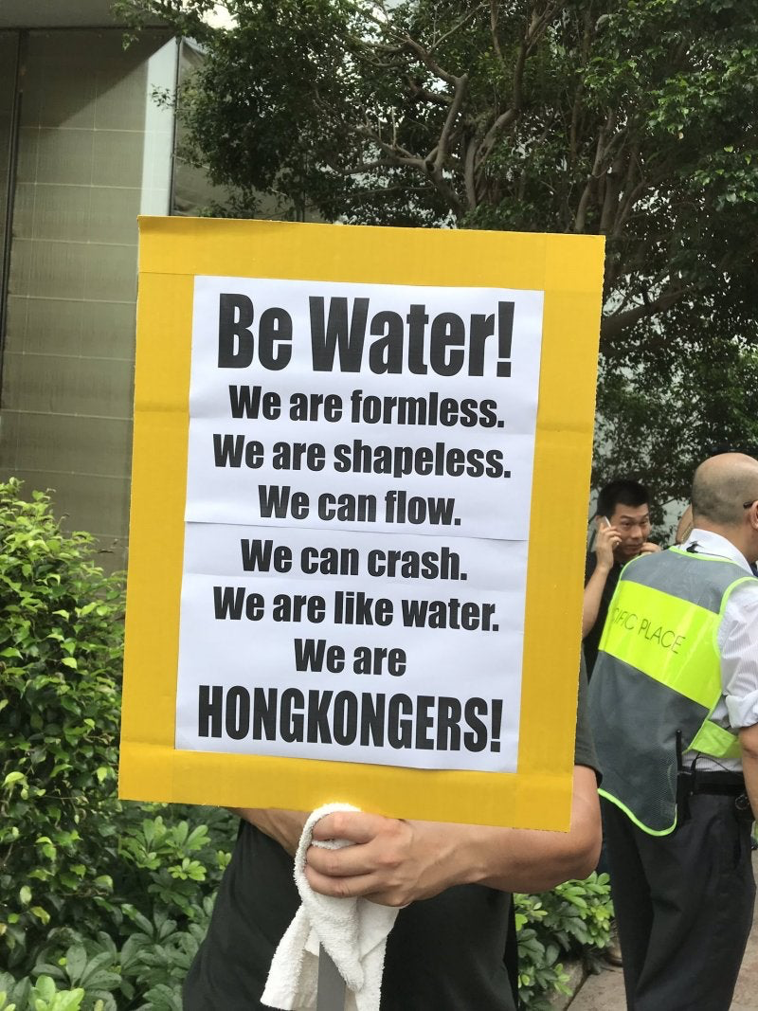
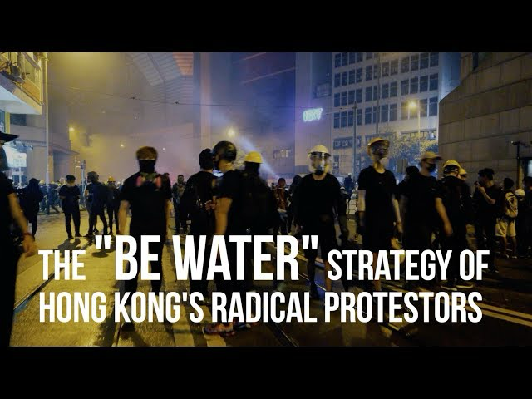
Notes:
For e.g., this was an important metaphor during the « be water » demonstrations in Hong Kong in 2019-20 in response to the Anti-Extradition Law Amendment Bill.
In order to avoid repression, activists adopted a “be water” strategy. They were strong like ice; fluid like water; they gathered like dew; and scattered like mist (Anderlini 2019, cited in Matthews 2023).
These water metaphors were used to shape the strategy of the protest, becoming a self-fulfilling prophecy.
Thus demonstrating the very material consequences of the kinds of metaphors we choose to use.

Slide 10
Conceptual metaphor: FEMINIST RESISTANCE IS WATER
Metaphor | Aspects of source (water) | Aspects of target (feminism) | Potential inferences
FEMINIST RESISTANCE IS WATER (“Behave like water, I told myself. Don’t’ try to oppose them. When they try to grasp you, slip through their fingers. Flow around them.” (Atwood (2005). The Penelopiad) | Water is sometimes difficult to hold / contain. | Many women face oppression and discrimination. If they fight back openly and directly, they will be punished. | When in a powerless position, adopt subversive tactics to achieve one’s goals.
Notes:
WATER IS A WOMAN
Like my first part, the
Source = women / the female body
Target = water

Slide 11
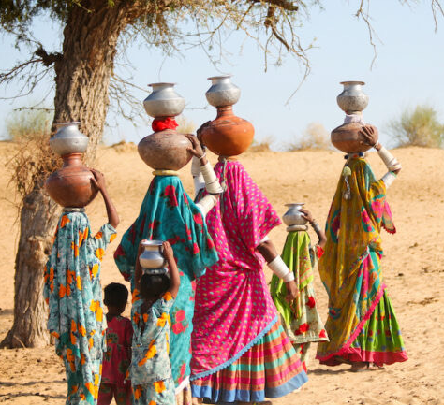
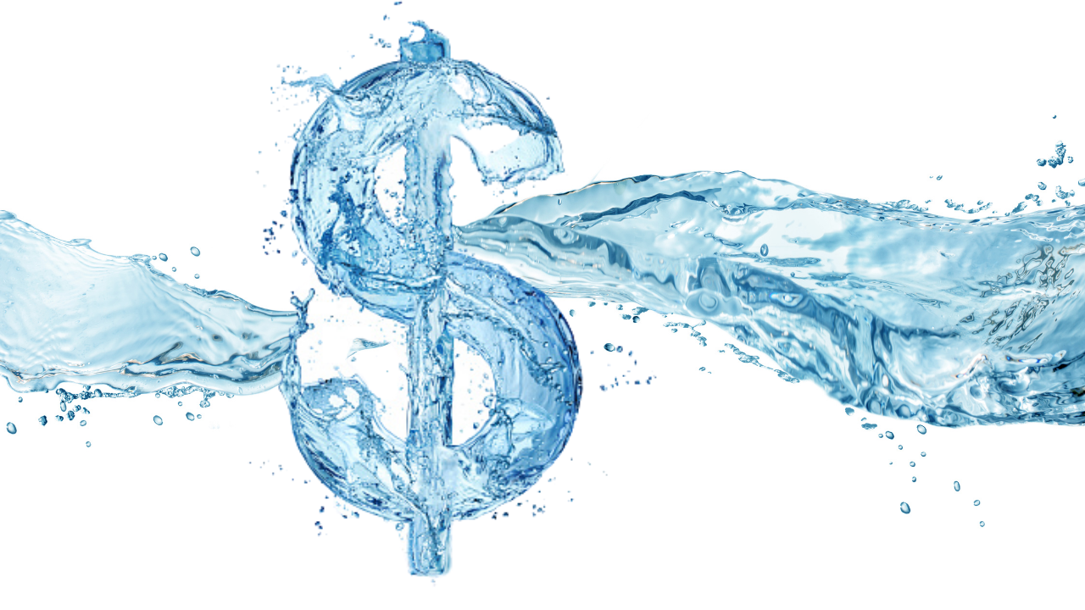
WATER IS
A COMMODITY
“We know water is the source of life. But it can also be a source for portfolio diversification. Like gold and oil, water is a commodity — and it happens to be rather scarce nowadays. So, as with any other scarcity, the water shortage creates investment opportunities.”
https://www.investopedia.com/articles/06/water.asp
Notes:
In my final part, I’d like to focus on the current water crisis and how feminists are actively involved in trying to change the metaphors we use to talk about water itself.
Metaphors themselves = the “battle field”
Why are feminists interesting in water scarcity?
B/c it disproportionally affects girls and women. Women and girls are the ones who walk for miles to collect water for their families.
Can’t go to school
Physically very demanding
Often face many dangers along insecure routes where they may face sexual harassment and violence.
Water scarcity is now therefore firmly on the feminist agenda.
Part of the problem is climate change, but another part is the way that multinational corporations now own water. Water is commodity to be bought and sold, invested in.
* QUOTE
The problem, according to many researchers is what they term “modern water”. The idea of Modern water emerged around the Industrial Revolution in the 18th C (which the Scientific Revolution paved the way for). Modern water is the “instrumentalisation [and commodification] of a universal resource.” (Matthews 2023) that is seen as a “source for portfolio diversification” rather than as a basic human right.
What feminists are currently trying to do is envisage new ways of thinking about our relationship with water, which are actually not that new at all but that go back to the premodern era.

Slide 12
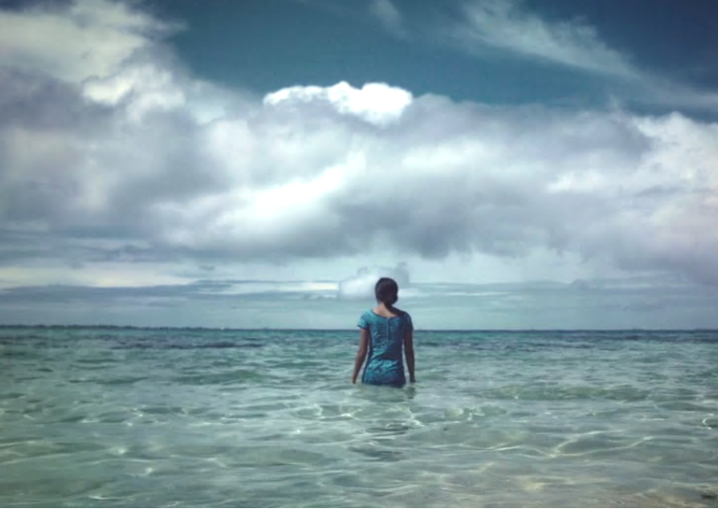
HUMANS ARE
BODIES OF WATER
“My body — like yours — primarily comprises water. My existence as a body of water is a biological fact, but living my embodiment as watery — embedded in a world that I share with other human, animal, vegetable, geophysical and meteorological bodies that also comprise water — has other implications as well. We are all bodies of water.”
Neimanis, Astrida (2013: 24). Bodies of Water.
Notes:
One particular movement in feminism, called “hydrofeminism” has questioned what consitutes our bodies in the first place. Our human bodies are, after all, made up of about 60% water and Lakoff and Johnson (1980) already “recognised the significance of the human body for mapping metaphors of all kinds” Matthews (2023: 1835).
So bearing this in mind, some feminists are asking what would be the consequences of reconceptualising the human body differently. Not as separate from water, but as a body of water.
* QUOTE
This is really interesting b/c we are now not strictly in the realm of metaphor. We now have one foot in metaphor and one in the literal world b/c we are literally 60% water.
There is an attempt to blur the boundaries between categories, so that we forced to reevaluation our relationship with other beings in the world and realise that “we are not separate from our 'environments' [… and that we have …] obligations to bodies beyond human ones.” (Neimanis 2013, p.25)

Slide 13
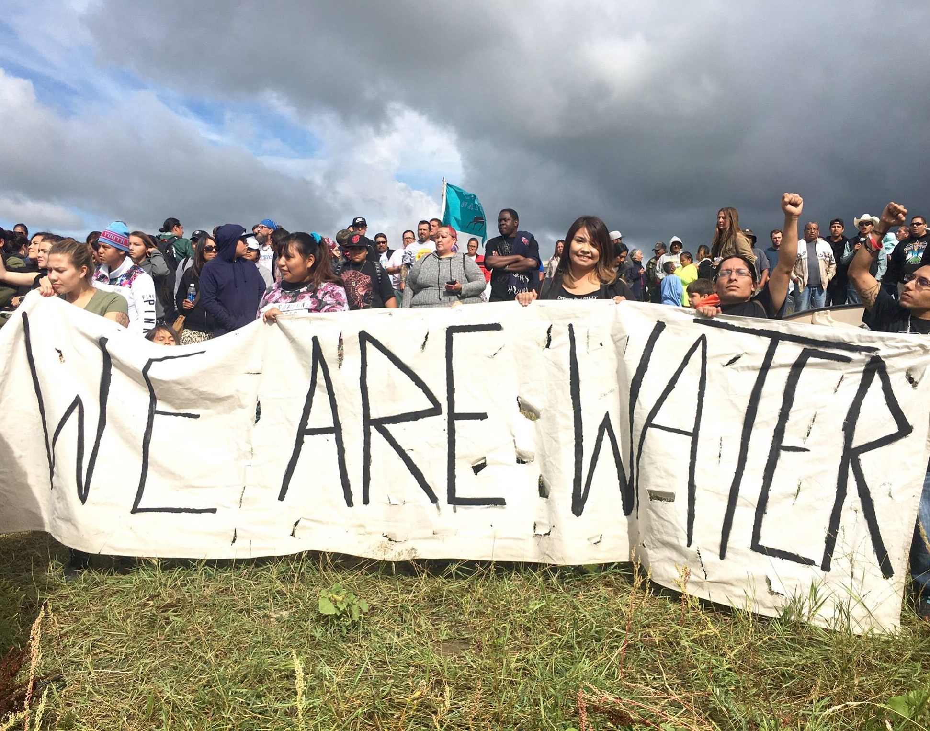
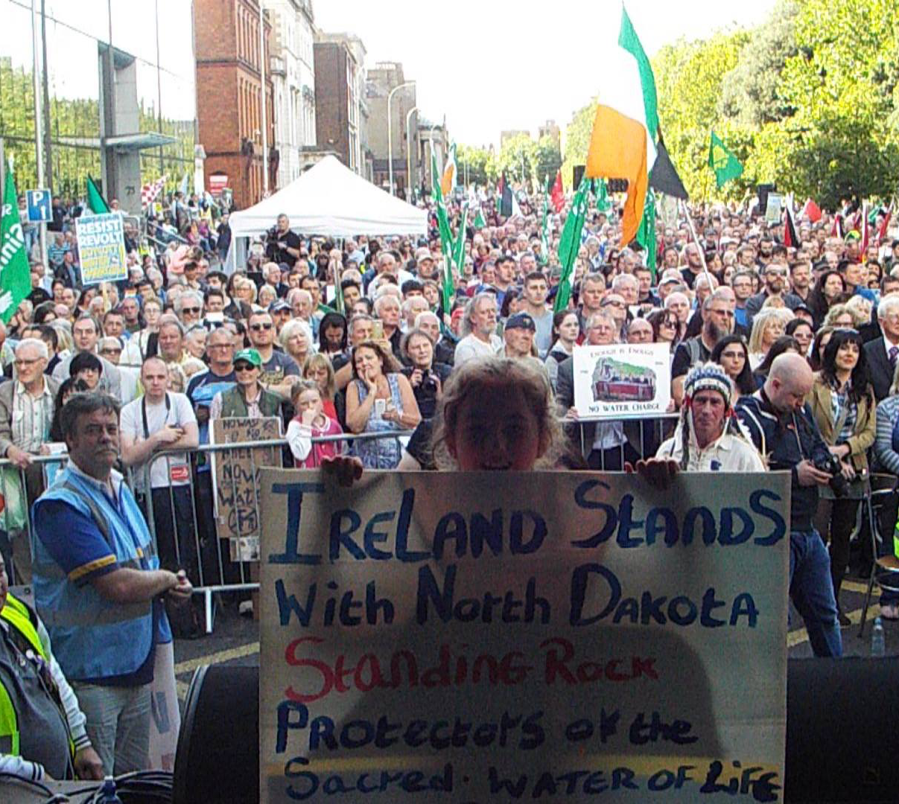
Ireland
Standing Rock, Dakota, USA
WATER IS
A UNIFIER
Notes:
This metaphor was used by ecofeminists in 2016 with the protest at Standing Rock, in the USA. The state govt had approved a 1000-mile pipeline which would lie just north of Standing Rock Sioux Reservation.
Environmentalists and Native Americans were concerned about the impact the pipeline would have on their environment and in particular on the water that ran thru their land.
In order to highlight this important connection, they used the slogan “we are water”.
This highlights a conception of water as something that we are not completely separate from. For this community, water part of an interconnected living organism that should be protected.
* The metaphor of HUMANS ARE BODIES OF WATER has resulted another metaphor: WATER IS A UNIFIER
** The resistance at Standing Rock and the metaphor “we are water” has had a profound international effect resulting in network-building between the Native American water protectors and Irish water activists.
Thus transforming water into “a mediator of new solidarities” (Matthews 2023), or “a unifier”.

Slide 14
Conceptual metaphors:
WATER IS A COMMODITY + HUMANS ARE WATER + WATER IS A UNIFIER
Metaphor | Aspects of source | Aspects of target | Potential inferences
WATER IS A COMMODITY (“it can also be a source of portfolio diversification” Investopedia) | Commodities can be contained, bought and sold. | If water can be contained (put into bottles, pushed through pipes…) it can be bought and sold. | Water is something that can be owned, therefore bought and sold. If you can’t afford it, you can’t have any. It’s not a right.
HUMANS ARE BODIES OF WATER (“We all bodies of water”. Niemanis (2013: 24). Bodies of Water) | Water is abundant on Earth. All living things are made predominantly of water and need it to survive. | The human body is at made up of about 60% water. | We should see ourselves, not as separate from nature, but as part of it. We are not at the top of a hierarchy, but part of an interdependent rhizomic structure. All elements in this giant living organism are dependent on each other. Polluting water = polluting humans = polluting water…
WATER IS A UNIFIER (Standing Rock and Ireland) | Something that creates a social link between humans and makes us responsible for each other. | Water is able to bond with many different elements. | Water plays an active role in society. It fulfils all kinds of important social and cultural roles that bind us and remind us that we are all in this boat (sinking ship?) together.
Notes:
In this part, I’ve spoken about 3 conceptual metaphors:
WATER IS A COMMODITY
HUMANS ARE WATER and
WATER IS A UNIFIER
There are lots of other metaphors that ecofeminists are also using, that I didn’t have time to talk about today, such as:
Water is a healer
Water is a teacher
Water is a storyteller
Water as a (non-human) possessor of rights.”
Water is heritage held in stewardship
Water is a (human) right
Water is a common good
Water is a sacred gift
What they all have in common is a “rejection of utilitarian, managerial attitudes toward nature”, a “refusal to accept definitions of water as a commodity” and a “call for an ethic in which humans see themselves as part of a “community of interdependent parts.” (Linton?)

Slide 15
CONCLUSION
Ann Coady
Université Paul-Valéry, Montpellier
ann.coady@univ-montp3.fr
Notes:
To conclude my presentation, I’ve looked at how water has been conceptualised as a female body. When Nature became simply a group of resources to be controlled and exploited by science, the female body was also able to be seen as a national resource.
But feminists have reclaimed water metaphors as a subversive tactic of resistance. This tactic is useful and practical but only makes sense b/c we live in a world where women are in a non-dominant position and will be punished for direct resistance.
What feminists are trying to do today is start off another epistemological revolution in the way that we conceptualise water and our relationship to it, including our very bodies. “Revolution” in its literal sense of re-volving, coming full circle, back to a premodern understanding of water as something that is part of us and something that we are part of.
Water is such a great metaphor b/c it’s so flexible.
It is the ultimate “shape shifter”. As a wave it can crash over you, as a current it can pull you along, as a trickle it can infiltrate into all kinds of nooks and crannies, as a drip it can wear away stone.
Thank you for listening!

Slide 16
References:
Atwood, Margaret (1985). The Handmaid’s Tale.
Atwood, Margaret (2005). The Penelopiad. Canongate.
Charteris-Black, Jonathan. 2004. Corpus Approaches to Critical Metaphor Analysis. Palgrave Macmillan.
Goatly, Andrew (2007). Washing the Brain: Metaphor and Hidden Ideology. John Benjamins.
Haden Elgin, Suzette (1994). Earthsong. Science Fiction Gateway.
Hayman, Eleanor Ruth. “Shaped by the Imagination: Myths of Water, Women, and Purity.” RCC Perspectives, no. 2 (2012): 23–34. http://www.jstor.org/stable/26240358
Josephson, Paul .R. 2002. Industrialised Nature: Brute-force Technology and the Transformation of the Natural World. Shearwater Books.
Lakoff, George & Mark Johnson (1980). Metaphors We Live By
Linton (2010). What is Water? The History of a Modern Abstraction. University of British Colombia Press. https://doi.org/10.59962/9780774817035
Matthews, Jamie. (2023). “Waves, Floods, Currents: The Politics and Poetics of Water in Social Movement Analysis”. Antiopode: 55(6), pp. 1822-1840. https://onlinelibrary.wiley.com/doi/full/10.1111/anti.12946
Merchant, Carolyn (1980). The Death of Nature: Women, Ecology, and the Scientific Revolution
Neimanis, Astrida (2013). “Feminist Subjectivity, Watered.” Feminist Review, no. 103: 23–41. http://www.jstor.org/stable/41819667
Showalter, Elaine (1992). Sexual Anarchy: Gender and Culture at the Fin de Siècle. Virago Press Ltd, 1992.

