Slide 1
European Association of Archaeologists 2024, Aug 2024, Rome (Italie), Italy Abstract # : 1262
. ALPHABETICAL NUMBERING (FROM THE ANTIKYTHERA MACHINE) USED IN MEDITERRANEAN TRADE SINCE THE BRONZE AGE AS A CONNECTING TOOL https://shs.hal.science/halshs-04597387
This presentation will focus on hypotheses concerning the birth of the alphabet
⟨halshs-04599865v3⟩ If you have any questions, please contact the following e-mail address: tyaglova.fayer.svetlana@sfr.fr
------------------------------------------------------------------------- NUMÉROTATION ALPHABÉTIQUE (DE LA MACHINE ANTICYTHERE)) UTILISÉE DANS LE COMMERCE MÉDITERRANÉEN DEPUIS L'ÂGE DU BRONZE COMME OUTIL DE CONNEXION Cette présentation se concentrera sur les hypothèses concernant la naissance de l'alphabet. Pour toutes questions, vous pouvez vous adresser au mail suivant : tyaglova.fayer.svetlana@sfr.fr
Tyaglova-Fayer Svetlana
Chercheur indépendant,
https://cv.hal.science/svetlana-tyaglova-fayer
Professeur en libéral

Slide 2
The birth of the alphabet (hypotheses, myths and legends) (https://shs.hal.science/halshs-04599865)
The emergence of the alphabet is a controversial topic, there are only more or less valid hypotheses. To learn more, read David Dieringer's book the "Alphabet". We agree with this author on the essential point: the alphabet is indeed a key that marks the history of humanity, like the birth of Jesus: there is a "before" and an "after". We hypothesize that the alphabet was formed at the beginning of the Bronze Age, during a period of intense commercial interaction: before becoming a writing tool, it was first used for accounting (in the form of alphabetical numbering). It is logical to think that the new skills (agriculture and animal husbandry), which provided more food than the tribes needed to survive, led them to trade.
- New skills for quantifying, negotiating and exchanging surplus production emerged. - When trade took on an ‘international’ dimension, a common accounting system had to be invented so that the whole world could agree on sales in a single system.
We call it the ‘ancestor’ of the alphabet and believe that it was born with the appearance of the first farmers (in Anatolia) who, following the demographic explosion, migrated in search of farmland in all directions (southwards and northwards), thus creating three cradles of writing: in the Balkans, Egypt and Mesopotamia. We put forward our hypothesis, which also has the right to exist, like others based on archaeological artefacts.

Slide 3
Introduction
Our starting point is the generally accepted hypothesis:
The alphabet is of Phoenician origin. The Phoenicians were a seafaring people, but their land was so poor that they were never farmers. However, this alphabet that they have recycled was created by farmers, because it contains letters that are the basis of words such as ox, stick for herding cattle, tool for cutting cereal stalks and so on.
Let's look at the hypothesis that the real phonetic alphabet (representing all the sounds of the language) was Greek. This is because we can see the presence of vowels: earlier versions only contained consonants. However, the Greeks completely lost track of the first letters of the alphabet: ALPHA (ox: ālefʾ), BETA (house: Bēth), GAMMA (camel: Gīmel), DELTA (door: Dāleth)...
Conclusion: the Greeks recycled (like the Phoenicians) one of the versions of the alphabet that we call ‘the ancestor’. We are therefore going in search of this ‘ancestor’ and putting forward our hypothesis, which also has the right to exist, as do others.

Slide 4
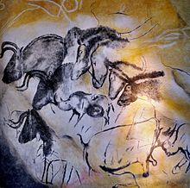
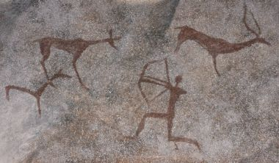
Contents: Our research began in the Upper Paleolithic with the first human creations in caves (drawings, sculptures and others, mainly of animals). Later, around the Neolithic period, these creations emerged from the ‘womb of the Goddess: Mother Earth’ to appear in broad daylight outside on rock faces around the representation of a human being . We believe that the evolution of humanity can be illustrated by the evolution of a child who, in the Paleolithic, draws the world he sees without separating himself from that world. Towards the Neolithic period, Sapiens discovered ‘I AM ME’, and we see the appearance of human beings and animal hunting scenes in which, unlike in the Paleolithic period, they fit in. This is, of course, how we see things
2
1
3
Image 1 : Drawings of Altamira (cave in Spain) - Image 2 Tarpans and woolly rhinoceros - in the Chauvet cave (south of France)
Image 3 Hunting animals of the primitive Neanderthal* - Image free of rights.
(this image of a Neanderthal is in a cave. We have not found any royalty-free images of Neolithic Sapiens).
*N.B. Following in the footsteps of Marylene Patou-Mathis, a prehistorian and director of research at the CNRS (for more details, see her lectures on the "Musée de l'Homme" website and her book "Neanderthal de A à Z", published by Allary Éditions in 2018), we do not believe that the Neanderthals were ‘primitive’. We even think that they were much further ahead of Sapiens in certain areas, as illustrated by this rock art (image 3). We even note a spiritual transfer between Neanderthals and Sapiens. In our view, the Bruniquel cave (176,000 years old) is proof of this, as we interpret the construction in this cave as a representation of the Great Goddess with her head and belly, inside which we can see two clusters of stalactites evoking breasts.

Slide 5
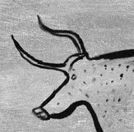
In any case, it took humanity several thousand years to move from the first drawings to pictograms and then ideograms, and a few thousand more to move on to writing proper. Initially, this writing consisted of several thousand symbols (like the Egyptian and Sumerian scripts), then a few hundred (syllabic writing: Minoan, Mycenaean and Cypriot), and finally phonetic writing (just a few dozen symbols).
This phonetic script is very practical, because it can be adapted to any language quite easily. For example, it took the Acadians at least two hundred years to adopt Sumerian script for their language.
The evolution of a drawing into the letter « A » in the phonetic alphabet (from the Paleolithic to the Iron Age)
6
7
4
5
Image 4 : Copy of a prehistoric drawing of a bull in caves such as Chauvet, Lascaux, etc. (between 30,000 and 17,000 BC)
Image 5 : Egyptian hieroglyph (around 3,000 BC) - Image 6 : Phoenician letter (around 1050 BC) - Image 7 : It's almost a modern ‘A’.

Slide 6
Our hypothesis on the birth of the alphabet :
In our opinion, the Göbekli-Tepe region (SCHMIDT, 2011) is the ‘0 point’ where nomads (gatherers and hunters) begin to transform themselves into sedentariness (farmers). Under favourable climatic conditions, they experienced a demographic explosion and migrated in all directions in search of new exploitable lands where they developed their know-how (already acquired in Anatolia, including the very first writing). In this way, we have three cradles of writing: in the Balkans, in Mesopotamia and in Egypt. We think they traded with each other: the spread of bronze technology suggests as much. In fact, the oldest bronze objects have recently been discovered in the Balkans (RADIVOJEVIC & al., 2013: 1030-1045).
This Balkan civilization may also be the origin of the oldest writing :
Shards dating back more than 7,000 years have been discovered bearing symbols on them.

Slide 7
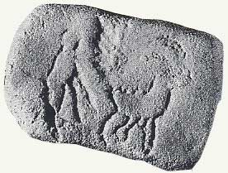
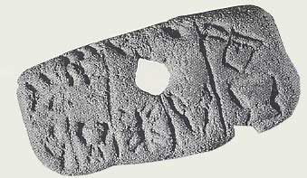
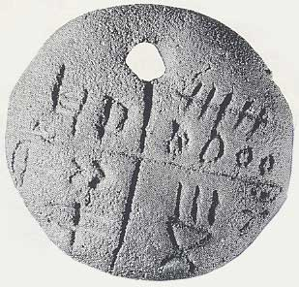
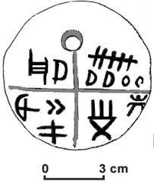
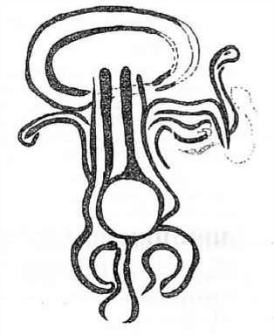
Many specialists believe that the first proto-writings appeared simultaneously and independently in Egypt and Mesopotamia during the 4th millennium BC (BAINES, 2004: 150-189 - WOODS, 2010: 15-25).
But they were obviously unaware of the existence of the Tărtăria (Tartary) tablets.
8
9
10
11
12
13
In the images: three famous tablets (Museum of History of Transylvania, Cluj-Napoca, Romania, images from the museum website, public domain) and the graphic reconstruction of the third (10-11). They lay at the bottom of what appeared to be a sacrificial pit, along with a few human bones. In our view, the first tablet depicts the domestication of a horned beast thanks to the knowledge provided by the Mother Goddess (a humanoid form with two long arms: the master or mistress of the animals that received the knowledge). The representation of the Mother Goddess is also thought to be present on the third tablet, bottom right (12). Her schematic form is reminiscent of representations known as “open” women’ by specialists in Saharan rock art . 13) Libyan Messak engravings (VAN ALBADA, 1995: 10)
The authenticity of these tablets was a subject of controversy until the latest analyses carried out in 2005 confirmed that they were dated before 5000 BC (LAZAROVICI, MERLINI, 2005: 205-219). Other archaeological finds, such as the Karanovo clay seal and the Dispilio and Gradešnica tablets (DE SAINT-BLANQUAT, 1971: 674-678 - CHRISTOV, 1973: 62-65 - WHITLEY, 2003: 43), have appeared proving the existence of the very first writing and the oldest civilization in the world that some specialists call : the Great Goddess (PALIGA, 1993 : 9-43 - ГИМБУТАС*, 2006, GIMBUTAS* 2005 - GIMBUTAS* 1978 : 228-235).

Slide 8
*N .B. : We follow only Mr Gimbutas, an archaeologist who has found archaeological evidence of the existence in "Ancient Europe" of the cult of the Great Goddess: the source of all life. However, we do not believe that this civilization was wiped out by the nomads of the steppes (cattle breeders). In our opinion, this civilization disappeared under the influence of the new way of life offered by agriculture (for more details, see the article by S. Tryaglova-Fayer for LAROS, 2024). There is every reason to believe that there was even a spiritual transfer between the inhabitants of 'Ancient Europe' and the cattle breeders. How else to explain the similarity of their myths and legends ?

Slide 9
Knowing that the Turdaș-Vinča culture (which includes the artefacts cited) was on the migration route from south to north and east to west, it is entirely plausible to suppose that it could have given birth to the first phonetic script, which initially should have served as a common accounting system for trade between peoples.
We have already mentioned in our "Abstract #: 1262" that the oldest symbols belonging to this Balkan Neolithic culture (Turdaș-Vinča) are engraved on burial pots. There is every reason to believe that the original function of these symbols was to indicate the value of goods and that they are primitive numerals. Let's take the Dispilio tablet, which represents these symbols well, and draw some parallels.

Slide 10
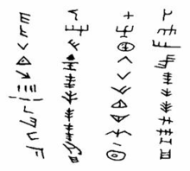
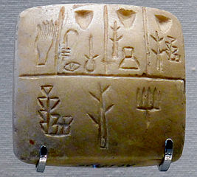
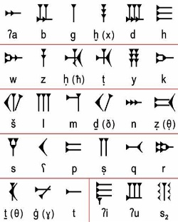
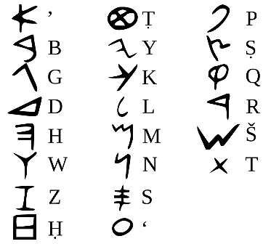
Parallels
14
15
16
17
14) Dispilio tablet, radiocarbon dated to 5260 BC - 15) Archaic Sumerian tablet, dated to around 3200 BC (Paris, Louvre Museum; https://www.photo.rmn.fr) - 16) Ugarit alphabet (around 1250-1185 BC; cuneiform script) - 17) Phoenician alphabet (created around 1050 BC. cuneiform script); gradually fell into disuse during the Hellenistic period, when the Greeks replaced the Phoenicians in international trade.
This archaic Sumerian tablet (image 15) is an archaeological artefact that supports our hypothesis.
In our view, it bears many similarities to the Tărtăria tablets: its pictograms (hand, jars, ear of maize, tree, irrigated field, and others) bear a very close resemblance in technical production to some of the pictograms on the Tărtăria tablets (images no. 8-11). Was this token (image 15) part of an agricultural contract? We'll never know, but it's clear that this archaic cuneiform version is closer to Balkan symbols than to cuneiform writing proper (image 16). We also note that some of the symbols on the Dispilio tablet (image 14) closely resemble the letters of the Phoenician alphabet (image 17).

Slide 11
Conclusion:
The history of the alphabet is closely linked to the history of trade and the geopolitical situation. The Phoenician version of the alphabet was widespread when the Phoenicians controlled international trade.
It was replaced by the Greek alphabet around the time of the Iron Age, when we find our Antikythera machine logically using Greek alphabetic numeration
(except of three letters).
To find out more, return to Abstract # : 1262
https://shs.hal.science/halshs-04597387

Slide 12
REFERENCES
1. BAINES, J. (2004). The Earliest Egyptian Writing: Development, Context, Purpose. The First Writing. Script Invention as History and Process. (pp. 150–189). Cambridge: Cambridge University Press.
2. CHRISTOV, S. (1973). L'histoire a commencé (sans doute) dans les Balkans. Science et Vie, 672(9)‎, 62-65.
De SAINT-BLANQUAT, H. (1971). Une écriture avant Sumer ? Sciences et Avenir, 294(8), 674-678.
DIRINGER, D. (1948). L’alphabet, clé de l’histoire de l’humanité, Londres : Publications scientifiques et techniques, http://asi.nic.in/asi_books/1287.pdf
GIMBUTAS, M. (1978). La fin de l'Europe ancienne. La Recherche, 87(3)‎, 228-235.
GIMBUTAS, M. (2005)., Le Langage de la Déesse. (Jean Guilaine). Paris, Edition des Femme
LAZAROVICI, G., & MERLINI, M. (2005). New archaeological data refering to Tărtăria tablets. Documenta Praehistorica XXXII, (vol. 32), 205–219. https://journals.uni-lj.si/DocumentaPraehistorica/article/view/32.16
MOSTEFAI, A. (2013). Les représentations féminines d’Ozan Ehéré (Tasīli-n-Ajjer, Sahara central, Algérie, Les Cahiers de l’AARS — 16 , 207-230.
https://www.academia.edu/11781589/Les_representations_feminines_dOzan_Ehere
PALIGA, S. (1993). Chronology of the Neolithic in Transylvania in the light of the Tartarian settlement's stratigraphy. Parcourir les collections, Diadoques d’histoire ancienne, 19-1, 9-43. https://www.persee.fr/doc/dha_0755-7256_1993_num_19_1_2073
PATOU-MATHIS, M. (2018). Neanderthal de A à Z, Montréal: Allary Éditions
RADIVOJEVIC, M, & al. (2013). Tainted ores and the rise of tin bronzes in Eurasia, c. 6500 years ago, in Antiquity, vol. 87(12), 1030-1045
SCHMIDT, K. (2011). Göbekli Tepe: A Neolithic Site in Southeastern Anatolia, The Oxford Handbook of ancient Anatolia (10,000–323 B.C.E.). Oxford : by Sharon R. Steadman and Gregory McMahon.
TYAGLOVA-FAYER, S. (2024). ALPHABETICAL NUMBERING (FROM THE ANTIKYTHERA MACHINE) USED IN MEDITERRANEAN TRADE SINCE THE BRONZE AGE AS A CONNECTING TOOL, In EAA 2024 https://shs.hal.science/halshs-04597387
TYAGLOVA-FAYER, S. (2024). Les premiers fermiers : leurs nouvelles croyances et expressions, in LAROS, Https://hal.science/hal-04637452, https://www.asjp.cerist.dz/en/PresentationRevue/533
VAN ALBADA, A., & A-M. (1995). Le Messak Libyen, Jardin Secret de l'Art Rupestre au Sahara Central, A la mémoire de Paul HUARD (1903-1994), Archéo-Nil, 9, 8-44.https://www.academia.edu/1651408/Art_rupestre_du_sahara_central_1996_hommage_a_Paul_Huard
WHITLEY, J (2003). Archaeology in Greece 2003—2004, in Archaeological Reports , 50. p. 43.
WOODS, Ch. (2015). Visible Language: The Earliest Writing Systems. Visible language: Inventions of Writing in the Ancient Middle East and Beyond. (pp. 15-25), (2e éd.). Chicago: Oriental Institute of the University of Chicago.
ГИМБУТАС, М. (2006). Цивилизация Великой Богини: Мир Древней Европы. Москва, РОССПЭH.

Slide 13
European Association of Archaeologists 2024, Aug 2024, Rome (Italie), Italy Abstract # : 1262
. ALPHABETICAL NUMBERING (FROM THE ANTIKYTHERA MACHINE) USED IN MEDITERRANEAN TRADE SINCE THE BRONZE AGE AS A CONNECTING TOOL https://shs.hal.science/halshs-04597387
This presentation will focus on hypotheses concerning the birth of the alphabet
⟨halshs-04599865v3⟩ If you have any questions, please contact the following e-mail address: tyaglova.fayer.svetlana@sfr.fr
------------------------------------------------------------------------- NUMÉROTATION ALPHABÉTIQUE (DE LA MACHINE ANTICYTHERE) UTILISÉE DANS LE COMMERCE MÉDITERRANÉEN DEPUIS L'ÂGE DU BRONZE COMME OUTIL DE CONNEXION Cette présentation se concentrera sur les hypothèses concernant la naissance de l'alphabet. Pour toutes questions, vous pouvez vous adresser au mail suivant : tyaglova.fayer.svetlana@sfr.fr
Tyaglova-Fayer Svetlana
Chercheur indépendant,
https://cv.hal.science/svetlana-tyaglova-fayer
Professeur en libéral

